Slide 1

Lead Online Trainings

Slide 2

Remind Alexis to hit record!

Slide 3

Agenda
Other Reminders
    Schedule pre-Amplify meeting with your group (optional)
    Send Amplify Placemats as the pre-program assignment
    Accept Make-up Session invite
    Respond to calendar request for 1:1 meeting with Alexis (coming soon!)
Amplify Recruitment and Registration
Desk Show & Tell
Session 5: Expanding Identity to Values and Strengths
Icebreaker: Last Time You Laughed
Session 6: Cracking the Confidence Code
Break (because OMG we are doing 3 sessions today!)
Session 7: Cultivating Resilience

Slide 4
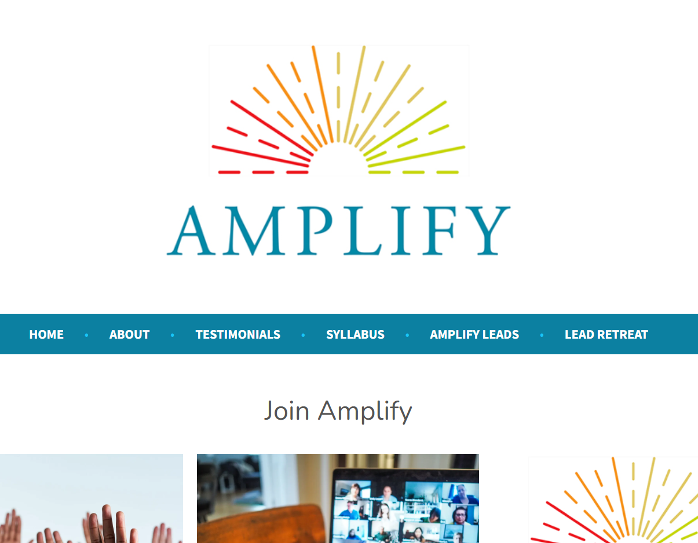
Registration due
3/20/26
Notes:
https://amplify-women.org/welcome/

Slide 5

Desk Show & Tell
Please share one item on your desk that is interesting, inspiring, funny, random, etc., and why you have it.

Slide 6

Volunteer to share your story during a session

Slide 7

Amplify Sessions
Every Thursday 12 Noon to 1:30 p.m. EST from March 26 – May 21, 2026
Session 1 (3/26/26) Amplifying Yourself and Others
Session 2 (4/2/26) Deconstructing Gender
Session 5 (4/23/26) Expanding Identity to Values & Strengths
Session 4 (4/16/26) Identifying as a Leader
Session 6 (4/30/26) Cracking the Confidence Code
Session 7 (5/7/26) Cultivating Resilience
Session 8 (5/14/26) Transforming Organizations
Session 3 (4/9/26) Getting Comfortable with Power
Session 9 (5/21/26) Creating Change through Community

Slide 8

Expanding Identity to Values & Strengths
Session 5 | April 23, 2026

Slide 9

Ask Amplify
https://amplify-women.org/ask/
Need advice on your next career move? Wondering how to manage a challenging situation at work? Trying to figure out a personal issue that's keeping you up at night?
Ask Amplify is your chance to tap into the experience of Amy and Alexis. No question is too small (or too big, for that matter), so ask away!
Questions may be submitted anonymously and will be answered during the large-group presentation.

Slide 10

A note about today’s session

Slide 11
We are just fine.
The skills we teach in Amplify are not intended to place the burden for change on people with marginalized identities. They are not intended to “fix” anyone.
It is our sexist, racist, ableist, ageist, classist, homophobic, transphobic, etc., workplaces that need the fixing.
Until that happens, we will learn to heal, protect ourselves, and act in ways that lead to our collective thriving.

Slide 12
5 Ways Organizations Can Fix Themselves
Pipeline
Pipeline gender-diverse employees from early career to executive level
Provide
Provide external support for gender-diverse employee advancement
Ensure
Ensure gender inclusion at all levels of decision making
Build
Build gender equity outcomes into performance measures
Monitor
Monitor organizational progress and outcomes from gender equity initiatives
Prime Employers for Women International Women’s Day Website

Slide 13

Imposter Phenomenon*
Persistent inability to believe that one's success is deserved or has been legitimately achieved as a result of one's own efforts or skills.
1 IN 3 GIRLS
WITH A GRADE POINT AVERAGE
ABOVE 4.0
DO NOT THINK THEY ARE SMART ENOUGH FOR THEIR DREAM CAREER
*Update to language: The use of “phenomenon” is preferable to “syndrome” because it is situation-specific rather than a constant state of being, is non-medical in nature, and emphasizes the role of external factors (e.g., discrimination) as the root cause rather than implying the person suffers from internal deficiencies.
Hinkelman, L. (2017). The Girls’ Index: New insights into the complex world of today’s girls. Columbus, OH: Ruling Our eXperiences, Inc.
Notes:
Alexis

Slide 14

Zoom Chat
What work situations make women feel like imposters?
Notes:
Alexis

Slide 15
Imposter Phenomenon
Themes
Public Speaking/Recognition
Presenting
Being viewed as the “expert”
Receiving awards
Career Changes
Applying, interviewing for, getting, and starting a new job
Getting a promotion
Becoming a manager
Intersectional Identities
Woman of color
Immigrant
Age (too young/old)
Education level
Traditionally Masculine Domains
Analytical discussions
Work meetings with mostly men
Being the only woman in the room
Persistent inability to believe that one's success is deserved or has been legitimately achieved as a result of one's own efforts or skills.

Slide 16
Discussion
Public Speaking/Recognition
Presenting
Being viewed as the “expert”
Receiving awards
Career Changes
Applying, interviewing for, getting, and starting a new job
Getting a promotion
Becoming a manager
Intersectional Identities
Woman of color
Immigrant
Age (too young/old)
Education level
Traditionally Masculine Domains
Analytical discussions
Work meetings with mostly men
Being the only woman in the room
Which of these Imposter Phenomenon themes have you experienced?
OR
Which of these themes have you witnessed at work?

Slide 17

Stereotype Threat
Apprehension about confirming negative stereotypes about one’s group when engaging in specific activities.
Math abilities of young girls
GRE scores of Black students
Athletic performance of white men
Steele, C. M. (2011). Whistling Vivaldi: And other clues to how stereotypes affect us (issues of our time). WW Norton & Company.
Notes:
Alexis

Slide 18
Zoom Chat
What stereotypes about one or more of your identity groups make you feel insecure or anxious at work?
Notes:
Alexis

Slide 19
General Stereotypes
Women are bad negotiators
Crying is a sign of weakness
Women should have children, and when they do, they plan to leave their jobs
Intersectional Stereotypes
Age: Too old/young means you’re incompetent
Race: Angry woman of color, techy/smart Asian, Lazy Latino, “difficult to work with”
Parental Status: Not committed, can’t manage work/life balance
Situations
Big meetings
Presentations
Meetings with leadership/c-suite execs
Being “Too Much”
Feminine: Emotional, sensitive, nice, timid,
Masculine: Talkative, enthusiastic, ambitious
Not (Fill in the Blank) Enough
Smart, Competent, Good, Strong
Stereotype Threat
Themes
Apprehension about confirming negative stereotypes about one’s group when engaging in specific activities.

Slide 20
Discussion
General Stereotypes
Women are bad negotiators
Crying is a sign of weakness
Women should have children, and when they do, they plan to leave their jobs
Intersectional Stereotypes
Age: Too old/young means you’re incompetent
Race: Angry woman of color, techy/smart Asian, Lazy Latino, “difficult to work with”
Parental Status: Not committed, can’t manage work/life balance
Situations
Big meetings
Presentations
Meetings with leadership/c-suite execs
Being “Too Much”
Feminine: Emotional, sensitive, nice, timid,
Masculine: Talkative, enthusiastic, ambitious
Not (Fill in the Blank) Enough
Smart, Competent, Good, Strong
Which of these Stereotype Threat themes have you experienced?
OR
Which of these themes have you witnessed at work?

Slide 21

Imposter Phenomenon
Stereotype Threat
1 IN 3 GIRLS
Math abilities of young girls
GRE scores of black students
Athletic performance of white males
WITH A GRADE POINT AVERAGE
ABOVE 4.0
DO NOT THINK THEY ARE SMART ENOUGH FOR THEIR DREAM CAREER
Notes:
Alexis

Slide 22
Imposter Phenomenon
Stereotype Threat
Reframe|Navigate|Advocate
1 IN 3 GIRLS
Math abilities of young girls
GRE scores of black students
Athletic performance of white males
WITH A GRADE POINT AVERAGE
ABOVE 4.0
DO NOT THINK THEY ARE SMART ENOUGH FOR THEIR DREAM CAREER

Slide 23


Equality
Service
Identity Shield
Personal Values
& Community Strengths

Slide 24
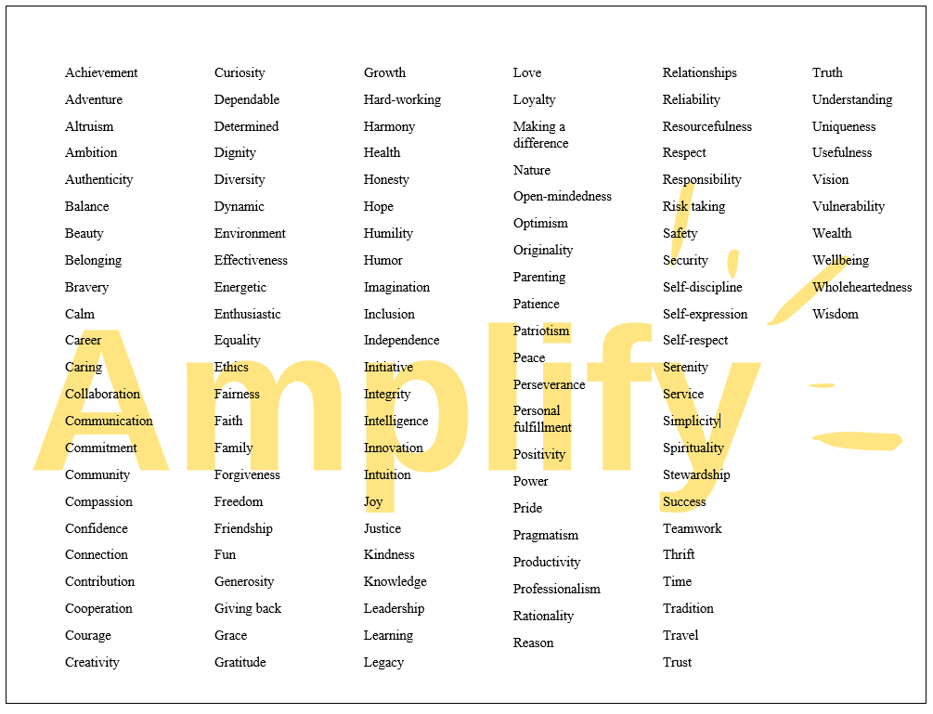
Personal Values as Superpowers

Slide 25
Online Poll
Community Strengths
What community strengths have you developed because of your identity as a woman and/or other marginalized group?
pollev.com/dartmouth
We are making a word cloud.
Please enter one-word or hyphenated responses.
Notes:
https://PollEv.com/free_text_polls/aHUFe1RA3VgxtfKhQKqOn/respond

Slide 26
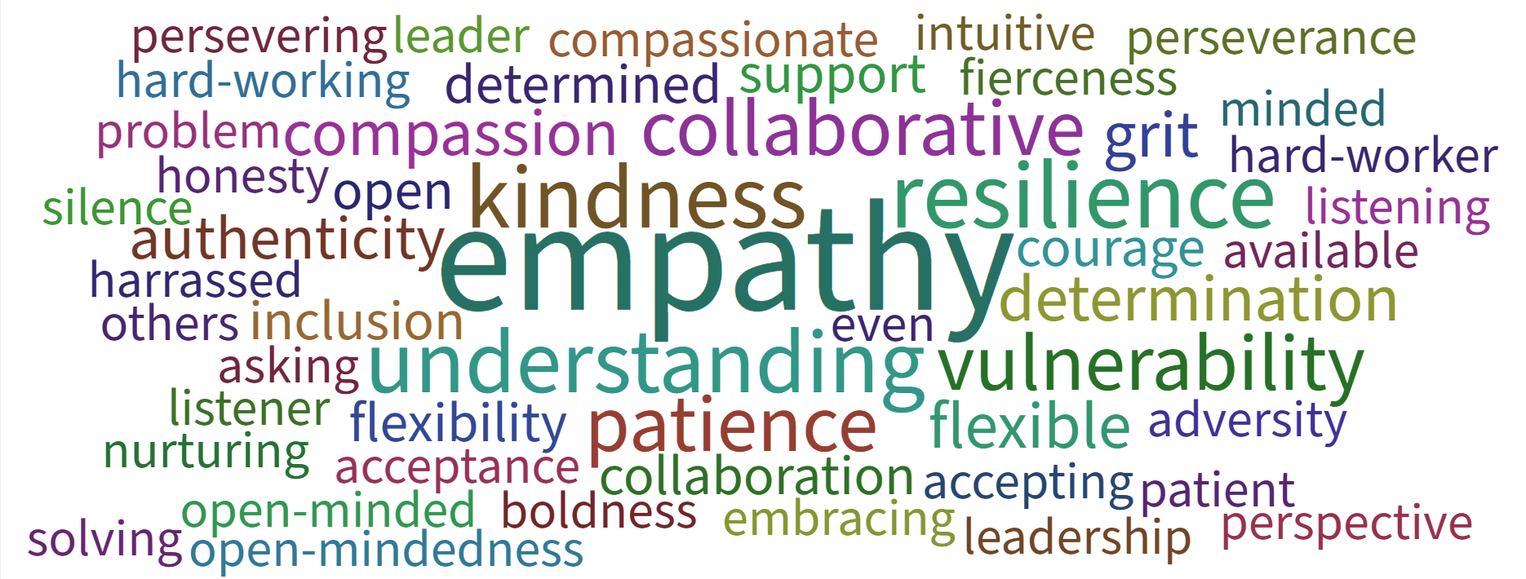

Slide 27
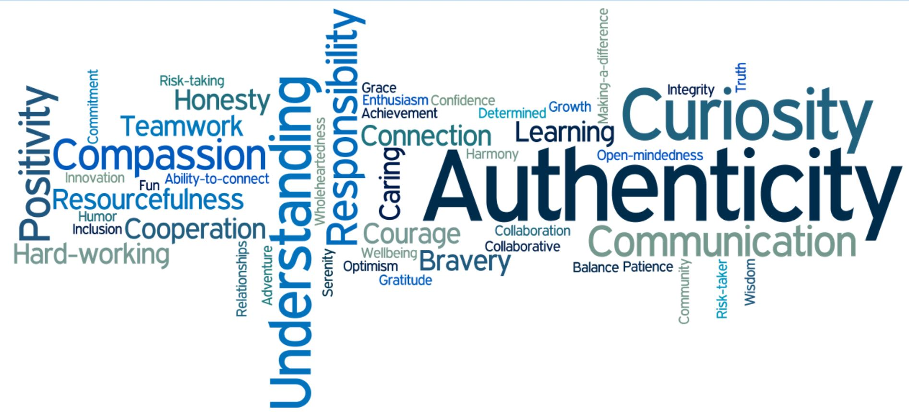
Identity Shield
Instructions
Draw the shape of a shield in your journal
Fill the blank space with your personal values and community strengths
Along the perimeter, write down how your Identity Shield makes you feel
Feelings
Feelings
Feelings
Feelings
Feelings
Feelings
Feelings
Feelings
Feelings
Feelings
Feelings

Slide 28
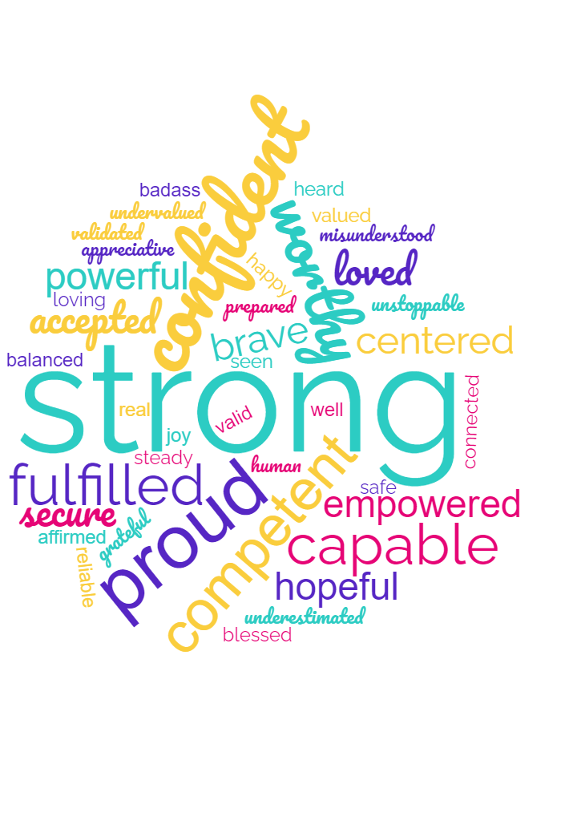
How does your Identity Shield make you feel?

Slide 29
…and also weak, tired, frustrated, depressed.
We need workplaces to change, not the people with marginalized identities. This is the only way to overcome Imposter Phenomenon, Stereotype Threat, and other manifestations of oppression.

Slide 30
Identity Shield
Private Reflection (Select 1+ prompts)
Reframing
To look at something in a new way
Navigating
To avoid or go around obstacles
Advocating
To create change for self and others
How do your marginalized and minoritized identities empower you?
When do you experience Imposter Phenomenon, and how might your Identity Shield help you navigate self-doubt?
What stereotypes are you afraid of fulfilling when you advocate for yourself, and how might your Identity Shield help you overcome your fear?

Slide 31
Volunteer to share your story during a session

Slide 32

AMPLIFICATION
Sharing the Amplify Love

Slide 33
Amplify Sessions
Every Thursday 12 Noon to 1:30 p.m. EST from March 26 – May 21, 2026
Session 1 (3/26/26) Amplifying Yourself and Others
Session 2 (4/2/26) Deconstructing Gender
Session 5 (4/23/26) Expanding Identity to Values & Strengths
Session 4 (4/16/26) Identifying as a Leader
Session 6 (4/30/26) Cracking the Confidence Code
Session 7 (5/7/26) Cultivating Resilience
Session 8 (5/14/26) Transforming Organizations
Session 3 (4/9/26) Getting Comfortable with Power
Session 9 (5/21/26) Creating Change through Community

Slide 34

When was the last time you laughed?

Slide 35
Cracking the Confidence Code
Session 6 | April 30, 2026

Slide 36
Supervisor Email
Sample Text:
Hi (Supervisor name),
I wanted to send a quick email to thank you for your support of my participation in the Amplify Gender Equity & Leadership Initiative.
Over the past six weeks, I’ve had the opportunity to learn about important topics related to gender at work, and the experience has been (describe what it’s been like for you).
If you’d like to learn more about Amplify, please find below a link to the website.
Click here to visit the Amplify website
Optional: As a trusted (leader/mentor/ally), I also wanted to invite you to the Amplify Allies and Partners Event. If you’d like to attend, please let me know, and I’ll send you the invite when it comes out.
Again, thanks so much for your support of my professional development and growth.
Sincerely,
(Your name)
Goals:
Thank your supervisor for their support
Give you the opportunity to follow-up and discuss Amplify topics
#BlameAmplify
Pave the way for others to participate next year

Slide 37

“
Codes have influenced events throughout history, both in the stories of those who make them and those who break them.
The Code Book: The Secret History of Codes and Code-breaking
Notes:
Codes are a language – many times, a secret language – that is used to disguise meaning and – once cracked – can shape the course of history. The betrayal of Mary Queen of Scots, the cracking of the enigma code that helped the Allies in World War II are examples of this.
The tricky part of codes, however, is that not everyone is able to understand them. Only the people who wrote the code or are taught the code can make sense of them.
For women who are working and living in a male-designed world, there are many “codes” that we have to crack. Today, we will be cracking the confidence code.

Slide 38

Zoom Poll
Where do you wish you had more confidence?

Slide 39


The Gender Gap
CONFIDENCE
Hiring and Promotion Rates
Management and Leadership Roles
Salary and Compensation
Mjgraphics / Shutterstock.com

Slide 40

What is Confidence?
Confidence
The belief that one is capable of successfully meeting the demands of a task
Gendered concept with a masculine bias
Reinforced by privilege and oppression
CISGENDER WOMEN
CISGENDER MEN
  Possess “internal confidence” but are socialized to act less confidently
  Receive more pushback when they do act confidently
  Generally feel more confident than women (“authentic overconfidence”)
  May be as much as 40% more confident based on related research
Confidence definition by the American Psychological Association
Chamorro-Premiuzic, T. (2019). Why Do So Many Incompetent Men Become Leaders? (And How to Fix It)

Slide 41
Gender, Confidence, and Work
Attitude | Cis Men | Cis Women
Success | Attribute to Skill | Attribute to Effort and Luck
Failure | Attribute to Bad Luck | Attribute to Inability
Applying for jobs | More likely to apply | Less likely to apply
Performance | Higher than Peers | Equivalent to Peers

Slide 42
Gender, Confidence, and Work
Attitude | Cis Men | Cis Women
Success | Attribute to Skill | Attribute to Effort and Luck
Failure | Attribute to Bad Luck | Attribute to Inability
Applying for jobs | More likely to apply | Less likely to apply
Performance | Higher than Peers | Equivalent to Peers

Slide 43
Gender, Confidence, and Work
Attitude | Cis Men | Cis Women
Success | Attribute to Skill | Attribute to Effort and Luck
Failure | Attribute to Bad Luck | Attribute to Inability
Applying for jobs | More likely to apply | Less likely to apply
Performance | Higher than Peers | Equivalent to Peers

Slide 44
Gender, Confidence, and Work
Attitude | Cis Men | Cis Women
Success | Attribute to Skill | Attribute to Effort and Luck
Failure | Attribute to Bad Luck | Attribute to Inability
Applying for jobs | More likely to apply | Less likely to apply
Performance | Higher than Peers | Equivalent to Peers
Notes:
GE internal report. May be in part because women take the qualifications literally (rule followers) whereas men believe they can figure things out on the job and/or sell themselves during the interview.
LinkedIn study titled, “Gender Insights Report: How women find jobs differently,” gathered data on 610 million users around the world over the course of 2018. They found that women apply for 20% fewer jobs than men and are 26% less likely to ask for a referral.

Slide 45
Gender, Confidence, and Work
Attitude | Cis Men | Cis Women
Success | Attribute to Skill | Attribute to Effort and Luck
Failure | Attribute to Bad Luck | Attribute to Inability
Applying for jobs | More likely to apply | Less likely to apply
Performance | Higher than Peers | Equivalent to Peers
Notes:
GE internal report. May be in part because women take the qualifications literally (rule followers) whereas men believe they can figure things out on the job and/or sell themselves during the interview.
LinkedIn study titled, “Gender Insights Report: How women find jobs differently,” gathered data on 610 million users around the world over the course of 2018. They found that women apply for 20% fewer jobs than men and are 26% less likely to ask for a referral.

Slide 46
Gender, Confidence, and Work
Attitude | Cis Men | Cis Women
Success | Attribute to Skill | Attribute to Effort and Luck
Failure | Attribute to Bad Luck | Attribute to Inability
Applying for jobs | More likely to apply | Less likely to apply
Performance | Higher than Peers | Equivalent to Peers

Slide 47
Confidence ≠ Competence

Slide 48

The Confidence Myth
CONFIDENCE MYTH
You must be competent and feel confident before you take action.
This Before That – “I’ll ask for a promotion after I secure a $500K gift.”
Endless Polishing – “This isn’t quite perfect so I’ll keep working on it.”
Designing at the Whiteboard – “Once I have everything finalized, I’ll share it.”
Evermore Education – “I need another degree. Maybe an MBA?”
Kay, K., & Shipman, C. (2014). The Confidence Code: The Science and Art of Self-Assurance--What Women Should Know.
Mohr, Tara. (2014). Playing Big: Find Your Voice, Your Mission, Your Message

Slide 49
The Confidence Code
CONFIDENCE MYTH
You must be competent and feel confident before you take action.
CONFIDENCE CODE
You must be competent and take action before you feel confident.
Kay, K., & Shipman, C. (2014). The Confidence Code: The Science and Art of Self-Assurance--What Women Should Know.
Mohr, Tara. (2014). Playing Big: Find Your Voice, Your Mission, Your Message

Slide 50
60% Confidence Rule
Am I at least 60% confident that I can do this?
(If yes, then do it.)
60% + 40% (Gender Confidence Gap) = 100%

Slide 51
60% + 40% (Gender Confidence Gap) = 100%
Can I at least get a “D”?
60% Confidence Rule
Am I at least 60% confident that I can do this?
(If yes, then do it.)
60% is a “D”
Then do it.
60% + 40% (Gender Confidence Gap) = 100%

Slide 52
Confidence Continuum
Step 1
Step 2
Chart along a continuum
Step 3
Step 4
Write down action steps
Identify a goal
Rank order by risk/fear
Step 5
Take 1 action in 1 week

Slide 53
Confidence Continuum
Step 1
Step 2
Chart along a continuum
Step 3
Step 4
Write down action steps
Identify a goal
Rank order by risk/fear
Step 5
Take 1 action in 1 week*
*The action must involve another person (email, meeting, phone call, etc.)

Slide 54
Confidence Continuum
Step 1
Step 2
Chart along a continuum
Step 3
Step 4
Write down action steps
Identify a goal
Rank order by risk/fear
Step 5
Take 1 action in 1 week
Plan and implement an amazing Amplify Lead Retreat that sets everyone up for success.

Slide 55
Confidence Continuum
Step 1
Step 2
Chart along a continuum
Step 3
Step 4
Write down action steps
Identify a goal
Rank order by risk/fear
Step 5
Take 1 action in 1 week
Facilitate 2-day retreat and reception
Draft retreat agenda and activities with BU
Discuss ideas with Sarah and get her feedback
Facilitate planning meetings with BU
Design and launch registration page for Leads

Slide 56
Confidence Continuum
Step 1
Step 2
Chart along a continuum
Step 3
Step 4
Write down action steps
Identify a goal
Rank order by risk/fear
Step 5
Take 1 action in 1 week
Low Risk
Insert
Discuss ideas with Sarah and get her feedback
Facilitate planning meetings with BU
Draft retreat agenda and activities with BU
Design and launch registration page for Leads
Facilitate 2-day retreat and reception
High Risk

Slide 57
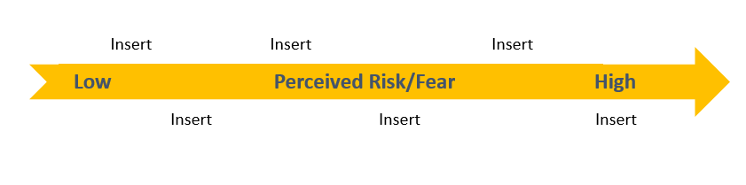
Confidence Continuum
Step 1
Step 2
Chart along a continuum
Step 3
Step 4
Write down action steps
Identify a goal
Rank order by risk/fear
Step 5
Take 1 action in 1 week

Slide 58
Confidence Continuum
Step 1
Step 2
Chart along a continuum
Step 3
Step 4
Write down action steps
Identify a goal
Rank order by risk/fear
Step 5
Take 1 action in 1 week*
*The action must involve another person (email, meeting, phone call, etc.)

Slide 59

Confidence Continuum
COVID-19
Facilitate planning mtgs.
Launch registration page
Facilitate 2-day retreat
Discuss ideas with Sarah
Draft retreat agenda with BU
Low
Perceived Risk/Fear
High

Slide 60
Goal Setting Exercise Part 1
Private Journal Reflection
Select one of the journal prompts to help you identify a professional (or personal) goal that feels like a stretch.
  Imagine you’re at a celebratory dinner in honor of you. What is everyone celebrating?
  If you could wave a magic wand, what job would you have? What would you be doing?
  What are you avoiding? What do you find frustrating? What do you want to change?

Slide 61
Goal Setting Exercise Part 2
Private Journal Reflection
Reread your journal as if it were written by a good friend who has asked for your advice.
What would help your friend move forward in their professional development/career/personal life? (Write down 1-3 options)
Based on your response to #1, what would be a good goal for your friend to consider?

Slide 62
Confidence Continuum
Journal Prep for Small Groups
Write down one goal you would like to pursue
Write down 5-7 action steps
Rank order by risk/fear (vulnerable to terrified)
Chart along a continuum
Circle 1 action that brings you in contact with someone else and can be done by next Thursday

Slide 63
Amplify Skills
Reframing
To look at something in a new way
Navigating
To avoid or go around obstacles
Advocating
To create change for self and others
Reframe our understanding of confidence from a “feeling you should have before acting” to the action itself.
Use the Confidence Continuum to identify low-risk activities that will build your confidence and move you forward. (Even if you fail, you win!)
Practice the 60% Confidence Rule: 60% + 40% (gender confidence gap) = 100%

Slide 64
Volunteer to share your story during a session

Slide 65
Amplify Sessions
Every Thursday 12 Noon to 1:30 p.m. EST from March 26 – May 21, 2026
Session 1 (3/26/26) Amplifying Yourself and Others
Session 2 (4/2/26) Deconstructing Gender
Session 5 (4/23/26) Expanding Identity to Values & Strengths
Session 4 (4/16/26) Identifying as a Leader
Session 6 (4/30/26) Cracking the Confidence Code
Session 7 (5/7/26) Cultivating Resilience
Session 8 (5/14/26) Transforming Organizations
Session 3 (4/9/26) Getting Comfortable with Power
Session 9 (5/21/26) Creating Change through Community

Slide 66

Let’s take a break

Slide 67
Cultivating Resilience*
*Self-Compassion
Session 7 | May 7, 2026

Slide 68
AMPLIFY ALLIES & PARTNERS EVENT
General Info
Unlimited number of invites; all genders welcome
Open to anyone in your college/university (e.g., leaders, supervisor/ees, colleagues, etc.)
Pro Tip: Send pre-event email with info about Amplify (include link to website) and/or schedule post-event follow-up meeting
Agenda
Amplify Program Overview
Lead and Participant Testimonials
Ally and Partner Strategies
Ally Action Planning

Slide 69


Resilience vs. Self-Compassion
Resilience
Process of adapting well in the face of trauma
Focused on surviving and enduring
Self-Compassion
Emotionally-supportive attitude toward self
Focused on healing and thriving
Notes:
Alexis

Slide 70

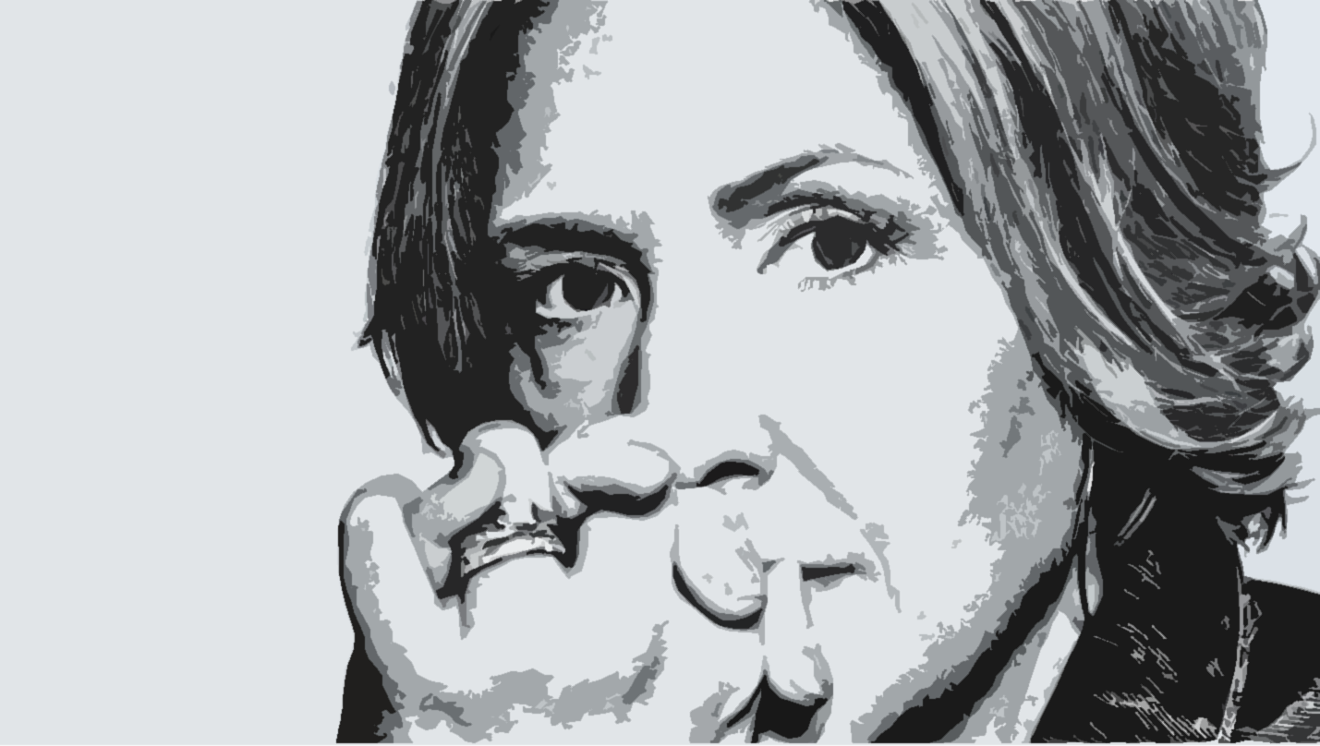
Brené Brown
Audre Lorde
Researcher, storyteller, currently enraged Texan
Black, lesbian, mother, warrior, poet
In a society that says, “Put yourself last,” self-love and self-acceptance are almost revolutionary.
Caring for myself is not self-indulgence, it is self-preservation, and that is an act of political warfare.

Slide 71
Caregivers
(children, elderly parents, sick family members, fur babies, etc.)
Drop the ball
Forgiveness

Slide 72


Black, Indigenous, and People of Color
Rest
Joy

Slide 73


LGBTQ
Defining your LGBTQ self
Being more than your gender identity and sexual orientation
Singh, A. A. (2018). The Queer and Transgender Resilience Workbook.

Slide 74

Confidence Continuum
Planning Mtgs.
Registration Process
Retreat Agenda
Retreat Day 1
Retreat Day 2
Self-Compassion Safety Net

Slide 75
Self-Compassion Safety Net
Common Humanity vs. Isolation
Mindfulness vs. Over-identification
Self-kindness vs. Self-judgment
https://self-compassion.org/the-three-elements-of-self-compassion-2/

Slide 76
Self-Compassion Safety Net
Common Humanity vs. Isolation
View our personal experiences as part of a much larger human experience
Mindfulness vs. Over-identification
Take a balanced approach to our emotions, neither suppressing nor overreacting
Self-kindness vs. Self-judgment
Accept and forgive ourselves when we suffer, fail, or feel inadequate
https://self-compassion.org/the-three-elements-of-self-compassion-2/

Slide 77
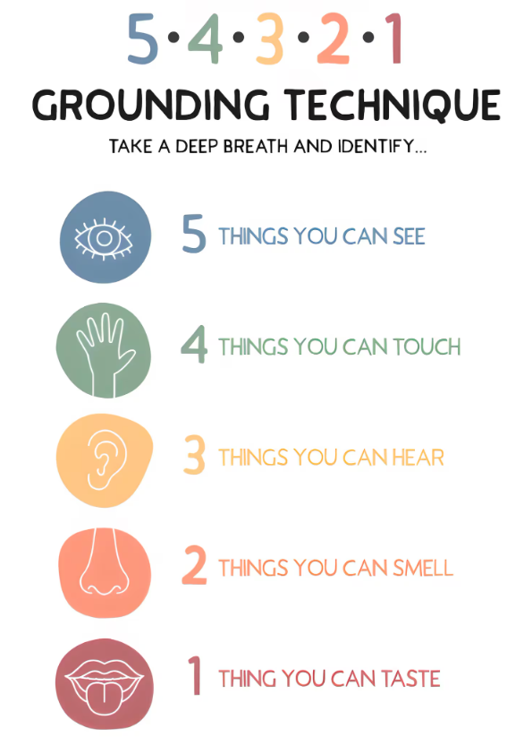
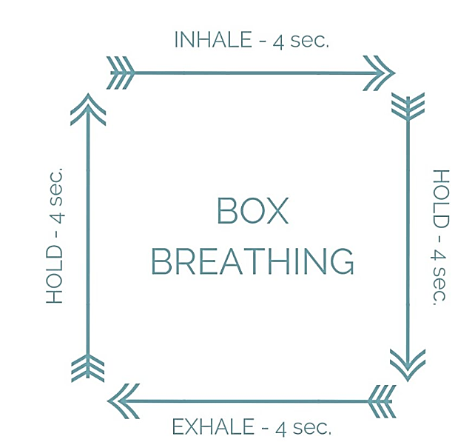
Mindfulness Exercises
Name
5 Things
Notes:
Chronic stress elevates cortisol and reduces prefrontal cortex efficiency (decision-making & emotional regulation).

Slide 78
Self-Compassion Safety Net
Common Humanity vs. Isolation
View our personal experiences as part of a much larger human experience
Mindfulness vs. Over-identification
Take a balanced approach to our emotions, neither suppressing nor overreacting
Self-kindness vs. Self-judgment
Accept and forgive ourselves when we suffer, fail, or feel inadequate
https://self-compassion.org/the-three-elements-of-self-compassion-2/

Slide 79
Circles of Community
Mentors & Sponsors
Professional
Allies
Inner
Circle
Notes:
Research Base
Relational-cultural theory suggests women’s resilience often grows through connection. Isolation predicts burnout more strongly than workload alone in many occupational health studies.
Teaching Point
Support isn’t accidental. It’s cultivated.
Introduce the Resilience Network Map:
Participants draw 3 circles:
Inner Circle (safe & restorative)
Professional Allies
Mentors/Sponsors
Reflection:
Where are the gaps?
Who do you need more access to?
Skill Practice: Support Scripts
Give language examples:
“I’m working through something challenging — could I get your perspective?”
“I don’t need solutions right now, just space to process.”

Slide 80
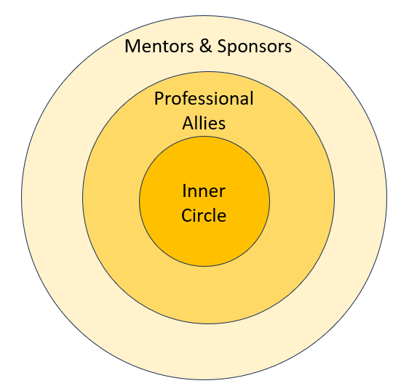
Circles of Community
ACTIVITY
Draw 3 concentric circles and label them (Inner Circle, Professional Allies, Mentors & Supporters)
Within each circle, write down people’s names who fulfill that role for you
Reflection questions:
  Are there any gaps that you would like to fill?
  How often do you access these people?
  Could you intentionally access them more?
Notes:
Research Base
Relational-cultural theory suggests women’s resilience often grows through connection. Isolation predicts burnout more strongly than workload alone in many occupational health studies.
Teaching Point
Support isn’t accidental. It’s cultivated.
Introduce the Resilience Network Map:
Participants draw 3 circles:
Inner Circle (safe & restorative)
Professional Allies
Mentors/Sponsors
Reflection:
Where are the gaps?
Who do you need more access to?
Skill Practice: Support Scripts
Give language examples:
“I’m working through something challenging — could I get your perspective?”
“I don’t need solutions right now, just space to process.”

Slide 81
Self-Compassion Safety Net
Common Humanity vs. Isolation
View our personal experiences as part of a much larger human experience
Mindfulness vs. Over-identification
Take a balanced approach to our emotions, neither suppressing nor overreacting
Self-kindness vs. Self-judgment
Accept and forgive ourselves when we suffer, fail, or feel inadequate
https://self-compassion.org/the-three-elements-of-self-compassion-2/

Slide 82

Letter from Your Future Self
How old will you be 20 years from today?
Dear (Your First Name),
This is your future self, and this is what I’d like you to know…
Notes:
Alexis 12:34-6

Slide 83
Self-Compassion Safety Net
Common Humanity vs. Isolation
Circles of Community
Mindfulness vs. Over-identification
Box Breathing
Self-kindness vs. Self-judgment
Letter from your Future Self
Name 5 Things
5-4-3-2-1 Technique
https://self-compassion.org/the-three-elements-of-self-compassion-2/

Slide 84
Confidence Continuum
Step 1
Step 2
Chart along a continuum
Step 3
Step 4
Write down action steps
Identify a goal
Rank order by risk/fear
Step 5
Take 1 action in 1 week
Deploy as needed
Self-Compassion
Safety Net

Slide 85
Confidence Continuum
Step 1
Step 2
Chart along a continuum
Step 3
Step 4
Write down action steps
Identify a goal
Rank order by risk/fear
Step 5
Take 1 action in 1 week
Deploy as needed
Self-Compassion
Safety Net

Slide 86
Volunteer to share your story during a session

Slide 87
Amplify Sessions
Every Thursday 12 Noon to 1:30 p.m. EST from March 26 – May 21, 2026
Session 1 (3/26/26) Amplifying Yourself and Others
Session 2 (4/2/26) Deconstructing Gender
Session 5 (4/23/26) Expanding Identity to Values & Strengths
Session 4 (4/16/26) Identifying as a Leader
Session 6 (4/30/26) Cracking the Confidence Code
Session 7 (5/7/26) Cultivating Resilience
Session 8 (5/14/26) Transforming Organizations
Session 3 (4/9/26) Getting Comfortable with Power
Session 9 (5/21/26) Creating Change through Community

Slide 88
Amplify Skill Application: Reframing
Which of the self-compassion practices could help you reframe a current or future challenge?
Reframing: To look at something in a new way
Common Humanity vs. Isolation
Community Circles
Mindfulness vs. Over-identification
Box Breathing
Self-kindness vs. Self-judgment
Letter from your Future Self
Name 5 Things
5-4-3-2-1 Technique

Slide 89
Amplify Skill Application: Navigating
Which of the self-compassion practices could help you navigate a current obstacle?
Navigating: To avoid or go around obstacles
Common Humanity vs. Isolation
Community Circles
Mindfulness vs. Over-identification
Box Breathing
Self-kindness vs. Self-judgment
Letter from your Future Self
Name 5 Things
5-4-3-2-1 Technique

Slide 90
Amplify Skill Application: Advocating
Which of the self-compassion practices could help you advocate for something you need?
Advocating: To create change for self and others
Common Humanity vs. Isolation
Community Circles
Mindfulness vs. Over-identification
Box Breathing
Self-kindness vs. Self-judgment
Letter from your Future Self
Name 5 Things
5-4-3-2-1 Technique

