Slide 1

Lead Online Trainings

Slide 2
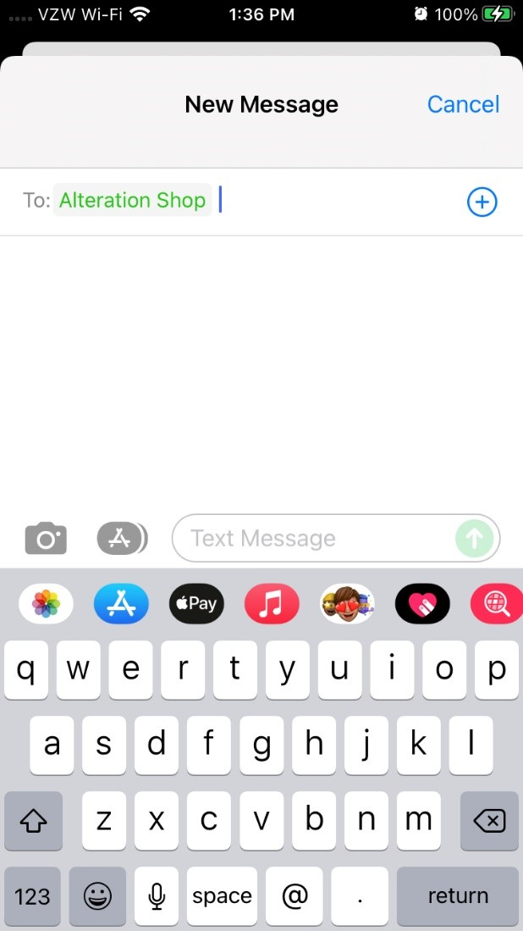
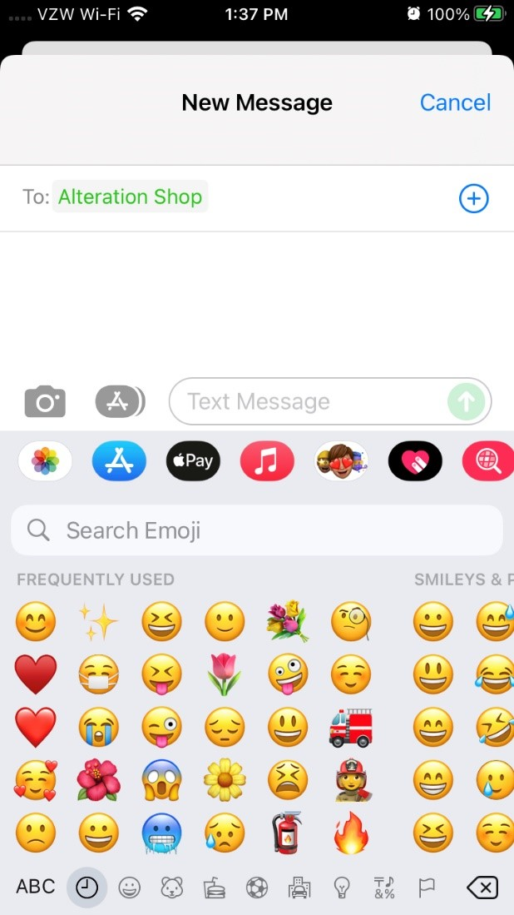
Frequently/Recently Used Emojis
1. Start a text and click on the smiley face icon
2. Scroll to the left to find “frequently used”

Slide 3

Participant Recruitment

Slide 4

In pairs, use the “3 B’s” to debrief how the recruitment process has been going for you.
Notes:
Amy (6 minutes in pairs)
Please explain that we will be doing the 3 B’s to debrief how their recruitment process h as been going to date

Slide 5

Recruitment Timeline
    2/10/26: Invitations
      Declines: Extend additional invites
      Accepts:
        Send Amplify Welcome email
        Forward calendar invites for large and small group sessions
    3/20/26: Registration due date
      Alexis will send weekly email with current list of registrants
    3/26/26: Amplify Launch Date
      Will you plan to send an introductory email to the group and/or meet before the Amplify launch date?
Notes:
Amy

Slide 6

Amplify Sessions
Every Thursday 12 Noon to 1:30 p.m. EST from March 26 – May 21, 2026
Session 1 (3/26/26) Amplifying Yourself and Others
Session 2 (4/2/26) Deconstructing Gender
Session 5 (4/23/26) Expanding Identity to Values & Strengths
Session 4 (4/16/26) Identifying as a Leader
Session 6 (4/30/26) Cracking the Confidence Code
Session 7 (5/7/26) Cultivating Resilience
Session 8 (5/14/26) Transforming Organizations
Session 3 (4/9/26) Getting Comfortable with Power
Session 9 (5/21/26) Creating Change through Community

Slide 7
Getting Comfortable with Power
Session 3 | April 9, 2026

Slide 8
Power
(noun)
physical might
possession of control, authority, or influence over others
the ability to act or produce an effect
Synonyms: capability, influence, capacity, potential
Antonyms: inability, incapacity, weakness, impotence
Merriam-Webster Dictionary
If power were an item of clothing, who would be most comfortable wearing it?

Slide 9
What makes us uncomfortable with power?
Power and Gender
Misperception that only position gives you power
Power Paradox: The more powerful you are, the more vulnerable you become
Power has been used against women and non-binary/transgender people
Definition of power trends towards
(toxic) masculinity

Slide 10

Horizontal Hostility
A manifestation of internalized oppression where marginalized people fight each other for power
Marginalized people believe, act on, or enforce dominant systems of oppression against each other
Can occur within marginalized communities or between marginalized communities
Fighting each other for power

Slide 11

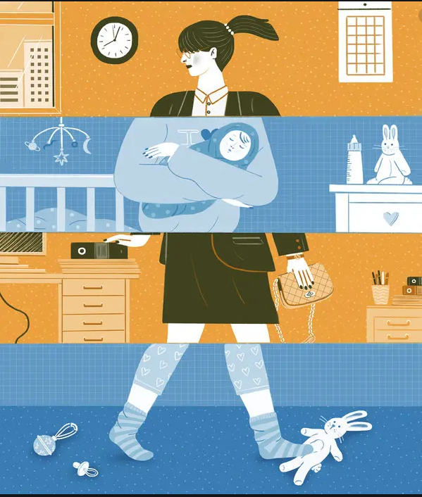
Horizontal Hostility Examples
Racism within the feminist movement
Intergenerational conflict (Baby Boomers, Gen Xers, Millennials)
Exclusion of transgender women
Conflict over status and roles
  Mommy Wars
  Queen Bee Phenomenon
  Tripping the Prom Queen

Slide 12
REFRAME
NAVIGATE
Definition of power
Traditional power
Amplify superpowers
ADVOCATE

Slide 13
REFRAME
NAVIGATE
Definition of power
Traditional power
Amplify superpowers
ADVOCATE

Slide 14
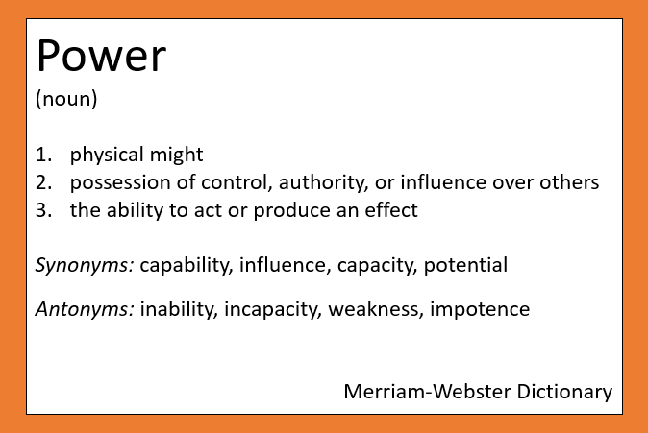
Reframe|Navigate|Advocate
What other words or phrases can we use for “power” that feel more accessible and inclusive?
(Please put your “reframes” into the chat)

Slide 15
REFRAME
NAVIGATE
Definition of power
Traditional power
Amplify superpowers
ADVOCATE

Slide 16
Reframe|Navigate|Advocate
Power
Expert
Legitimate
Coercive
Referent
Reward
Information
Bases
of Power
French and Raven (1959, 1965)

Slide 17
Reframe|Navigate|Advocate
Personal Power
Expert
Legitimate
Coercive
Referent
Reward
Information
Bases
of Power
French and Raven (1959, 1965)

Slide 18
Reframe|Navigate|Advocate
Positional Power
Expert
Legitimate
Coercive
Referent
Reward
Information
Bases
of Power
French and Raven (1959, 1965)

Slide 19
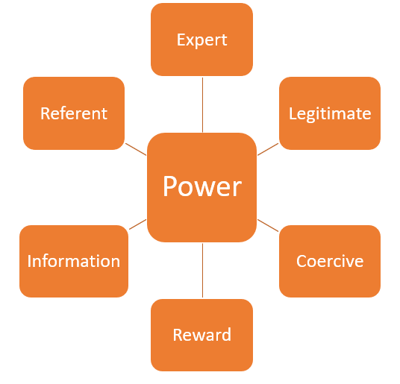
Bases of Power
Zoom Poll
Which bases of power do you hold?

Slide 20
REFRAME
NAVIGATE
Definition of power
Traditional power
Amplify superpowers
ADVOCATE

Slide 21
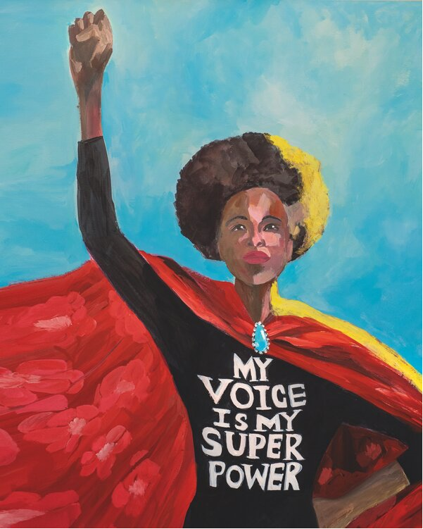

Values-based strength used to make positive change
Reframe|Navigate|Advocate

Slide 22
What are values?
Represent our beliefs about what is important, both to us and to society as a whole
Underpin our definition of a meaningful and worthwhile life
Serve as a compass, helping us navigate through tricky situations and moral dilemmas

Slide 23
What are your values?
What values do you believe are important, both to yourself and society as a whole?
What values underpin your definition of a meaningful and worthwhile life?
What values serve as a compass, helping you navigate through tricky situations and moral dilemmas?

Slide 24
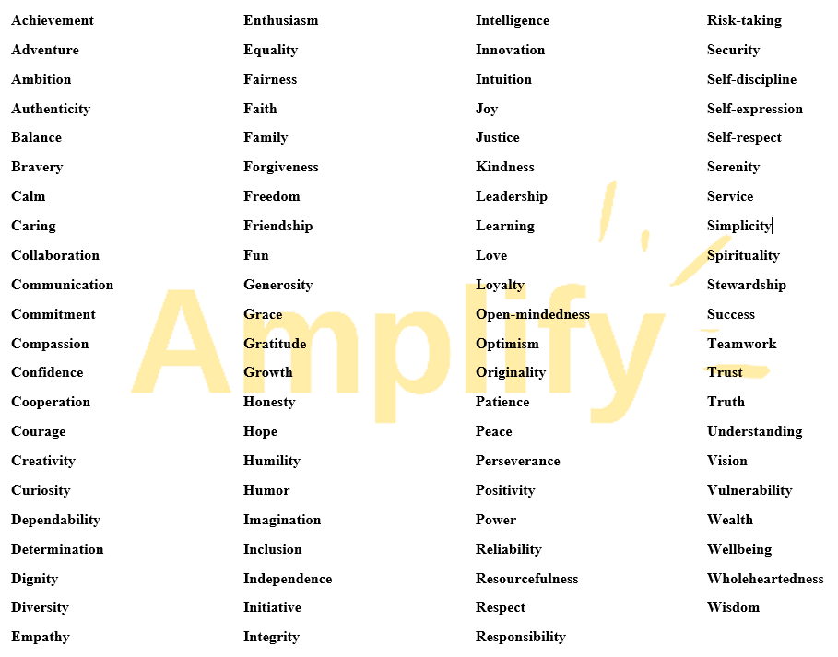

Slide 25

Reframe|Navigate|Advocate
Journal
Write down your top 3-5 values (please put at least one value into the chat).
Looking back, when have you used your superpowers to create positive change for yourself or others?
Looking ahead, how could you leverage your superpowers to create positive change for yourself or others?

Slide 26
REFRAME
NAVIGATE
Definition of power
Traditional power
Amplify superpowers
ADVOCATE

Slide 27


Session 4:
Identifying as a Leader
Illustration HBS Executive Ed

Slide 28
Amplify Sessions
Every Thursday 12 Noon to 1:30 p.m. EST from March 26 – May 21, 2026
Session 1 (3/26/26) Amplifying Yourself and Others
Session 2 (4/2/26) Deconstructing Gender
Session 5 (4/23/26) Expanding Identity to Values & Strengths
Session 4 (4/16/26) Identifying as a Leader
Session 6 (4/30/26) Cracking the Confidence Code
Session 7 (5/7/26) Cultivating Resilience
Session 8 (5/14/26) Transforming Organizations
Session 3 (4/9/26) Getting Comfortable with Power
Session 9 (5/21/26) Creating Change through Community

Slide 29
Identifying as a Leader
Session 4 | April 16, 2026

Slide 30
REFRAME
NAVIGATE
Definition of power
Traditional power
Amplify superpowers
ADVOCATE

Slide 31
Leadership as power

Slide 32
Zoom Poll
How comfortable are you identifying as a “leader”?

Slide 33
Great Man/Trait Leadership
Leader
Leadership as Power Over
Top-down, hierarchical
Only a select group of people can participate in leadership
Use of power is to command and control followers
Followers

Slide 34
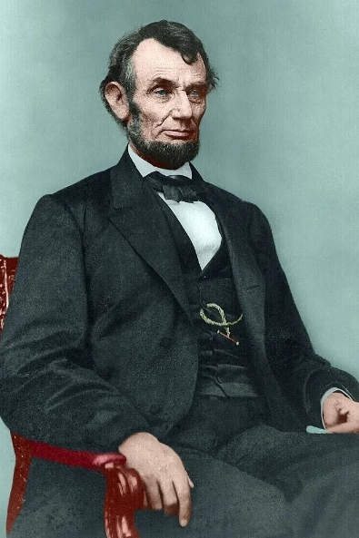
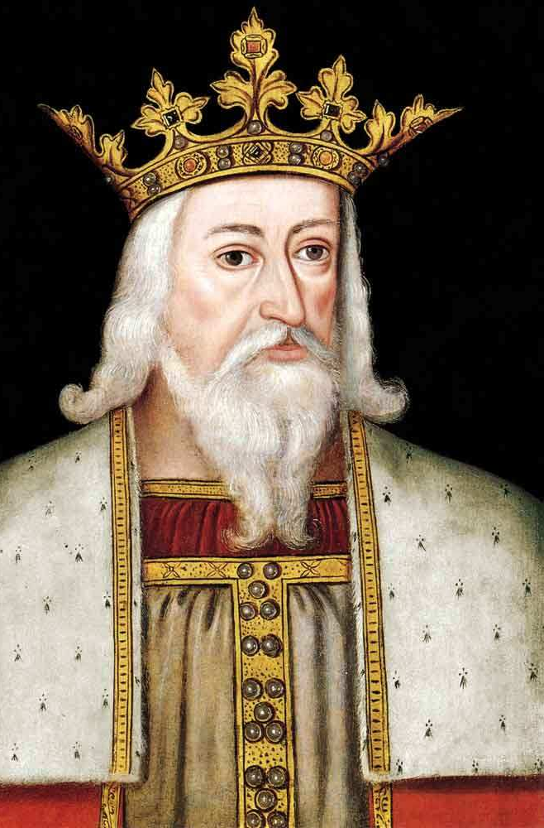
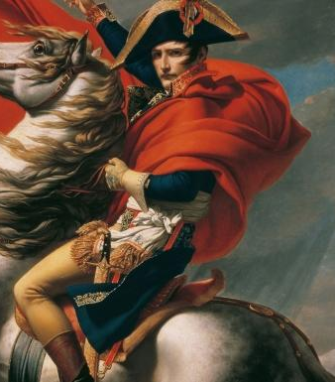
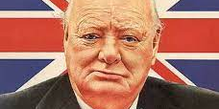
Great leaders are born, not made.

Slide 35
Relational Leadership
Leadership as Power With
Process-oriented, collaborative
Everyone can participate in leadership
Use of power is to create and solve problems with followers
Leader and Followers

Slide 36

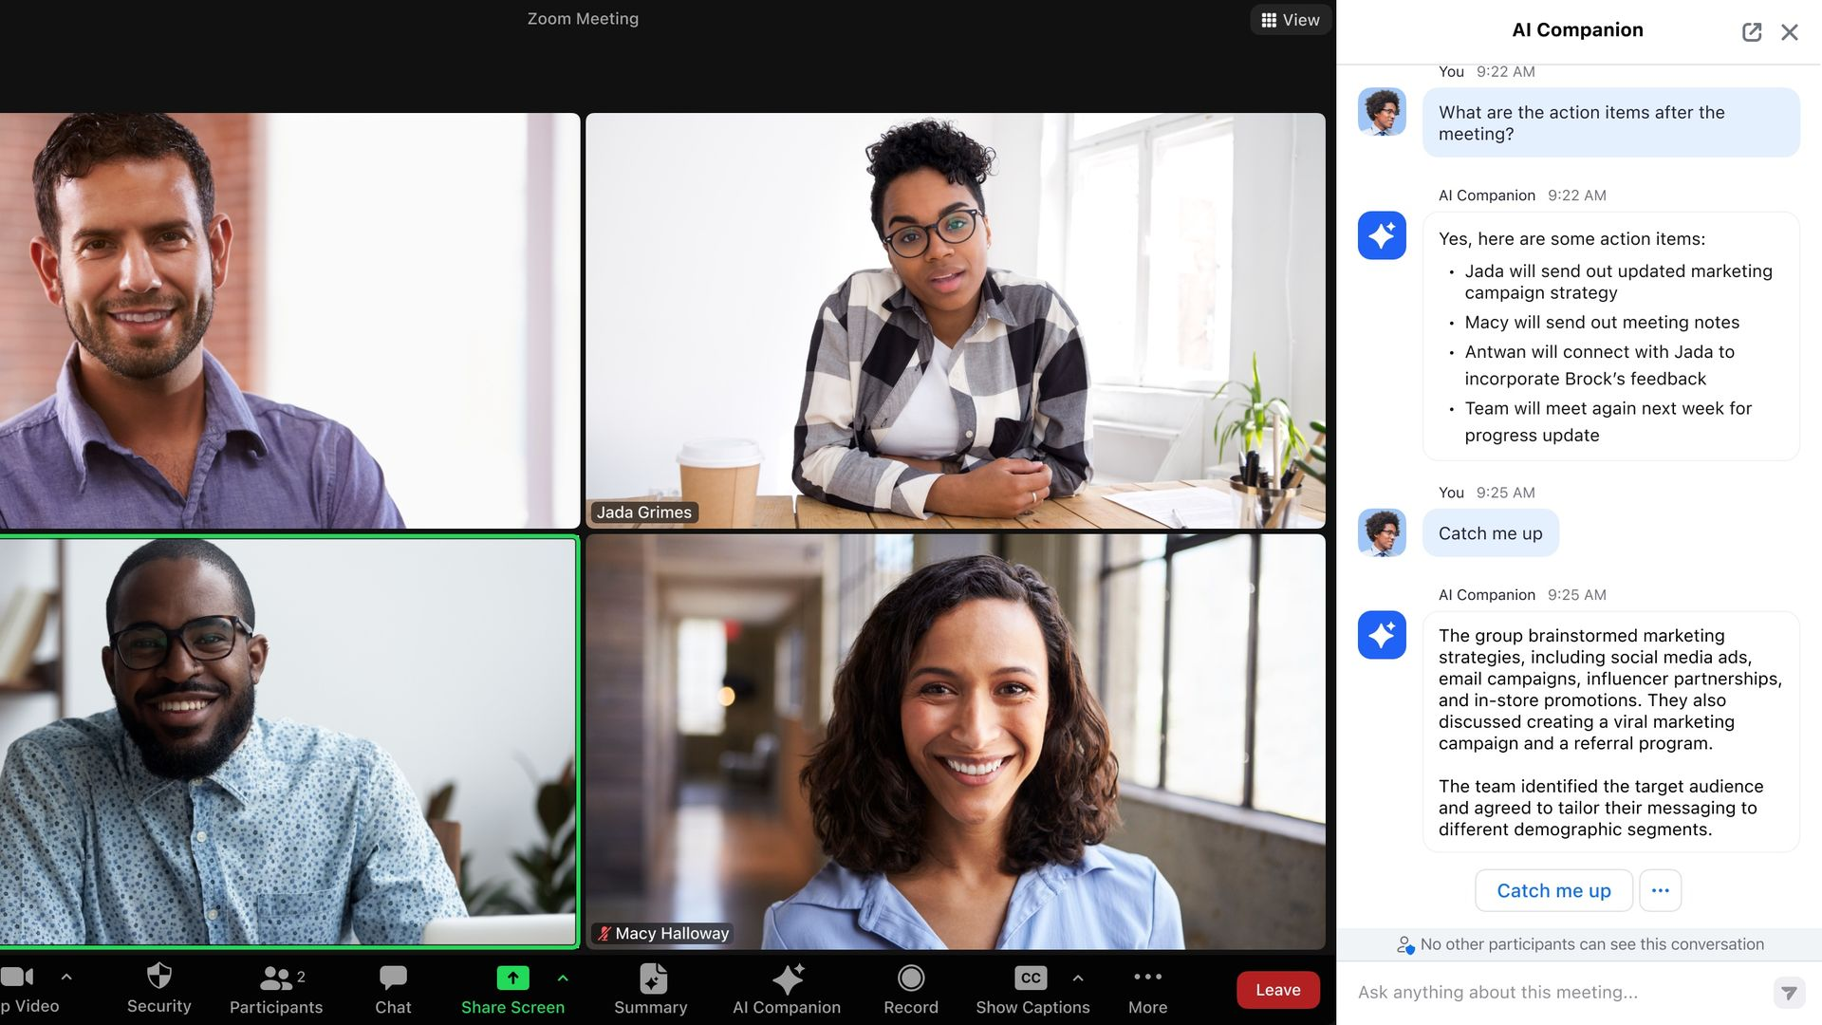
Leadership is a process, not a position

Slide 37
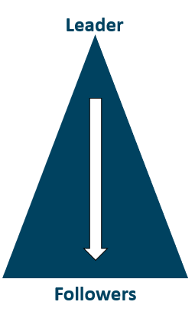
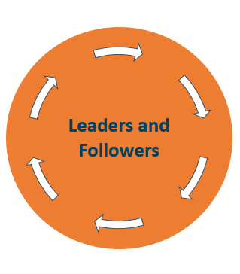
Which model best describes what you were taught about leadership? (Please put number in the chat)
1. Great Man/Trait
Leadership
2. Relational
Leadership

Slide 38

adrienne maree brown
Writer, activist, facilitator
Who leads matters.

Slide 39

Standpoint Theory
Knowledge stems from social position or “standpoint”
Marginalized people have access to knowledge that is not available to those with privilege
All forms of inquiry and change should begin with the lives of the marginalized
Objectivity is actually “collective subjectivity.”

Slide 40
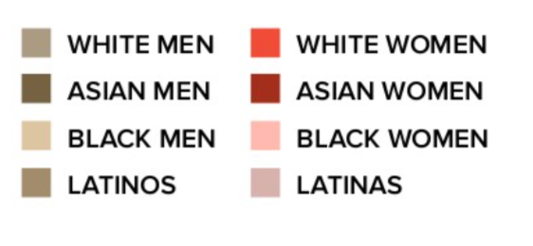
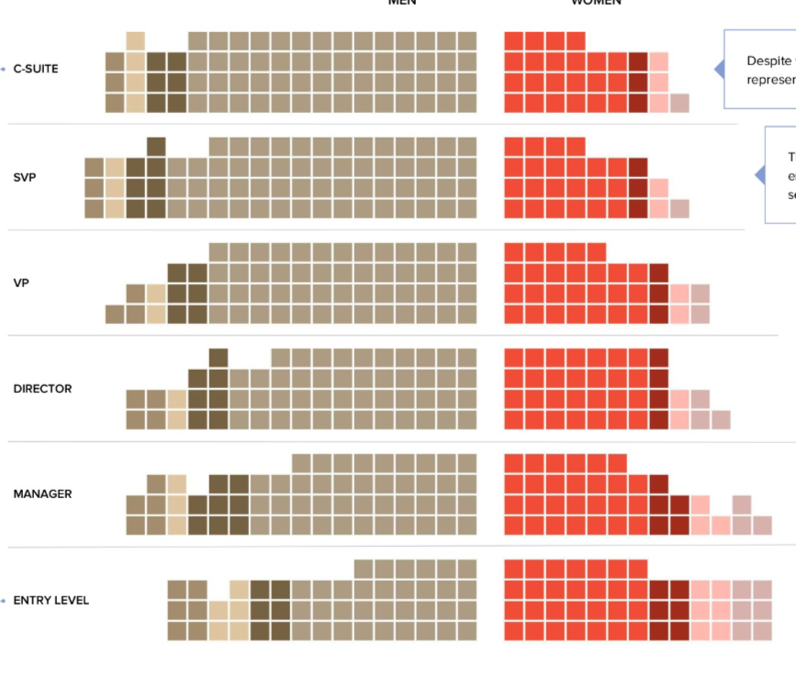
Employees by gender and race by level (2024)
Each square equals 1% representation
C-Suite
29% women
SVP
28% women
VP
30% women
Director
37% women
Manager
38% women
Entry Level
46% women
Women in the Workplace 2024 Report by McKinsey & Company

Slide 41
would
Employees by gender and race by level (2024)
Each square equals 1% representation
C-Suite
29% women
It’s not for a lack of ambition but of opportunity
SVP
28% women
Gallup research shows 45% of women would like a CEO or senior management role even if that requires working 50+ hour per week, but women only account for 23% of U.S. senior business roles.
VP
30% women
Director
37% women
Manager
38% women
Entry Level
46% women
Women in the Workplace 2024 Report by McKinsey & Company

Slide 42
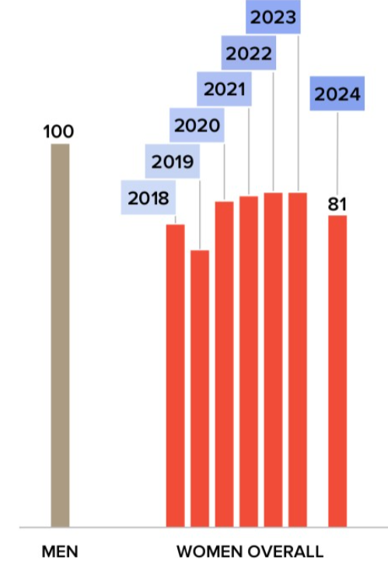

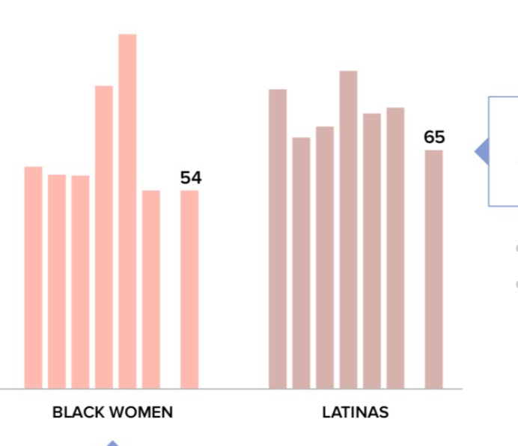
The Broken Rung
100
For every 100 men promoted to manager, only 81 women are promoted to manager.
For every 100 men promoted to manager, 89 white women,
65 Latinas, and 54 Black women are promoted to manager.
89
81
65
54
WHITE WOMEN
LATINAS
BLACK WOMEN
ALL MEN
ALL WOMEN
42
Women in the Workplace 2024 Report by McKinsey & Company

Slide 43
Leader Identity

Slide 44

Zoom Chat
Picture an effective leader.
What qualities do they embody?

Slide 45
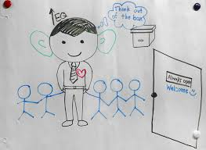
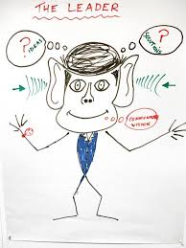
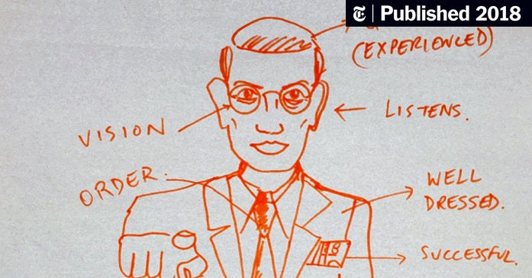
Picture an
effective leader
Leader = Man
Also:
Cisgender
White
Able-bodied
Etc.
Brown, H. (2018, March 16). Picture an effective leader: Is she a woman?
Retrieved from: https://www.nytimes.com/2018/03/16/health/women-leadership-workplace.html?save=nyt-gateway-stories

Slide 46
REFRAME
NAVIGATE
Leader = Man
Leadership
Double Bind
Relational Leadership
ADVOCATE

Slide 47
REFRAME
NAVIGATE
Leader = Man
Leadership
Double Bind
Relational Leadership
ADVOCATE

Slide 48
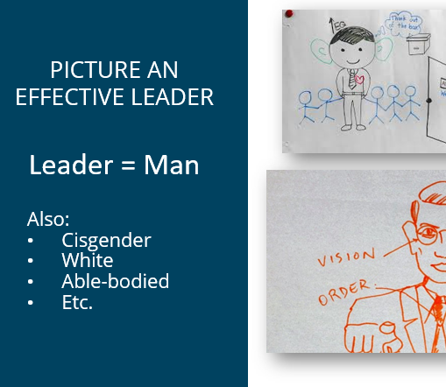
Reframe|Navigate|Advocate
Looking at the chat, which “effective leader” qualities do you embody
that transcend gender?

Slide 49
REFRAME
NAVIGATE
Leader = Man
Leadership
Double Bind
Relational Leadership
ADVOCATE

Slide 50
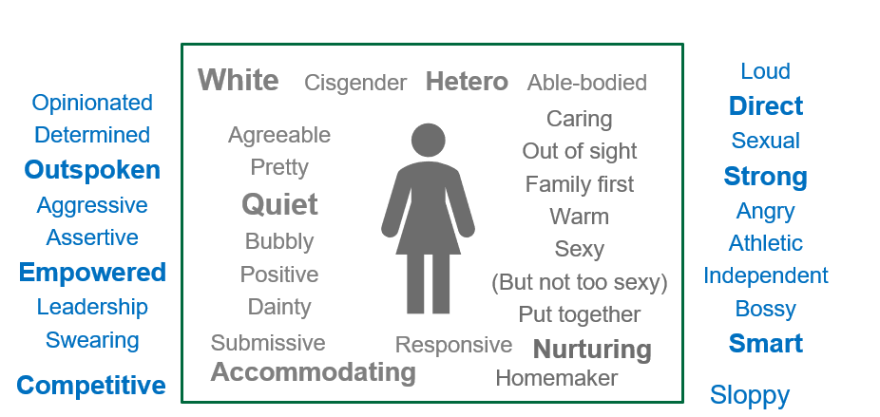
Leadership Double Bind
You can be a good woman but then you’re a bad leader
You can be a good leader but then you’re a bad woman

Slide 51
Reframe|Navigate|Advocate
Understand the problem
Combine authoritative, decisive behavior with interpersonal skills like collaboration and empathy (strategic softening)
Build a Strong Network
Cultivate supporters, partners, mentors and sponsors
Own your unique value
Leadership Double Bind: Women leaders are expected to be assertive (competent) and warm (likable)
Balance Warmth and Assertion
Recognize your individual strengths that transcend gender stereotypes

Slide 52
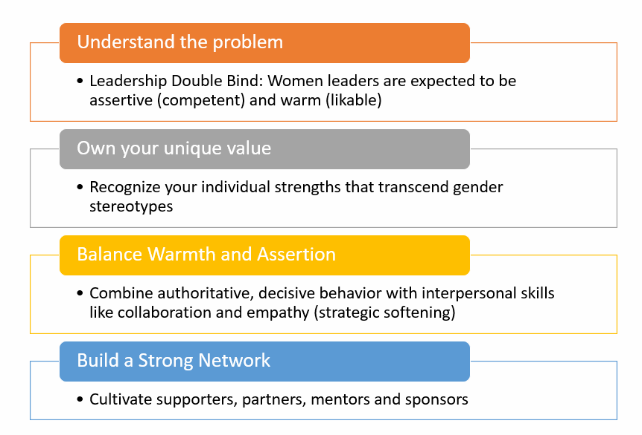
Reframe|Navigate|Advocate
Journal and Chat
Where can you spend more energy navigating the leadership double bind?

Slide 53
REFRAME
NAVIGATE
Leader = Man
Leadership
Double Bind
Relational Leadership
ADVOCATE

Slide 54
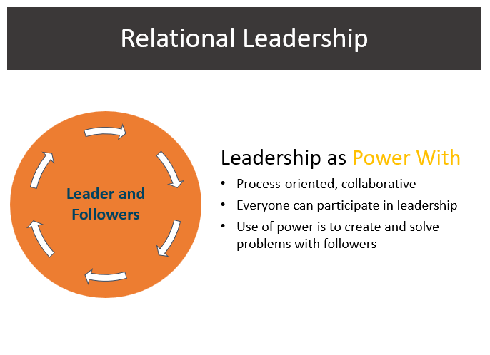
Reframe|Navigate|Advocate
Where and in what ways can you step us as a relational leader?

Slide 55
REFRAME
NAVIGATE
Leader = Man
Leadership
Double Bind
Relational Leadership
ADVOCATE

Slide 56

Choose To Do List
Send a thank you email to your supervisor for their support with a personal reflection about the retreat and Amplify.
Accept all the Amplify calendar invites (online trainings, large group sessions, make-up sessions, debrief & celebration, allies & partners event).
Create Zoom/in-person calendar invites for your Amplify small group sessions on Thursdays from 12:45 – 1:30 P.M. EST from March 26 to May 21, 2026.
Send personalized “Amplify Invite to Join” emails to your invitees
Send “Amplify Welcome to Participants” email with registration info as people accept your invitation to join
Send the calendar invites for both the Large Group and Small Group sessions to your participants as they accept your invitation
Monitor participant registration (due 3/20/26) on the Amplify website and send reminders as needed
Celebrate because you totally just rocked this Choose To Do List!
The Choose To Do List is available on the Retreat Handouts webpage
Notes:
Survey: https://dartmouth.co1.qualtrics.com/jfe/form/SV_5BGVYznMrLkPr1A

Slide 57
Amplify Community
Notes:
https://amplify-community-zone.mn.co/share/2gcfntCw6vyP1jDm?utm_source=manual

Slide 58


Slide 59
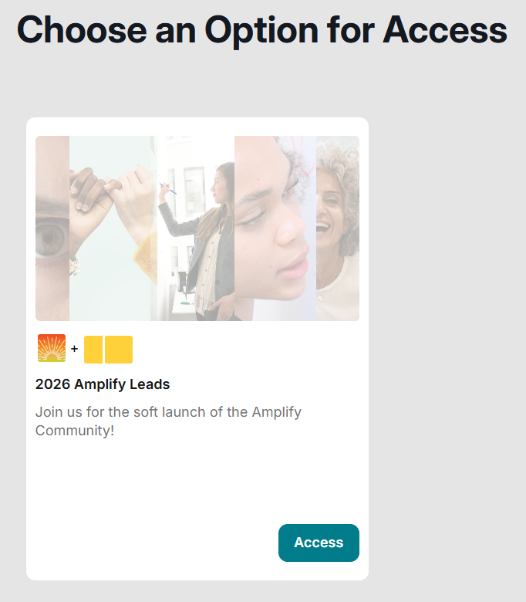
Click “Access” to join

Slide 60
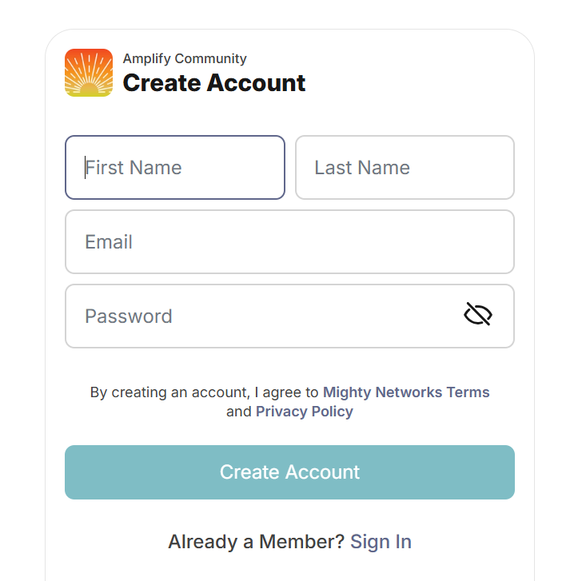
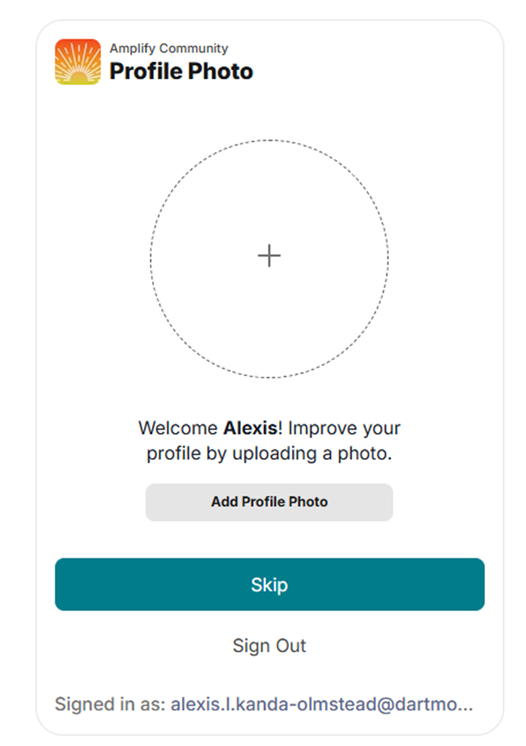
Please do this!

Slide 61
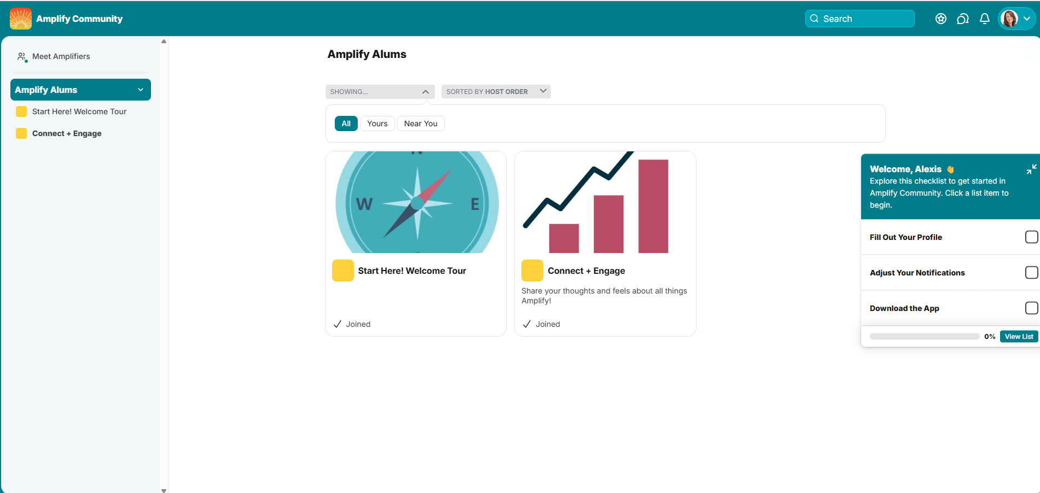

Complete during your first visit to the community

Slide 62
Fill Out
Your Profile
Choose a background banner
Write your Mini Bio and About Me to introduce yourself
  Use the AI “Get Me Started” option or copy/paste your LinkedIn profile
Enter your Location and Personal Links (Insta, LinkedIn, etc.)
Enter your Amplify Year(s)
Enter your Institution and Functional Area
Share Your Why for joining Amplify
Share your Walk On Song

