Slide 1
First and Last Name
Department
College/University/School
Please insert your headshot and 4-6 candid photos that capture your life outside of work. For example, family, pets, hobbies, special occasions, milestones, travel, a favorite quote, etc. (See Slide 2 for an example)

Slide 2

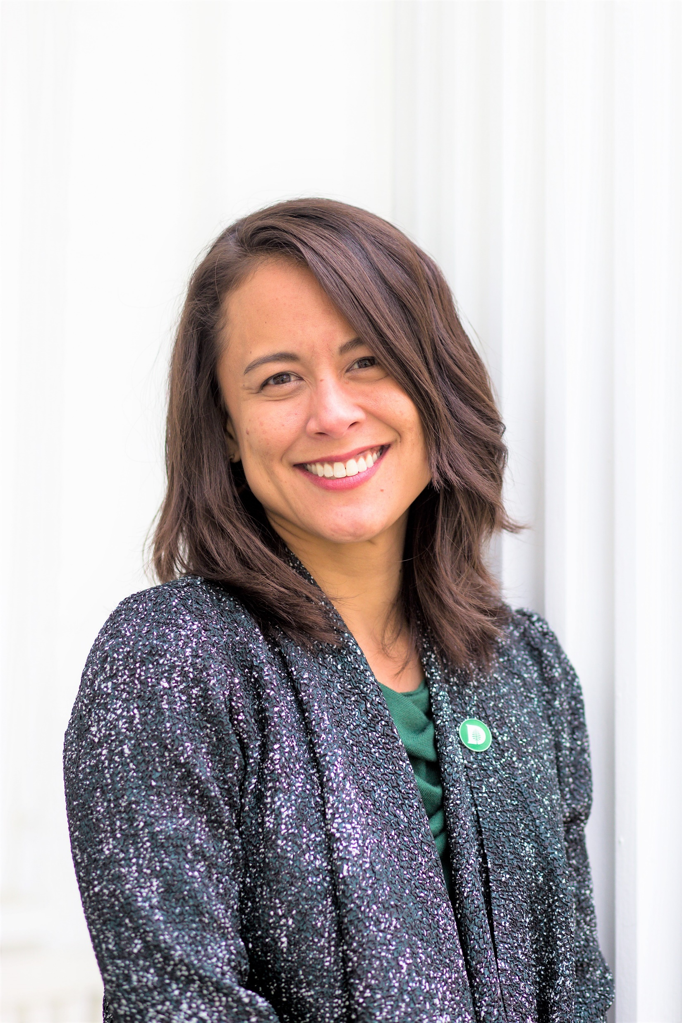
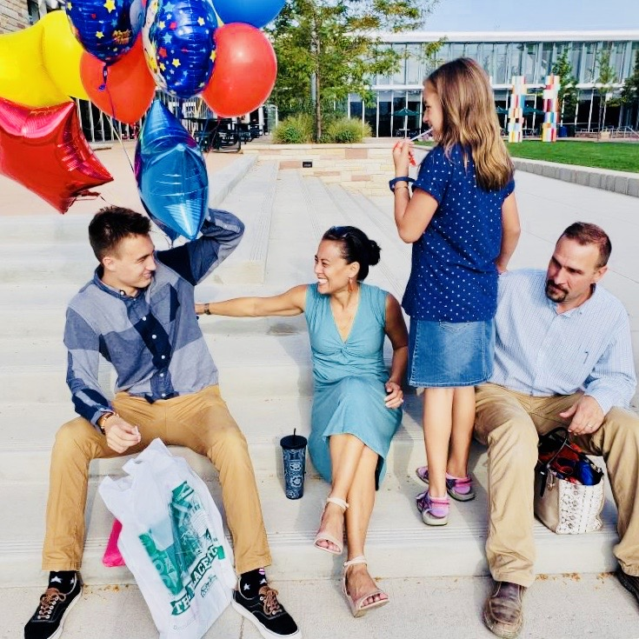

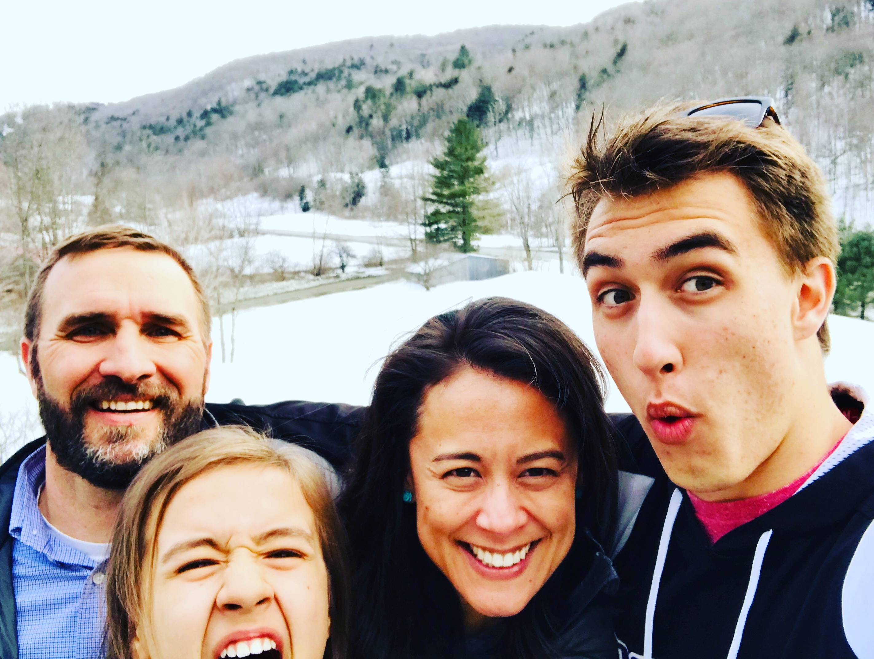
Alexis Kanda-Olmstead
Advancement Talent Management
Dartmouth College

