Slide 1
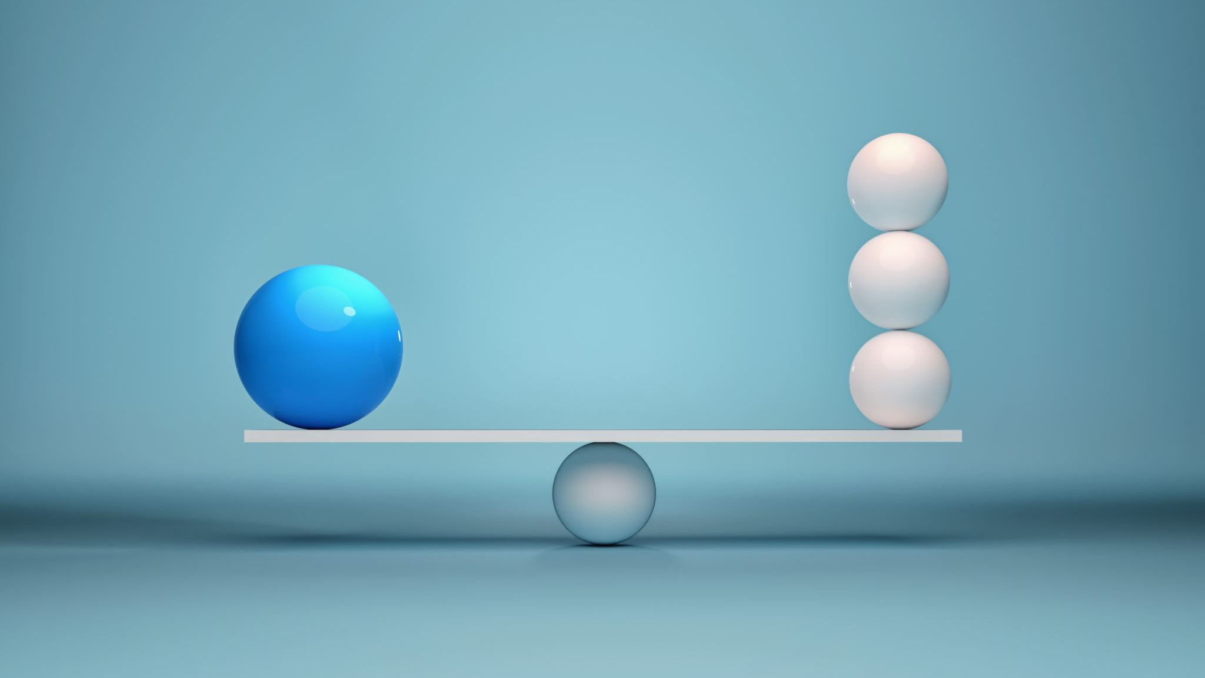
Okayness
The state or condition of being okay during times of uncertainty

Slide 2
Okayness tips & Tactics
Process your feels
Journal to get the noise out of your head and onto the page
Move your body
Take a 5-10 min stretch break
Practice mindfulness hacks
Trace your hand
Distract yourself
Scroll happy animal videos

Slide 3
Okayness tips & Tactics
Process your feels
Journal to get the noise out of your head and onto the page
Move your body
Take a 5-10 min stretch break
Practice mindfulness hacks
Trace your hand
Distract yourself
Scroll happy animal videos

Slide 4

journal
Imagine yourself 20 years from today – How old will you be? What will your life look like?
With all the wisdom of your future self, write your current self a letter.
  Dear ,
  This is your future self, and this is what I want you to know….
  Love,
  Your Future Self

Slide 5
Okayness tips & Tactics
Process your feels
Journal to get the noise out of your head and onto the page
Move your body
Take a 5-10 min stretch break
Practice mindfulness hacks
Trace your hand
Distract yourself
Scroll happy animal videos

Slide 6
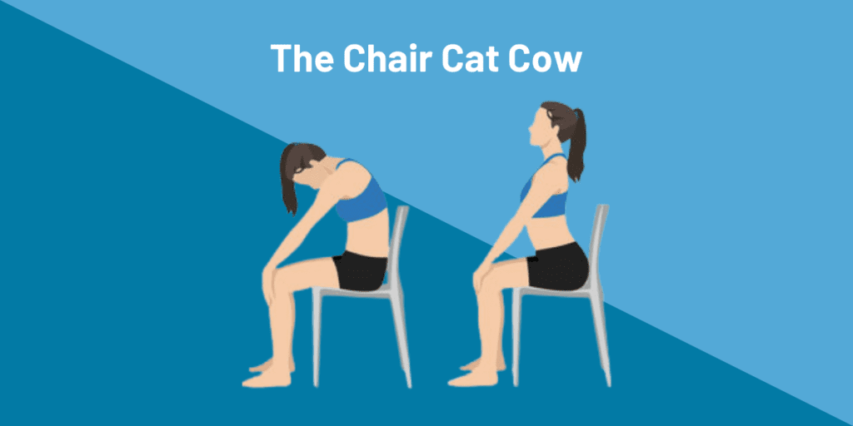
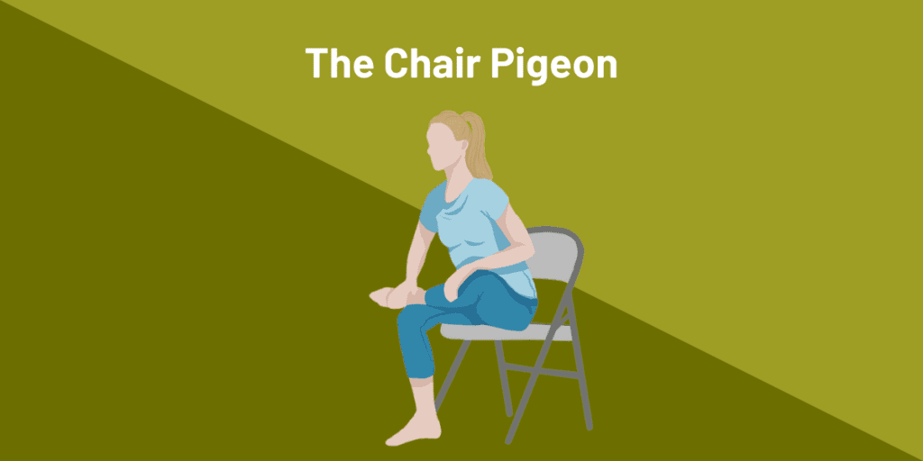
Chair yoga

Slide 7
Okayness tips & Tactics
Process your feels
Journal to get the noise out of your head and onto the page
Move your body
Take a 5-10 min stretch break
Practice mindfulness hacks
Trace your hand
Distract yourself
Scroll happy animal videos

Slide 8
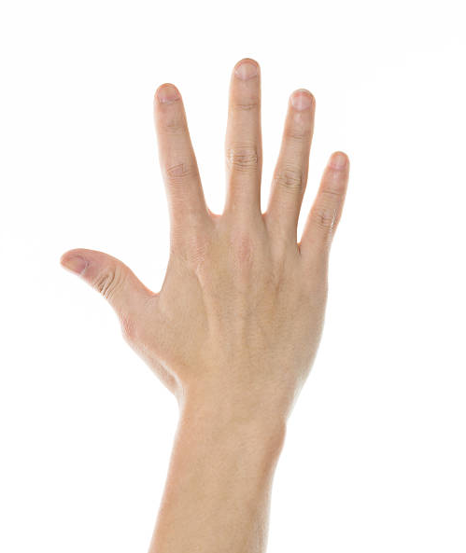
Trace your hand
Place your non-dominant hand on a flat surface (you can do this during a meeting by using your lap)
With a closed pen or pointer finger “trace” your hand
Repeat until you feel better

Slide 9
Okayness tips & Tactics
Process your feels
Journal to get the noise out of your head and onto the page
Move your body
Take a 5-10 min stretch break
Practice mindfulness hacks
Trace your hand
Distract yourself
Scroll happy animal videos

Slide 10
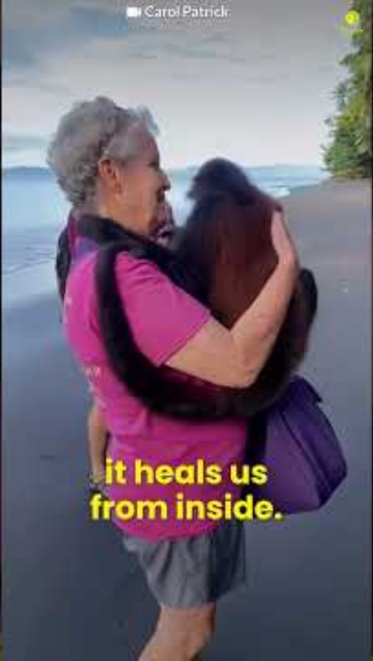
Happy animal videos

Slide 11
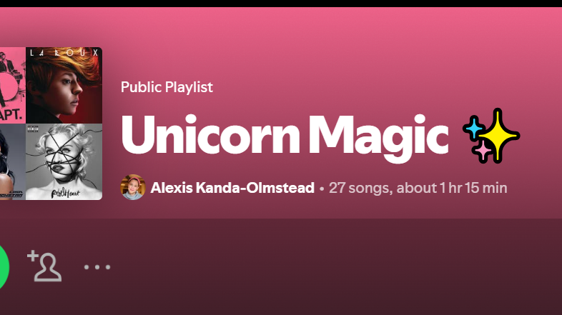
https://open.spotify.com/playlist/6K4a7q79q95XYhYPzSp7zT?si=yDkDEyuvTTiwPG4MjKy9xA

