Slide 1
Inspiring Word for the Year
Living with hope and courage in 2025
Mountainmodernlife.com

Slide 2
Instructions
Grab your Amplify journal and cozy up with these powerful reflection questions to find your inspiring word for the year.
As you go through the presentation, be sure to read the slide notes for more detailed information.
Ready to get inspired? Let’s go!

Slide 3
Reflect
What could I use more of in my life?
What could I use less of in my life?
What characteristics would I like to have?
By the end of the day, I feel (fill in the blank.) How do I want to feel?
STEP 1
Notes:
Look back upon the last year and ask yourself these questions. Write down whatever pops into your head without self-editing.

Slide 4
Visualize
Envision the perfect day – what does it feel like?
STEP 2
Notes:
Envision the perfect day – what does it feel like (emphasize the “feel” here). How do you want your morning to feel? How do you want to feel at work and throughout the day? How do you want to feel right before you go to bed?
What would make you feel this way? Picture that perfect day in your mind. Walk through it and get really clear on what you’re doing.

Slide 5
Create a List
Write down a list of words that support how you want to feel. No self-editing. Just write the words down.
STEP 3
Notes:
Next, write down a list of words that support how you want to feel. For example, if you want to feel “energized,” you might write down words that bring you energy, whether that’s “rest,” “creativity,” “friendship,” or “purpose.” The list will be unique to you. Spend a few minutes creating a list of words.
The next slide has some example words that might help you get started.

Slide 6
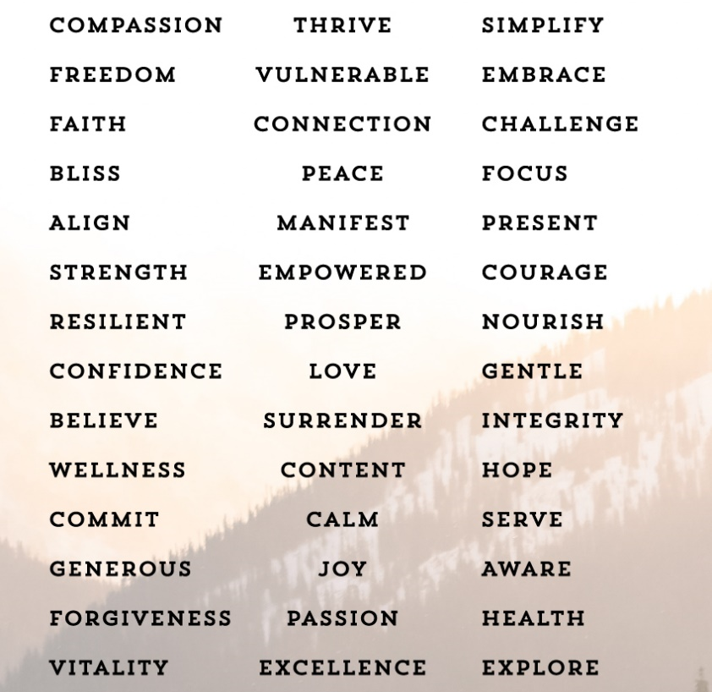

Example Words

Slide 7
Review & Refine
Gently review your list and select words that resonate with you. Let the words find you.
STEP 4
Notes:
Read through your list. Do any of the words jump out at you? Do any make you feel excited, nervous, scared, or at ease? Sometimes, the words that scare us most can mean we’re on the right track because change isn’t always comfortable. At the same time, finding your word can also bring peace and happiness.
Selecting your word is more than what you should do or wish you would do. For some, the word “empowered” will feel, well, empowering. But for others, it may feel like a burden. If a word makes you feel stressed or guilty or sad in any way, delete it from your list.
You also may see a theme with some of the words. If so, is there one word that captures this theme?
Highlight or circle 3 words. As you go through this process, think about the words, try them on, and see what feels right. No need to over-analyze – it’s about how the word makes you feel. Gently review your list and let the words find you.

Slide 8
Commit
Ask yourself, “Are you interested, or are you committed?”
STEP 5
Notes:
Now it’s time to choose your word. To do this, it’s helpful to ask yourself, “Are you interested, or are you committed?” for each of the 3 words. Is this a word that you really, really want to define your life?
Does the word do more than satisfy a surface-level need or goal? Does it touch many aspects of your life? If so, then you’re more likely to commit to it for an entire year. You will be intrinsically motivated to make the choices needed to bring that word into your life. You will say “yes” and “no” to opportunities based on the word. You will center the word and its meaning in how you interact with others, care for yourself, show up at work, and grow and change over the next year.

Slide 9
Choose
Which word are you 100% committed to? Choose that word!
STEP 6
Notes:
Which word are you 100% committed to? Choose that one!
Your answer to this question may be immediately clear to you or it may take a few days. If you need more time, create space to meditate or sit in silence for a couple of minutes and ask yourself, “What word do I truly want to focus on for 2025?”
You can also think about it right before you go to sleep or when you wake up. You’ll be amazed at how being in a relaxed state can help your intuition shine through, bringing your word to the forefront.

Slide 10
Template Instructions
Select from the 4 design options in the following slides.
Replace the template word with your word.
Adjust the font size and text box placement.
Convert to an image using a snipping tool (see below)
  Microsoft snipping tool
  Mac screenshot instructions
Save the image to your desktop and/or print a copy.
Notes:
Now it’s time to create a visual reminder of your word! Use this template to create an image that you can print or save electronically.

Slide 11
Inspire

Slide 12

Peace

Slide 13

Sparkle

Slide 14

Courage

