Slide 1
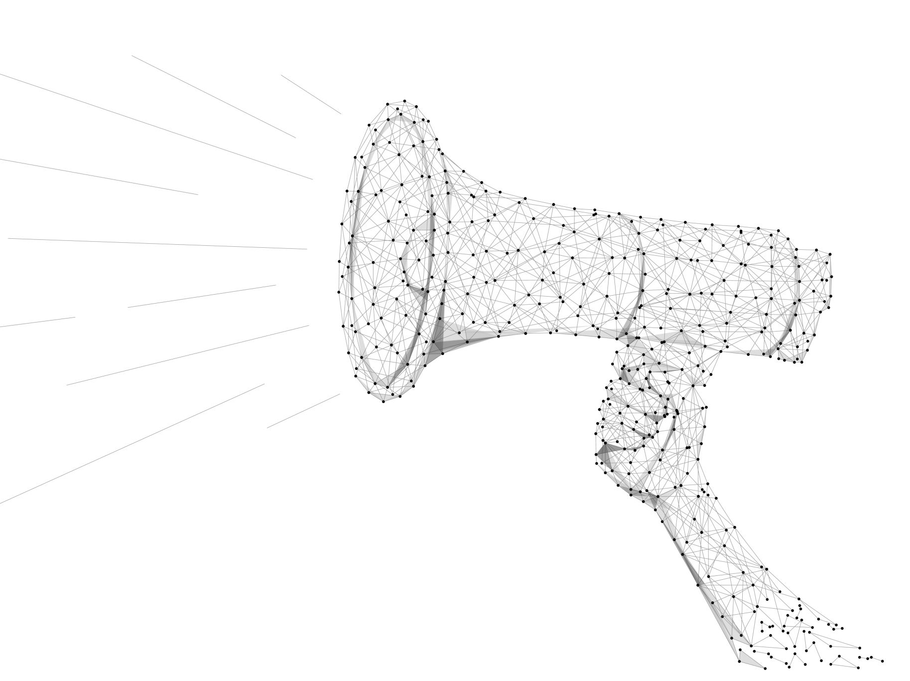
AMPLIFICATION
Sharing the Amplify Love

Slide 2
Amplify Email
Dear (First Name),
I’m in a workshop where I’ve been asked to “amplify” a woman I (appreciate, admire, adore) at work, and your name was at the top of my list!
Amplifying someone means to reflect back their superpowers – the values and strengths they embody. I wanted you to know that I think you are an amazing person because…and I see your superpowers as ….
Thanks for being this person. ☺
Sincerely,
Your Name
PS – No need to respond. I just wanted you to know.
Make a list of women you appreciate, admire, or adore at work
Next to each name, write down their superpowers
  What do you appreciate, admire, or adore?
  What inspires you about them?
  What are their values and strengths?
Select one woman to amplify and email her right now

