Slide 1

Lead Online Trainings

Slide 2

Remind Alexis to hit record!

Slide 3

Online Lead Trainings
2/27/25: Review Sessions 3 and 4
3/6/25: Review Sessions 5 and 6
3/13/25: Review Sessions 7 and 8
3/20/25: Review Session 9 & Prep for Launch

Slide 4

Agenda
Check-ins and updates:
    1:1 with Alexis (Calendly invite)
    Scholarships vs. waivers
Icebreaker: When was the last time you laughed?
Session 7: Cultivating Resilience
Session 8: Transforming Organizations
Notes:
https://amplifywomen.files.wordpress.com/2024/03/amplify-placemat-template-participant-email.docx

Slide 5

When was the last time you laughed?

Slide 6

Registration due
3/20/25
Notes:
https://amplify-women.org/welcome/

Slide 7

Amplify Sessions
Every Thursday 12 Noon to 1:30 p.m. EST from March 27 – May 22, 2025
Session 1 (3/27/25) Amplifying Yourself and Others
Session 2 (4/3/25) Deconstructing Gender
Session 5 (4/24/25) Expanding Identity to Values & Strengths
Session 4 (4/17/25) Identifying as a Leader
Session 6 (5/1/25) Cracking the Confidence Code
Session 7 (5/8/25) Cultivating Resilience
Session 8 (5/15/25) Transforming Organizations
Session 3 (4/10/25) Getting Comfortable with Power
Session 9 (5/22/25) Creating Change through Community

Slide 8

Cultivating Resilience*
*Self-Compassion
Session 7 | May 8, 2025

Slide 9
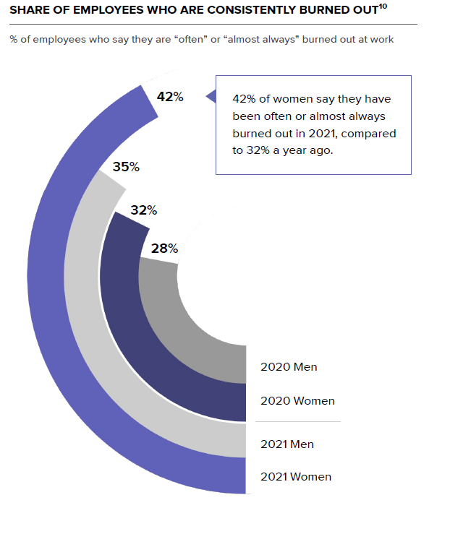
Gender
& Burnout
42% of women say they have been often or almost always burned out
Women are 32% more likely to experience burnout than men
2021 and 2022 Women in the Workplace Report by McKinsey & Company and Lean In
Future Forum Pulse Report Falls 2022

Slide 10
“What is ‘burnout’ really? If we peek behind the curtain, the real culprit of our burnout woes is employer exploitation.”
Reframing “Employee Burnout”
“Zoinks! Like, is burnout at it again? Orrr is there anew villain in town?” by Carlos Garcia Leon, Community-centric Fundraising

Slide 11


Resilience vs. Self-Compassion
Resilience
Process of adapting well in the face of trauma
Focused on surviving and enduring
Self-Compassion
Emotionally-supportive attitude toward self
Focused on healing and thriving
Notes:
Alexis

Slide 12


Brené Brown
Audre Lorde
Researcher, storyteller, currently enraged Texan
Black, lesbian, mother, warrior, poet
In a society that says, “Put yourself last,” self-love and self-acceptance are almost revolutionary.
Caring for myself is not self-indulgence, it is self-preservation, and that is an act of political warfare.

Slide 13
Caregivers
(children, elderly parents, sick family members, fur babies, etc.)
Drop the ball
Forgiveness

Slide 14


Black, Indigenous, and People of Color
Rest
Joy

Slide 15


LGBTQ
Defining your LGBTQ self
Being more than your gender identity and sexual orientation
Singh, A. A. (2018). The Queer and Transgender Resilience Workbook.

Slide 16

Confidence Continuum
Planning Mtgs.
Registration Process
Retreat Agenda
Retreat Day 1
Retreat Day 2
Self-Compassion Safety Net

Slide 17
Self-Compassion Safety Net
Common Humanity vs. Isolation
Mindfulness vs. Over-identification
Self-kindness vs. Self-judgment
https://self-compassion.org/the-three-elements-of-self-compassion-2/

Slide 18
Self-Compassion Safety Net
Common Humanity vs. Isolation
View our personal experiences as part of a much larger human experience
Mindfulness vs. Over-identification
Take a balanced approach to our emotions, neither suppressing nor overreacting
Self-kindness vs. Self-judgment
Accept and forgive ourselves when we suffer, fail, or feel inadequate
https://self-compassion.org/the-three-elements-of-self-compassion-2/

Slide 19
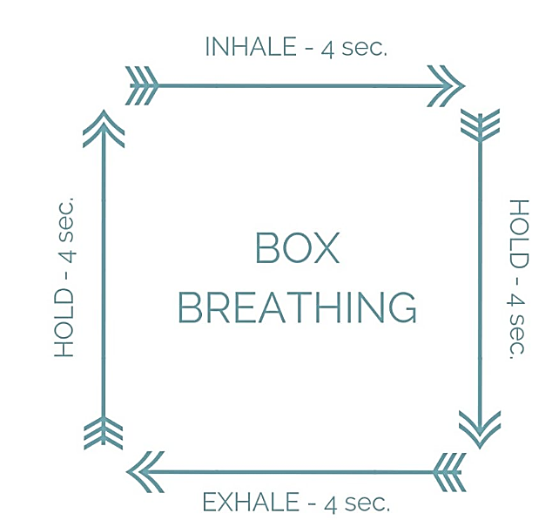
Mindfulness vs. Over-identification
Name
5 Things
Notes:
Alexis 12:27-29

Slide 20
Self-Compassion Safety Net
Common Humanity vs. Isolation
View our personal experiences as part of a much larger human experience
Mindfulness vs. Over-identification
Take a balanced approach to our emotions, neither suppressing nor overreacting
Self-kindness vs. Self-judgment
Accept and forgive ourselves when we suffer, fail, or feel inadequate
https://self-compassion.org/the-three-elements-of-self-compassion-2/

Slide 21
Common Humanity vs. Isolation
Taking and Sending Meditation
Rest your mind for a second of stillness
Breathe in all your negative feelings (e.g., sadness, anger, fear) for a few breaths
Breathe out all the positive feelings you wish you felt (e.g., happiness, peace, love) for a few breaths
Think about your personal situation that is causing these feelings
  Breathe in the negative feelings about your situation (3-4x)
  Breathe out the positive feelings that you wish you had (3-4x)
Expand your focus to others who share your situation or something like it
  Breathe in the negative feelings about their situations (3-4x)
  Breathe out the positive feelings that you wish for them (3-4x)
https://www.lionsroar.com/how-to-practice-tonglen/
Notes:
Alexis 12:29-32

Slide 22
Self-Compassion Safety Net
Common Humanity vs. Isolation
View our personal experiences as part of a much larger human experience
Mindfulness vs. Over-identification
Take a balanced approach to our emotions, neither suppressing nor overreacting
Self-kindness vs. Self-judgment
Accept and forgive ourselves when we suffer, fail, or feel inadequate
https://self-compassion.org/the-three-elements-of-self-compassion-2/

Slide 23

Self-Kindness vs. Self-Judgment
Letter from Your Future Self
20 Years from Today
Dear (Your First Name),
This is your future self, and this is what I’d like you to know…
Notes:
Alexis 12:34-6

Slide 24
Self-Compassion Safety Net
Revisit your Confidence Continuum and practice two of the elements.
Common Humanity vs. Isolation
Taking & Sending Meditation
Mindfulness vs. Over-identification
1. Box Breathing
Inhale
Self-kindness vs. Self-judgment
Letter from your Future Self
Hold
Exhale
Hold
4 seconds each:
Breathe in negative
Breathe out positive
Focus on self (repeat steps 1-2)
Dear (Your Name), This is your future self, and this is what I’d like you to know
2. Name 5 Things
Expand to others (repeat steps 1-2)
https://self-compassion.org/the-three-elements-of-self-compassion-2/

Slide 25

Zoom Chat
What was that like?

Slide 26
Confidence Continuum
Step 1
Step 2
Chart along a continuum
Step 3
Step 4
Write down action steps
Identify a goal
Rank order by risk/fear
Step 5
Take 1 action in 1 week
Deploy as needed
Self-Compassion
Safety Net

Slide 27
Confidence Continuum
Step 1
Step 2
Chart along a continuum
Step 3
Step 4
Write down action steps
Identify a goal
Rank order by risk/fear
Step 5
Take 1 action in 1 week
Deploy as needed
Self-Compassion
Safety Net

Slide 28
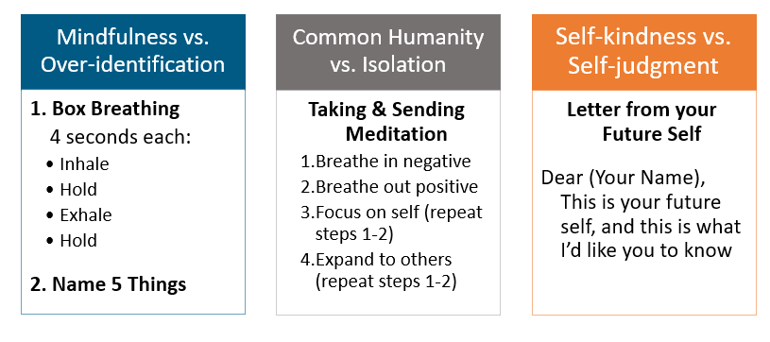
Amplify Skill Application: Reframing
Which of the self-compassion practices could help you reframe a current or future challenge?
Reframing: To look at something in a new way

Slide 29
Amplify Skill Application: Navigating
Which of the self-compassion practices could help you navigate a current obstacle?
Navigating: To avoid or go around obstacles

Slide 30
Amplify Skill Application: Advocating
Which of the self-compassion practices could help you advocate for something you need?
Advocating: To create change for self and others

Slide 31


Session 8:
Transforming Organizations
Image Credit: Deloitte Insights

Slide 32
Amplify Sessions
Every Thursday 12 Noon to 1:30 p.m. EST from March 27 – May 22, 2025
Session 1 (3/27/25) Amplifying Yourself and Others
Session 2 (4/3/25) Deconstructing Gender
Session 5 (4/24/25) Expanding Identity to Values & Strengths
Session 4 (4/17/25) Identifying as a Leader
Session 6 (5/1/25) Cracking the Confidence Code
Session 7 (5/8/25) Cultivating Resilience
Session 8 (5/15/25) Transforming Organizations
Session 3 (4/10/25) Getting Comfortable with Power
Session 9 (5/22/25) Creating Change through Community

Slide 33
Transforming Organizations
Session 8 | May 15, 2025

Slide 34

Standpoint Theory
Revisiting
Objectivity = collective subjectivity
Knowledge stems from social position or “standpoint”
Marginalized people have access to knowledge that is not available to those with privilege
All forms of inquiry and change should begin with the lives of the marginalized

Slide 35
Online Poll
Standpoint Theory
From your standpoint, what are the primary challenges women and people with marginalized identities face in your organization?
(Please submit one at a time. Upvote to show agreement.)
Instructions
Go to Pollev.com
Username “Dartmouth”
Select “Join”
“Skip” credit
Notes:
Response Link:
https://PollEv.com/dartmouth
https://PollEv.com/discourses/F2bPbcZXLPXFGedQ3HVSc/respond

Slide 36
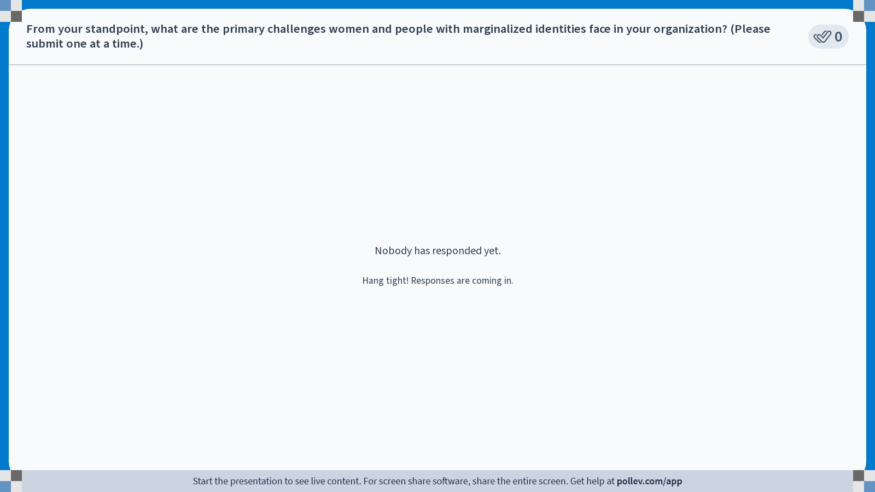
Notes:
Poll Title: Do not modify the notes in this section to avoid tampering with the Poll Everywhere activity.
More info at polleverywhere.com/support
From your standpoint, what are the primary challenges women and people with marginalized identities face in your organization? (Please submit one at a time.)
https://www.polleverywhere.com/discourses/2tNj4nzogWFgygkYX8Pgj

Slide 37
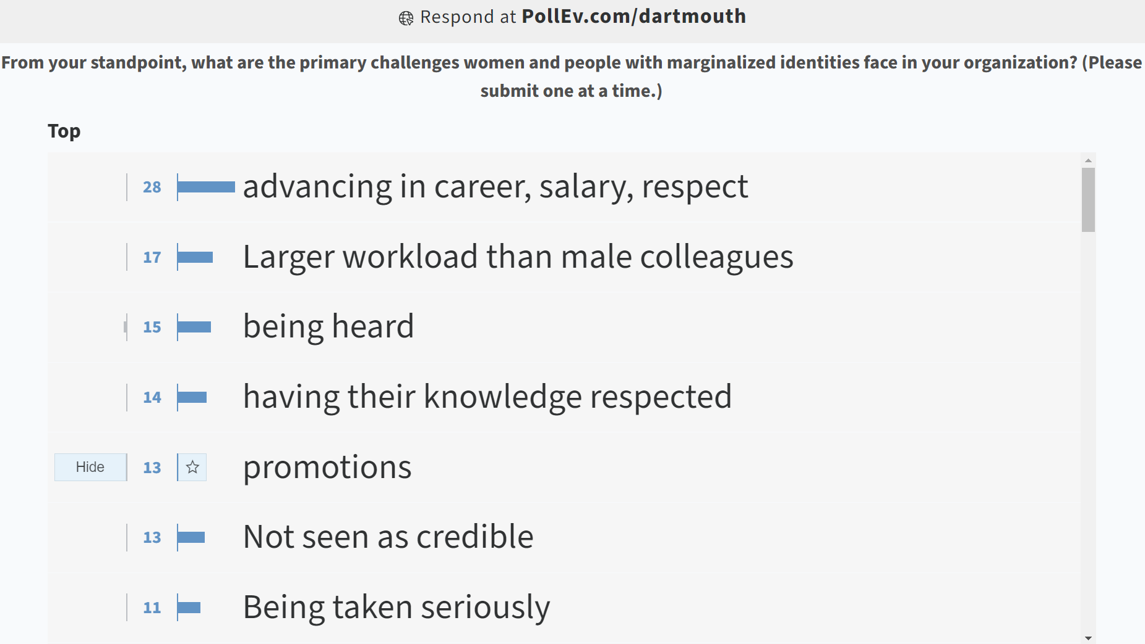
Online Poll: From your standpoint, what are the primary challenges women and people with marginalized identities face in your organization?

Slide 38
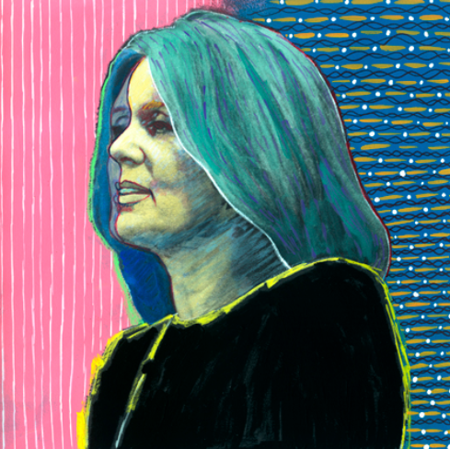
Gloria Steinem
Feminist journalist and political activist
The truth will set you free,
but first it will piss you off.
https://www.haveartwilltravel.org/prints/mood-portraits/gloria-449/

Slide 39
Gender Gaps
Compensation
Promotion
Unpaid Labor

Slide 40
Gender Gaps
Compensation
Promotion
Unpaid Labor

Slide 41
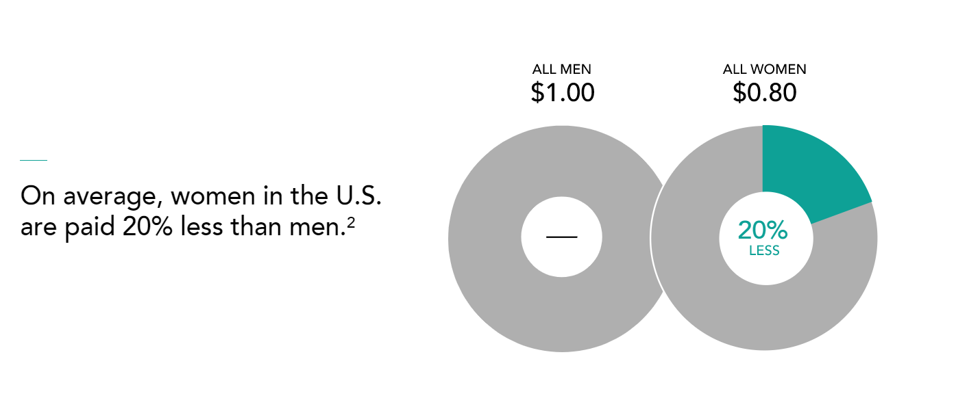
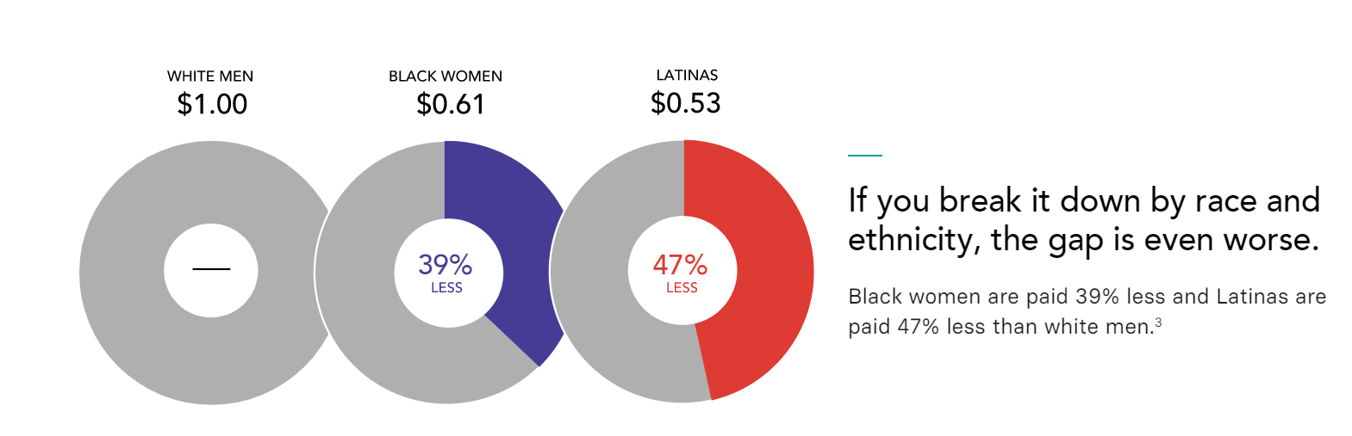
National Trends: Compensation Gap
ALL MEN
ALL WOMEN
On average, women in the U.S. are paid 20% less than men.
WHITE MEN
BLACK WOMEN
LATINAS
If you break it down by race and ethnicity, the gap is even worse.
Black women are paid 39% less and Latinas are paid 47% less than white men.
Women in the Workplace 2018 Report by McKinsey & Company https://leanin.org/women-in-the-workplace-report-2018/men-still-outnumber-women-at-every-level
Notes:
Any way you look at it, there’s a pay gap for women.
When you control for important factors such as education, experience, industry, occupation, role, and hours worked, the pay gap still exists.

Slide 42
National Trends: Compensation Gap
ALL MEN
ALL WOMEN
As a result, the average woman misses out on more than $400,000 during the course of her career.
On average, women in the U.S. are paid 20% less than men.
WHITE MEN
BLACK WOMEN
LATINAS
If you break it down by race and ethnicity, the gap is even worse.
Black women are paid 39% less and Latinas are paid 47% less than white men.
Equal Pay Counts: What Companies Can Do, Lean In Website
National Partnership for Women and Families, The Lifetime Wage Gap, State by State (April 2018)
Women in the Workplace 2018 Report by McKinsey & Company https://leanin.org/women-in-the-workplace-report-2018/men-still-outnumber-women-at-every-level
Notes:
Any way you look at it, there’s a pay gap for women.
When you control for important factors such as education, experience, industry, occupation, role, and hours worked, the pay gap still exists.

Slide 43
Impact of the Compensation Gap in Advancement
v
$15,000-20,000
Gender accounts for a 10% difference in salaries between women and men fundraisers.
Average amount that women fundraisers are paid less than men fundraisers per year.
The Impact of Gender on Fundraising Salaries 2014-2018 https://afpglobal.org/sites/default/files/attachments/2019-03/EffectofGenderonFundraisingSalaries2019.pdf

Slide 44
Gender Gaps
Compensation
Promotion
Unpaid Labor

Slide 45
National Trends: Unpaid Labor Gap
In hetero couples, women perform 2x as much domestic work and childcare as their men partners
2 of 3 caregivers for elderly parents and sick family members are women
Women of color are asked to do more “office housework” than white women
Bianchi, S.M., et al. (2012). Housework: Who Did, Does or Will Do It, and How Much Does It Matter?
McKinsey & Co (2021). Creating a Postpandemic Recovery for Women in the Workplace

Slide 46
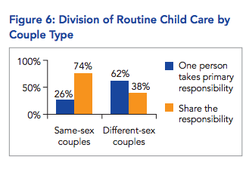
Same-sex couples more likely to share chores
Same-sex couples experience much narrower income gaps after having children than their different-sex counterparts.
2015 PriceWaterHouse Coopers and the Family and Workplace Institute Survey

Slide 47

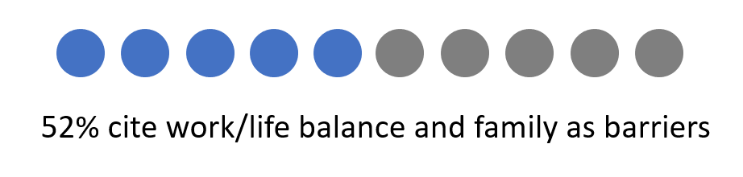
Impact of the Unpaid Labor Gap in Advancement
v
Advancing Women’s Leadership Survey (2018)

Slide 48
Gender Gaps
Compensation
Promotion
Unpaid Labor

Slide 49
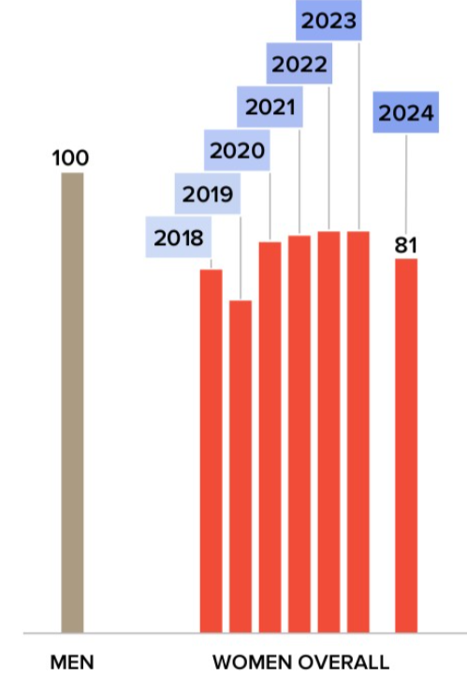

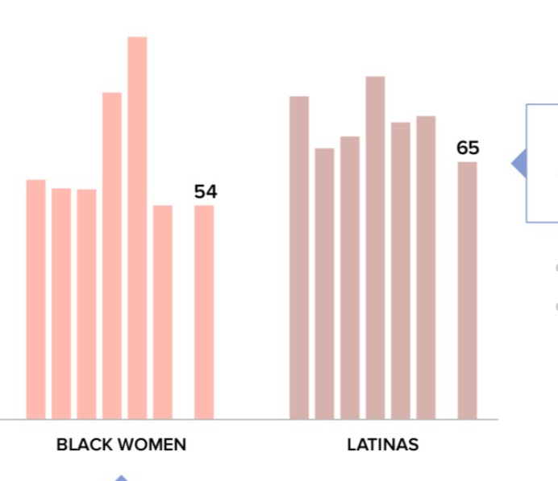
National Trends: Promotion Gap
100
For every 100 men promoted to manager, only 81 women are promoted to manager.
For every 100 men promoted to manager, 89 white women, 65 Latinas, and 54 Black women are promoted to manager.
89
81
65
54
WHITE WOMEN
LATINAS
BLACK WOMEN
ALL MEN
ALL WOMEN
49
Women in the Workplace 2024 Report by McKinsey & Company

Slide 50
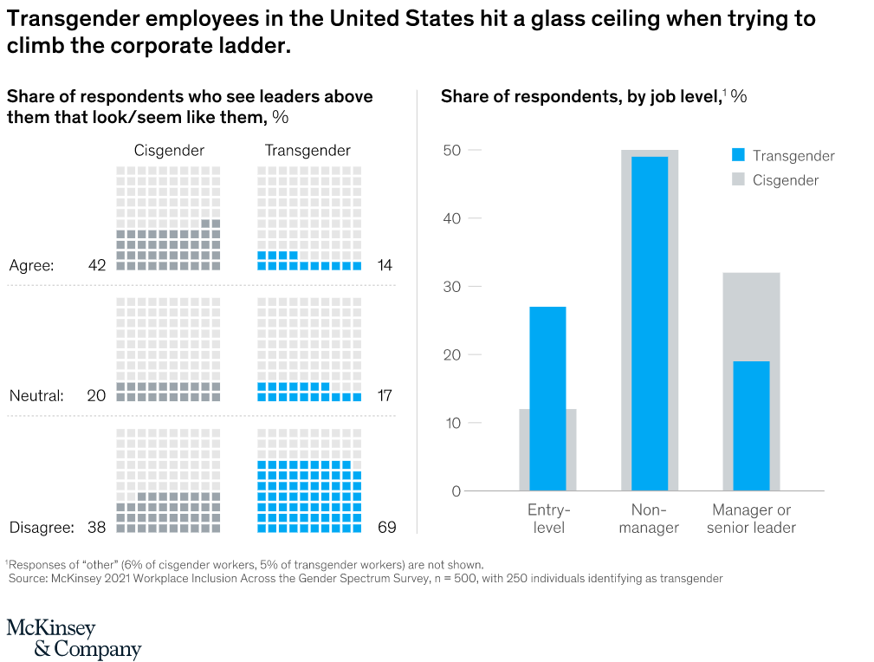
Transgender employees hit a glass ceiling when trying to climb the corporate ladder
Being Transgender at Work, McKinsey Quarterly Nov. 10, 2021
Notes:
Transgender employees are also underrepresented in management and company leadership. Only 12 percent of our cisgender respondents reported being entry-level employees, while 32 percent were managers or senior leaders. In contrast, 27 percent of transgender respondents were on the entry level and only 19 percent were managers or senior leaders. Without seeing representation in the upper ranks, no wonder many transgender people have concerns about their prospects for career advancement (Exhibit 7).

Slide 51
Impact of the Hiring and Promotion Gap in Advancement
v
AFP membership is 70% women, but 4 out of 5 senior positions in fundraising are held by men.
Among the CASE 50 Institutions, only 42% are headed by women Chief Advancement Officers.
2018 statistics reported by the Educational Advisory Board and the Association of Fundraising Professionals.
2023 CASE email communication from US/Canda Executive Director

Slide 52
Individual
Change Strategies
Learn from previous change efforts
Educate yourself about related policies
Focus on your locus of control
Gather data and testimonials
Identify the “triple win” (you-manager-org)

Slide 53
Organizational Change Strategies
Intrapreneurs
Operate in large, highly-structured organizations
Utilize entrepreneurial methodologies to innovate
Bring beneficial and revolutionary ideas to fruition
https://www.forbes.com/sites/jordandaykin/2019/01/08/intrapreneurship/#2b6cf4f74ea3

Slide 54


Intrapreneurs Toolkit
  Make the Business Case
  Negotiate the System
  Build Your Community
  Unlock Resources
  Foster Personal Resilience
Notes:
https://amplify-women.org/intrapreneurship-toolkit-activity/

Slide 55
Make the Business Case
Negotiate the System
Build Your Community
Unlock Resources
Foster Personal Resilience
Intrapreneurs Toolkit
https://www.leagueofintrapreneurs.com/2017/02/06/league-intrapreneurs-toolkit-sharing-lessons-field/

Slide 56
Make the Business Case
Assess perceived pain points
Connect with organizational priorities
Practice your pitch and use their language
Establish proof of concept
https://www.leagueofintrapreneurs.com/2017/02/06/league-intrapreneurs-toolkit-sharing-lessons-field/
Notes:
-Org priority of increasing Dartmouth Advancement’s visibility in the profession
-Pilot with staff
-Proof of concept – hired independent research consultants, applied for and won CASE awards

Slide 57
Make the Business Case
Negotiate the System
Build Your Community
Unlock Resources
Foster Personal Resilience
Intrapreneurs Toolkit
https://www.leagueofintrapreneurs.com/2017/02/06/league-intrapreneurs-toolkit-sharing-lessons-field/

Slide 58
Negotiate the System
Map the players
Work with the grain
Establish partnerships
Be patient
https://www.leagueofintrapreneurs.com/2017/02/06/league-intrapreneurs-toolkit-sharing-lessons-field/
Notes:
-Amy Bronson at BU – networked and shero in talent management; my supervisor, woman COO who went to a women’s college; The CASE D1 Chair, Mo Cotton Kelly, who was a BGSU alum; Also knew that Dartmouth as an institution would never be able to endorse without getting highly involved, so needed to look elsewhere to a “third space” that include CASE and another institution
-Got an external grant, which helped me avoid trying to kickstart a new initiative with a funding request
-Involved partners in planning and retreat
-Did not launch in fall – decided to wait until spring to allow for planning time

Slide 59
Make the Business Case
Negotiate the System
Build Your Community
Unlock Resources
Foster Personal Resilience
Intrapreneurs Toolkit
https://www.leagueofintrapreneurs.com/2017/02/06/league-intrapreneurs-toolkit-sharing-lessons-field/

Slide 60
Build your community
Identify key influencers
Find a leader to champion
Deepen your network
Be a graceful warrior
https://www.leagueofintrapreneurs.com/2017/02/06/league-intrapreneurs-toolkit-sharing-lessons-field/
Notes:
-CASE D1 agreed to send out marketing emails; Amy B. promoted to talent management leaders
-Amy Bronson
-Answered questions, met with interested partners
-Was pro-woman without being anti-man

Slide 61
Make the Business Case
Negotiate the System
Build Your Community
Unlock Resources
Foster Personal Resilience
Intrapreneurs Toolkit
https://www.leagueofintrapreneurs.com/2017/02/06/league-intrapreneurs-toolkit-sharing-lessons-field/

Slide 62
Unlock Resources
Do more with less (MVP)
Prototype/test/repeat
Channel passion as a resource
Self-impose constraints
https://www.leagueofintrapreneurs.com/2017/02/06/league-intrapreneurs-toolkit-sharing-lessons-field/
Notes:
-Tested out CASE LMS and abandoned the idea
-Built my own website
-Women helping women is a force
-One year to see if it worked (success looked like being canceled by the establishment or generating enough enthusiasm for another year)

Slide 63
Make the Business Case
Negotiate the System
Build Your Community
Unlock Resources
Foster Personal Resilience
Intrapreneurs Toolkit
https://www.leagueofintrapreneurs.com/2017/02/06/league-intrapreneurs-toolkit-sharing-lessons-field/

Slide 64
Foster Personal Resilience
Stay mission focused
Spend time with supporters
Don’t be a martyr
Practice mindfulness
https://www.leagueofintrapreneurs.com/2017/02/06/league-intrapreneurs-toolkit-sharing-lessons-field/
Notes:
-Fundamentally not about me
-Every year for the first 3 years, anxiety and doubt would overtake me. Amy, Patricia, and Sarah were my cheerleaders, reflecting back what they were seeing.
-Every year, the Lead application process reminded me that it was a strong program
-Minimum effort for maximum impact. I am not creating certificates for 120 participants or hosting an in-person retreat for Leads even though I could.
-Self-aware of my anxieties and weaknesses; worked through with journaling as part of my process and stayed faithful

Slide 65

Applying the Intrapreneurs Toolkit
  Make the Business Case
  Negotiate the System
  Build Your Community
  Unlock Resources
  Foster Personal Resilience
Notes:
https://amplify-women.org/intrapreneurship-toolkit-activity/

Slide 66
Placeholder slide for activity
Use your own case study or one we make up
Give them journal time with entire Toolkit and then get into small groups
Need to update Toolkit

Slide 67
Make the Business Case
Negotiate the System
Build Your Community
Unlock Resources
Foster Personal Resilience
Intrapreneurs Toolkit Application
https://www.leagueofintrapreneurs.com/2017/02/06/league-intrapreneurs-toolkit-sharing-lessons-field/

Slide 68
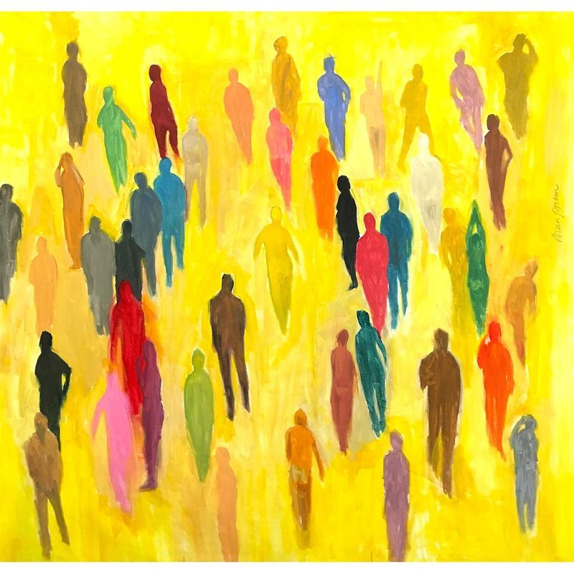
Session 9:
Creating Change through Community
Notes:
AKO

