Slide 1

Amplify
Women and Gender Initiative

Slide 2



Slide 3
Session Schedule
Every Friday from 12 Noon to 1:30 p.m. from April 30 – June 18, 2021
Session 1 (4/30/21) Amplifying Yourself and Others
Session 2 (5/7/21) Deconstructing Gender and Leadership
Session 4 (5/21/21) Cracking the Confidence Code
Session 3 (5/14/21) Expanding Identity to Values and Strengths
Session 5 (5/28/21) Cultivating Resilience
Session 6 (6/4/21) Building Inclusive Organizations
Session 7 (6/11/21) Creating Change through Community
Session 8 (6/18/21) Sustaining a Movement

Slide 4

Creating Change through Community
Session 6 Activity
Women’s Communities
Men as Allies and Partners

Slide 5
Building
Inclusive
Organizations

Slide 6
Unpaid Labor Gap
In hetero couples, women perform 2x as much domestic work and childcare as their male partners
2 of 3 caregivers for elderly parents and sick family members are women
Women of color are asked to do more “office housework” than white women
Bianchi, S.M., et al. (2012). Housework: Who Did, Does or Will Do It, and How Much Does It Matter?
McKinsey & Co (2021). Creating a Postpandemic Recovery for Women in the Workplace

Slide 7
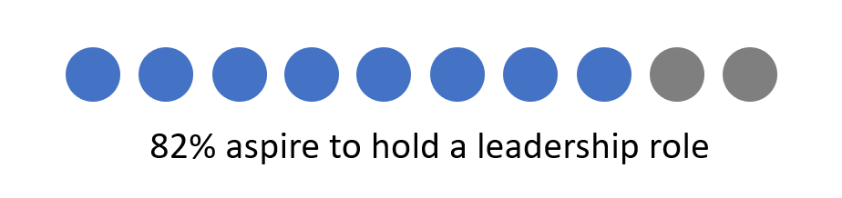
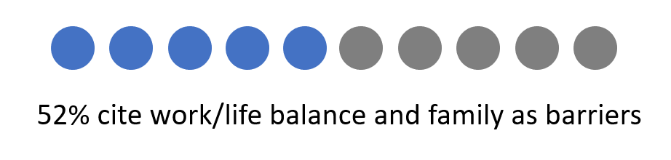
Impact of Unpaid Labor Gap in Advancement
v
Advancing Women’s Leadership Survey (2018)

Slide 8

Zoom Chat
Inclusion Barriers
What are the barriers for women who are caregivers (children, elderly parents, sick family members, etc.)?

Slide 9

Zoom
Discussion
Reframe Barriers as
Opportunities for Inclusion
How can we navigate these barriers?
How can we advocate for change?

Slide 10
Make caregiving visible and encourage it in others (especially men)
Distribute office housework equitably by using a rotating list
Flex “traditional” business hours to accommodate caregiving
Adjust expectations to avoid overburdening non-caregiving staff
Caregiving
Gender Equity Checklist

Slide 11
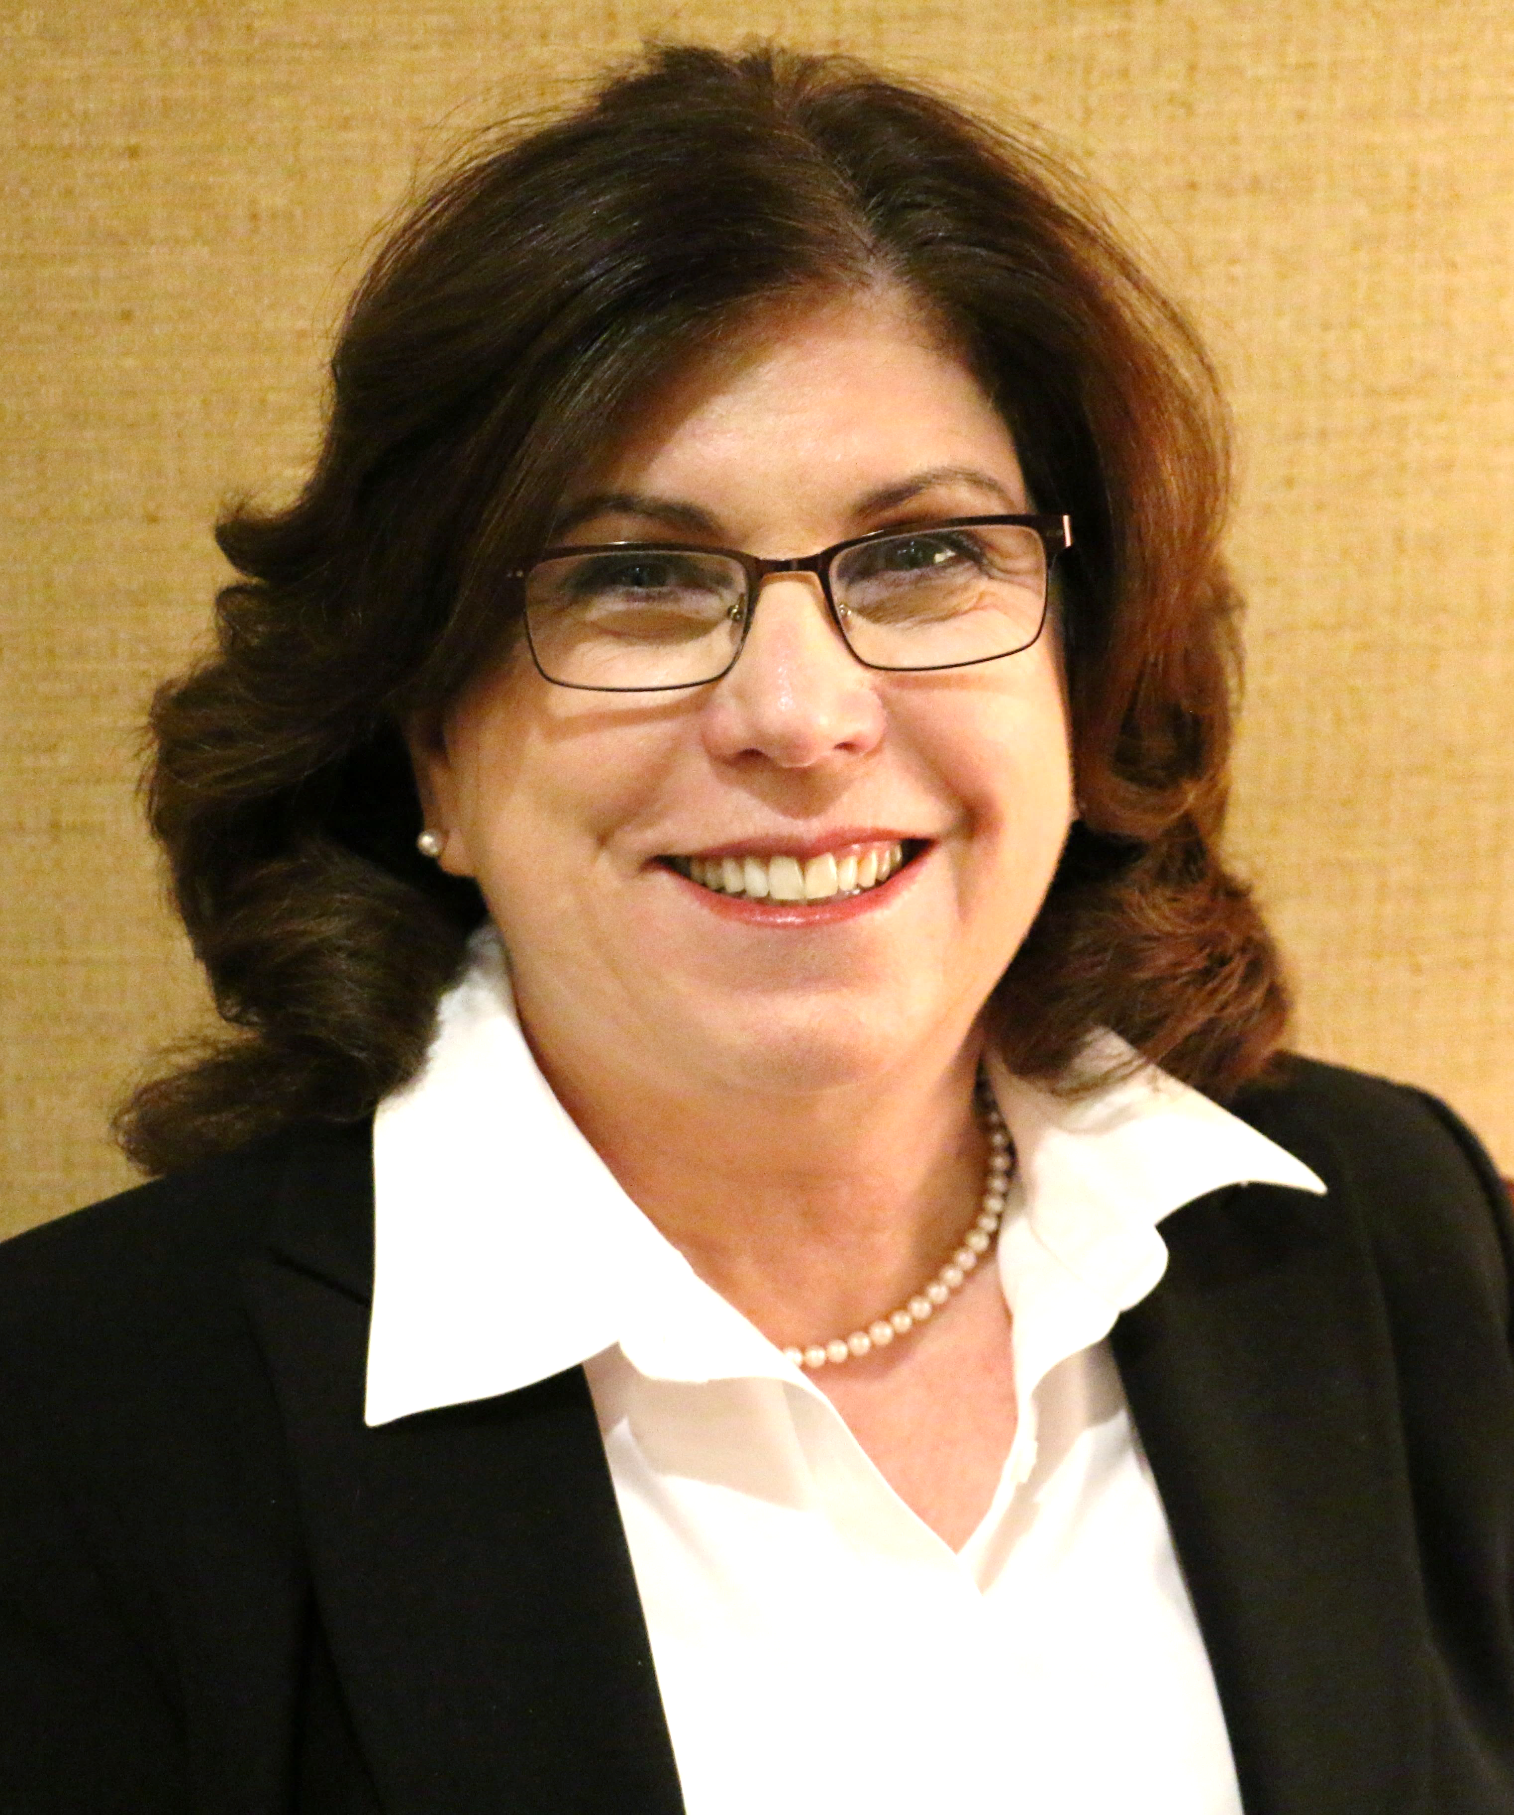
Susan Richardson
Boston University

Slide 12
Gender Gaps
Hiring and Promotion
Compensation
Unpaid Labor
COVID-19 “Shecession”

Slide 13
Change Strategies
Individual
Focus on your locus of control
Organizational
Identify the win-win-win (you-manager-org)
Play the long game
Align with a business priority
Gather data and testimonials
Learn from previous change efforts
Educate yourself about related policies
Treat everyone as an ally and partner

Slide 14
Creating Change through Community

Slide 15
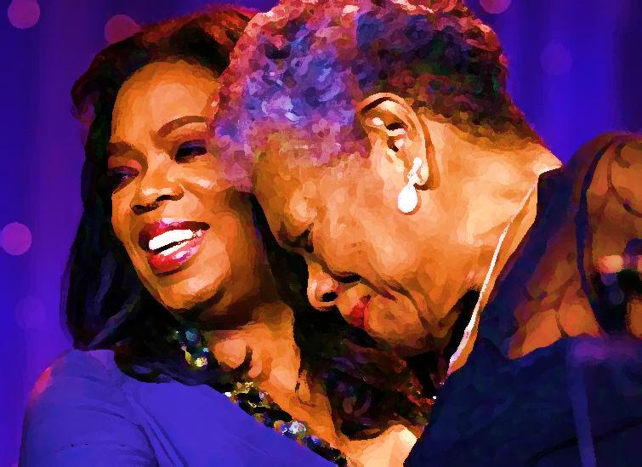
Oprah Winfrey
and Maya Angelou
I come as one, but I stand as 10,000.
Adapted from “Our Grandmothers” by Maya Angelou

Slide 16
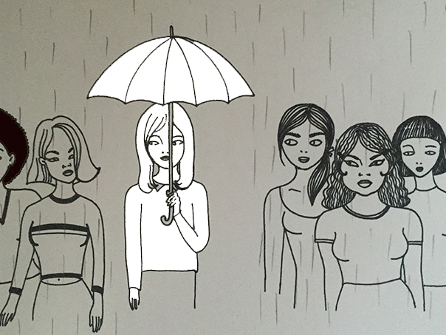
Women’s Communities

Slide 17

Horizontal Hostility
A manifestation of internalized oppression
Marginalized people believe, act on, or enforce dominant systems of oppression against each other
Can occur within marginalized communities or between marginalized communities

Slide 18

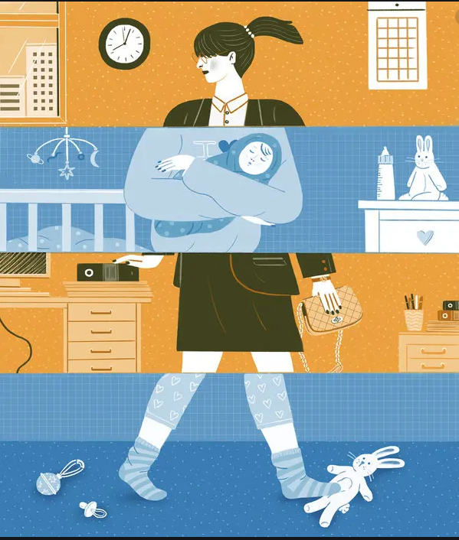
Women & Gender Examples
Racism within the feminist movement
Resentment against working parents
Exclusion of transgender women
Conflict over status and roles
  Mommy Wars
  Queen Bee Phenomenon
  Tripping the Prom Queen

Slide 19

Zoom Poll
Have you ever experienced horizontal hostility from other women?
Have you ever perpetuated it?

Slide 20
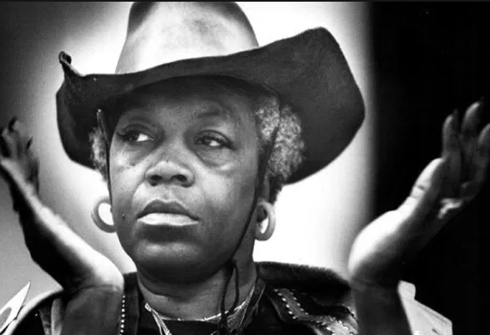
Florynce Kennedy
Lawyer, Civil Rights and Women’s Rights Advocate
Horizontal hostility…is misdirected anger that rightly should be focused on the external causes of oppression.

Slide 21
Zoom Chat
How can women in senior leadership roles better support women?

Slide 22
Zoom Chat
How can white women better support women of color?

Slide 23
Zoom Chat
How can cisgender hetero women better support LGBTQ women?

Slide 24
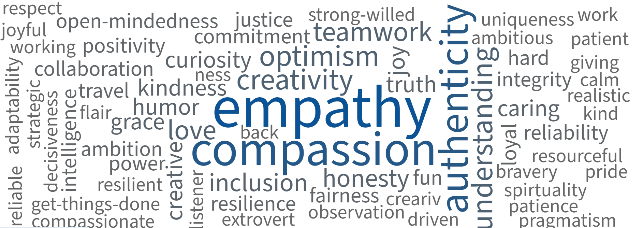

Community Strengths

Slide 25

Men as Allies and Partners

Slide 26
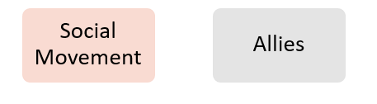
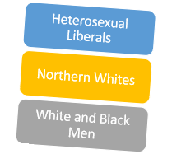
A person who uses their privilege to advocate for marginalized groups
Ally
Social Movement
Civil Rights
LGBTQ Rights
Allies
Northern Whites
Heterosexual Liberals
Women’s Suffrage
White and Black Men

Slide 27


Need for Men in the Movement
Women get less meaningful feedback from their managers
Women are less likely to have a sponsor
Women get less access to senior leaders, the majority of whom are men
  Almost 60% of women of color have never had an informal interaction with a senior leader
LeanIn.Org 2019 Working Relationships in the #MeToo Era: https://leanin.org/mentor-her
Notes:
60% of managers who are men in the US are uncomfortable participating in a common work activity with a woman, such as mentoring, working alone, or socializing together.
32% jump from last year.
1/3 of men say they’ve avoided mentoring/socializing because they were nervous about how it would look
We need to actively support women at work, including by mentoring and sponsoring them. Men—who are the majority of managers and senior leaders—can help make this happen

Slide 28
Men and the #MeToo Workplace
60% of men managers cited discomfort with common work activities such as mentoring, working alone, or socializing
30% of men say they’ve avoided mentoring and socializing
Hesitant to spend time with junior women
9x more likely to hesitate to travel together for work
6x more likely to hesitate to have work dinners
More uncomfortable working with a woman
Senior-level men are:
12x more likely to hesitate to have 1:1 mtgs
LeanIn.Org 2019 Working Relationships in the #MeToo Era: https://leanin.org/mentor-her
Notes:
Men managers are uncomfortable working with a woman
60% cited discomfort with common work activities (32% increase)
30% of men say they’ve avoided mentoring and socializing with women
Senior-level men are hesitant to spend time with junior women
12x more likely to hesitate to have 1-on-1 meetings
9x more likely to hesitate to travel together for work
6x more likely to hesitate to have work dinners

Slide 29
Poll Everywhere
How can men serve as better allies to women?
Go to POLLEV.COM
Enter username DARTMOUTH
Select JOIN
Complete the survey

Slide 30
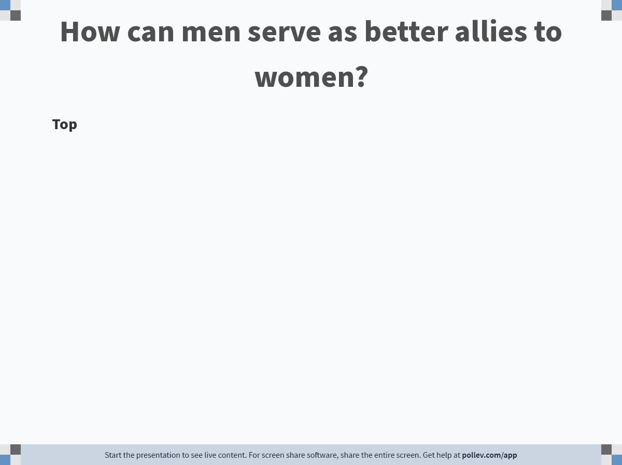
Notes:
Poll Title: Do not modify the notes in this section to avoid tampering with the Poll Everywhere activity.
More info at polleverywhere.com/support
How can men serve as better allies to women?
https://www.polleverywhere.com/discourses/XvJbLA921UvrlW88gc0ht

Slide 31
Men as Allies
Share opportunities
Do less, not more
Publicly celebrate accomplishments
Pass up and pass on
Acknowledge women’s contributions at mtgs.
Share the non-promotable workload
Volunteer for “office housework”
Redirect women’s volunteering for these tasks
Sponsor a woman
Create opportunities
Increase visibility, access, and connection
30 min. meet with a talented up-and-coming woman
5 min. congratulate a woman for a success or win
1 min. talk up the woman’s win to other colleagues
36 Minutes a Week
Five Simple Ways to be a Better Male Ally. JP Morgan Chase
Notes:
Spend 30 minutes a week having coffee with a talented up and coming woman.
Spend 5 minutes a week congratulating a female colleague on a win or success.
Spend 1 minute a week talking up the woman who had that win to other colleagues around the firm.

Slide 32

Allies & Partners Event
Join us to learn more about the Amplify program, hear from Amplify participants, and review gender equity strategies that you can implement at your institution.
Date: Friday, June 25, 2021
Time: 11 a.m. - Noon
Zoom Link: See Outlook calendar invite

Slide 33

Session 8:
Sustaining a Movement
Notes:
AKO

Slide 34
Amplify
Women and Gender Initiative

