Slide 1

Amplify
Women and Gender Initiative
Notes:
To Do:
Need to assign tables and make nametags. How will women find their table?
Room Set-Up
*Rolling PowerPoint with pro-woman music playing in background
Table Set-Up:
*Tent cards with names and institution
*Yellow binder preloaded with content
*Journal and pen
*List of values/superpowers on table
Binder Content:
*Bio sheet - Leads, Program Leads, and special guests
*Things to do in Boston
*Cover sheet for binder
*Retreat agenda
*Key dates
*Roles and responsibilities
*Social Justice Glossary
*Facilitation tips

Slide 2
Ideas
Inclusion strategies for caregivers, BIPOC, hierarchy (Zoom breakouts or fishbowl)
  Poll: Where/how do you feel excluded?
  Fishbowl
Inclusion strategies for orgs - policy
  Hiring
  Talent audits
  Pay equity
  Equity pathways
Inclusion strategies by campus (polleverywhere?)

Slide 3

Zoom Chat
What one word describes how you’re doing today?
Notes:
AB (2-3 min)
Amy will greet and ask people to respond to the question in the chat
Alexis will manage any Zoom issues (e.g., joining the call, muting themselves, etc.)
Patricia will post the question “What’s one word that describes how you’re doing today?” in the chat.
Please re-post this every few minutes because new participants won’t see the original question

Slide 4
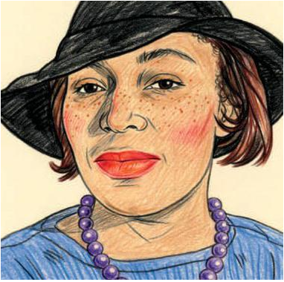
Zora Neale Hurston
author, anthropologist
Grab the broom of anger and drive off the beast of fear.
https://www.scribd.com/article/380218822/Zora-S-Lost-Book

Slide 5
Educational Pathways for White Women
Introductory
What it takes to be racially literate (TEDWomen)
Celebrate Women’s Suffrage, but Don’t Whitewash the Movement’s Racism (ACLU)
Intermediate
Color blind or color brave? (TED Talk)
The “white fragility” that prevents white Americans from confronting racism (New Yorker)
Don’t understand the protests? What you’re seeing is people pushed to the edge (LA Times)
Advanced
The urgency of intersectionality (TEDWomen)
How white women use themselves as instruments of terror (Chicago Tribune)

Slide 6
Ally Action
Support your black colleagues in ways that are truly helpful
  5 ways to start being a better ally for your black coworkers
  3 things you should not say to your black colleagues right now
Frequent black-owned businesses
  How to Find Black Owned Businesses
  7 Black Owned Businesses to Support Right Now
Sign a petition for justice and police reform
  NAACP We Are Done Dying
Lead a White Accountability Group in your organization
  Click here for info and handout
  Email wasracialjustice@gmail.com to join a facilitator group

Slide 7

Zoom
Breakouts
Discussion Group Options
Go into a breakout room to discuss actions that you can take as an ally
Stay in the main session with Alexis to discuss the needs of women of color
Take a break, reflect, and rejoin the call in 15 minutes.
Notes:
AB (2-3 min)
Amy will greet and ask people to respond to the question in the chat
Alexis will manage any Zoom issues (e.g., joining the call, muting themselves, etc.)
Patricia will post the question “What’s one word that describes how you’re doing today?” in the chat.
Please re-post this every few minutes because new participants won’t see the original question

Slide 8

Journal
Private Reflection
What did you notice?
How did it feel?
What are you going to do?

Slide 9

Amplify Sessions
Session 1 (5/1/20) Amplifying Yourself and Others
Session 2 (5/8/20) Deconstructing Gender and Leadership
Session 3 (5/15/20) Expanding Identity to Values and Strengths
Session 4 (5/22/20) Cracking the Confidence Code
Session 5 (5/29/20) Cultivating Resilience
Session 6 (6/5/20) Building Inclusive Organizations
Session 7 (6/12/20) Creating Change through Community
Session 8 (6/19/20) Sustaining a Movement
Make-up sessions will take place Wednesdays at 4 p.m. Zoom info on the website.
Notes:
AKO

Slide 10
Building
Inclusive
Organizations
Session 6 • June 5, 2020
Social Justice in Organizations
Gender Diversity and Gaps
Tactics that Actually Work

Slide 11
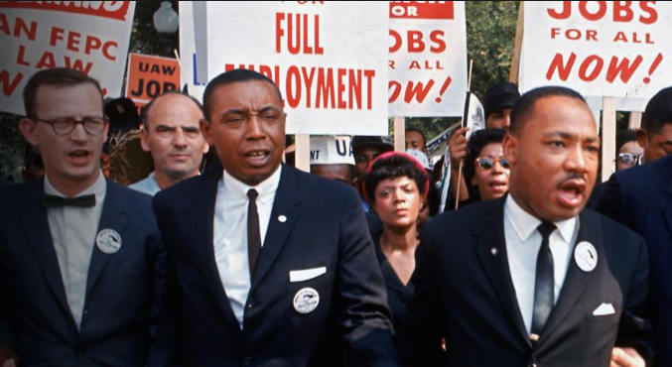

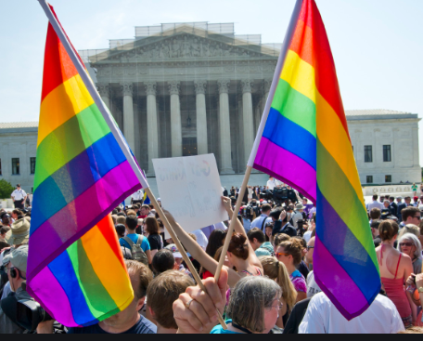
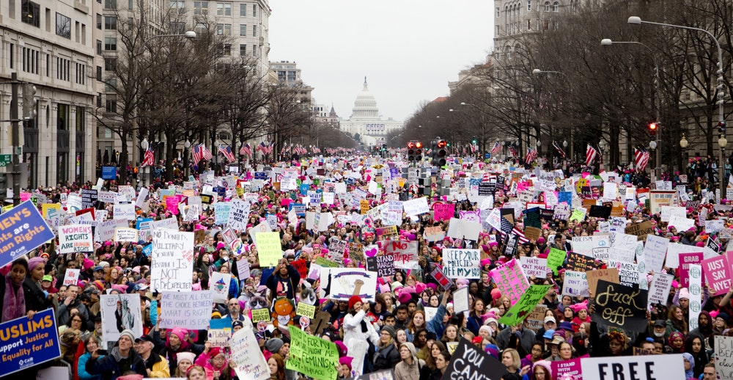
Until people with diverse identities have full access to all levels of our organizations, they will not have full access to society.
Notes:
The Civil Rights movement and more recently the women’s movement. But these are not the only places where leadership and social justice intersect. They also intersect in our organizations, which reflect and perpetuate society.
I have been a student and teacher of leadership for more than 20 years. In the classroom as a teacher, in the training room as a facilitator. I’ve also been in positions of leadership – both formal and informal.
I have taught students with privileged identities as well as minoritized and marginalized identities.
I have sat across the table from the most powerful leaders at my institution AND the most vulnerable staff.
From these vantage points, I know this much to be true. Social justice and the dynamics of power/privilege/oppression are part of every organization, in every industry.
This is problematic because in modern economies like ours, organizations are the purveyors of wealth and status. They create and sustain society.
So it follows that until people with diverse identities have access to all levels of these organizations, they will not have full access to society.
This has real consequences. Social injustices that play out in every sector, from higher education to private industry to our communities and the streets of America.

Slide 12
Value of Gender Diversity
Improves organizational and financial performance
Facilitates more creative and effective decision making
Increases innovation while also lowering risk
Decreases bias, harassment, and other inequities
Krawcheck, S. (2017). Own It: The Power of Women at Work
Notes:
Who is taking notes during meetings? Who is volunteering? Women more likely to volunteer.
Who is speaking up more in meetings? “Men speak more than women in professional meetings, interrupt more frequently
And women are twice as likely as men to be interrupted (even more so if you are a
Woman of color).”
Who is organizing staff gatherings, meals, potlucks, socials?

Slide 13
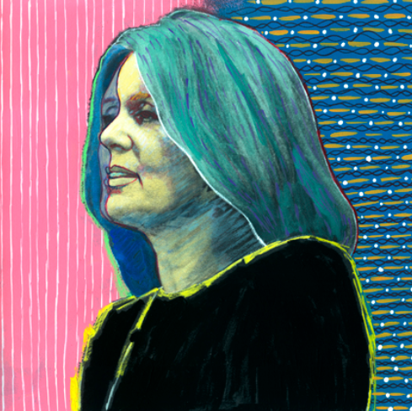
Gloria Steinem
Feminist journalist and political activist
The truth will set you free,
but first it will piss you off.
https://www.haveartwilltravel.org/prints/mood-portraits/gloria-449/

Slide 14
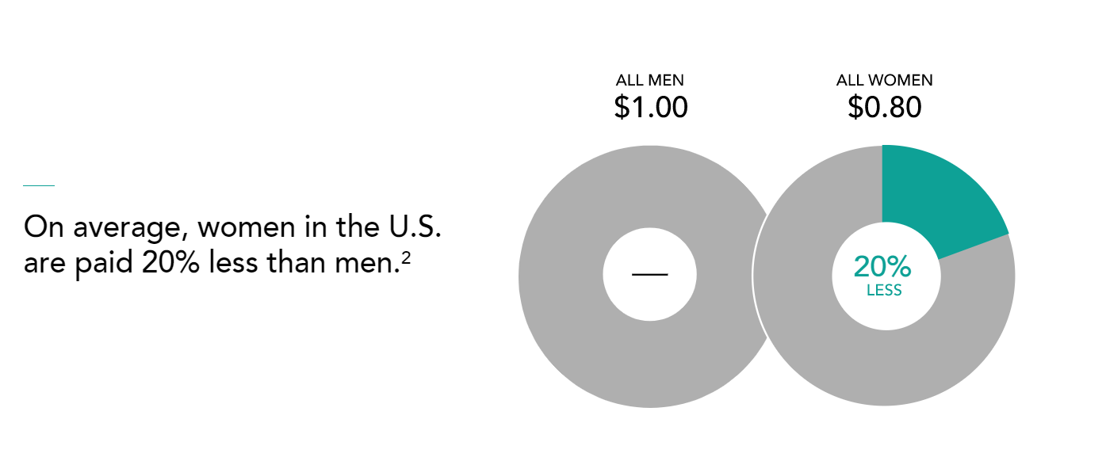
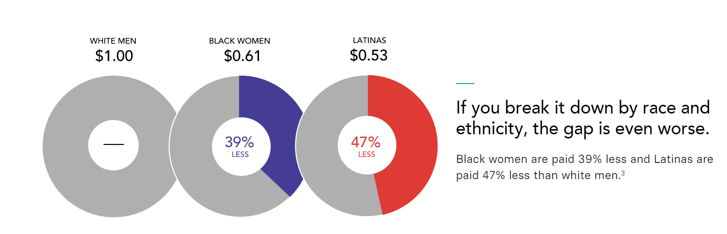
Compensation Gap
ALL MEN
ALL WOMEN
On average, women in the U.S. are paid 20% less than men.
WHITE MEN
BLACK WOMEN
LATINAS
If you break it down by race and ethnicity, the gap is even worse.
Black women are paid 39% less and Latinas are paid 47% less than white men.
Women in the Workplace 2018 Report by McKinsey & Company https://leanin.org/women-in-the-workplace-report-2018/men-still-outnumber-women-at-every-level
Notes:
Any way you look at it, there’s a pay gap for women.
When you control for important factors such as education, experience, industry, occupation, role, and hours worked, the pay gap still exists.

Slide 15

$15,000-20,000
$15,00 – 20,000
Gender accounts for a 10% difference in salaries between male and female fundraisers.
Average amount that female fundraisers are paid less than male fundraisers
Average amount that female fundraisers are paid less than male fundraisers
The Impact of Gender on Fundraising Salaries 2014-2018 https://afpglobal.org/sites/default/files/attachments/2019-03/EffectofGenderonFundraisingSalaries2019.pdf
Notes:
Again, this is a problem. Case in point, dealing with sexual harassment in the profession. One of the top 3 remedies for combatting sexual harassment is to have gender diversity at the leadership level.
I remember a conversation with some leaders about a donor who was consistently behaving inappropriately at away football games. He would ask women fundraisers to join him in his hotel room for an after-party.
The men in the room said the women just needed to decline the invitation and ignore it but still keep the donor in their pipeline.
But the women? They said, “Nope. We need to do something about this behavior and protect our fundraisers, present and future. And not only that, we need a division-wide policy with trainings on what is and is not appropriate behavior and how to manage it.”
This is what diversity does. It helps our organizations and our people.
Now let’s take a look at race.

Slide 16
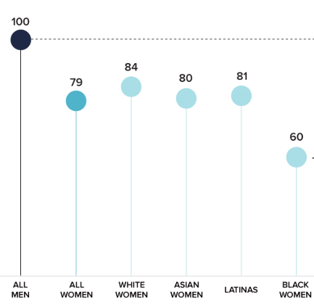
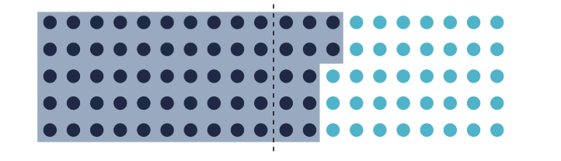
Hiring and Promotion Gap
Ratio of promotions to manager
for men vs. women
% of manager positions held
by men vs. women
62%
50%
38%
ALL MEN
ALL WOMEN
Women in the Workplace 2018 Report by McKinsey & Company https://leanin.org/women-in-the-workplace-report-2018/men-still-outnumber-women-at-every-level
Notes:
Women are less likely to be hired into manager-level jobs, and they are far less likely to be promoted into them - for every 100 men promoted to manager, 79 women are. Largely because of these gender gaps, men end up holding 62% of manager positions, while women hold only 38%.

Slide 17


AFP membership is 70% female, but 4 out of 5 senior positions in fundraising are held by males.
Among the CASE 50 Institutions, only 26% are headed by female Chief Advancement Officers.
2018 statistics reported by the Educational Advisory Board and the Association of Fundraising Professionals.
Notes:
AKO –
3:00 p.m. Gender and Leadership (AKO)
3:00-3:15 p.m.: Inside/outside the box in large group (15 min)
3:15-3:30 p.m.: Large group debrief (15 min)
3:30-4:00 p.m.: Create posters (30 min)
4:00-4:30 p.m.: Poster presentations
This has implications in Advancement – in our organizations. (Refer to stats)
Why is this a problem?
In modern societies, orgs are conveners of wealth and status. Until women get full access to all levels of an org, they don’t have full access to society.
One of the top 3 remedies for combatting sexual harassment is to have gender diversity at the leadership level.
I remember a conversation with some leaders about a donor who was consistently behaving inappropriately at away football games. He would ask women fundraisers to join him in his hotel room for an after-party. The men in the room said the women just needed to decline the invitation and ignore it but still keep the donor in their pipeline.
But the women? They said, “Nope. We need to do something about this behavior and protect our fundraisers, present and future. And not only that, we need a division-wide policy with trainings on what is and is not appropriate behavior and how to manage it.”
This policy ended up helping men as well. There was a DO who went to a donors house and when he excused himself to use the restroom, found a large hunting knife laying across the sink. He knew to get out of there right away because he was uncomfortable.
This is what diversity does. It helps all of the people in the organization.

Slide 18
Unpaid Labor Gap
Women perform 2x as much domestic work and childcare as their male partners.
2 of 3 caregivers for elderly parents and family members are women.
77% of men think they spend equivalent time with household and care-related tasks. Only 40% of women agree.
Bianchi, S.M., et al. (2012). Housework: Who Did, Does or Will Do It, and How Much Does It Matter?
McKinsey & Co (2021). Creating a Postpandemic Recovery for Women in the Workplace

Slide 19
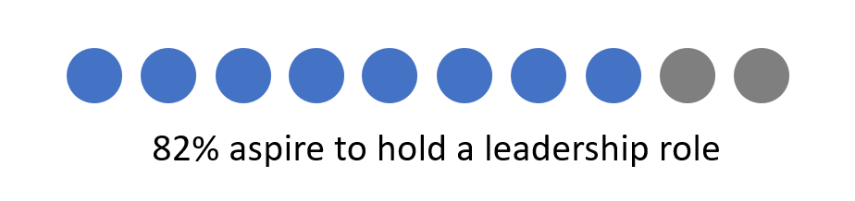
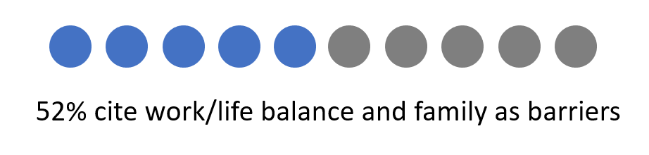
Career Aspirations
When Women Can’t Do It All
v
Advancing Women’s Leadership Survey (2018)

Slide 20
COVID-19
1 in 3 women are considering downshifting or leaving their careers
Women have lost 1 million more jobs than men
Employment for women is projected to recover two full years after that of men
Lean In and McKinsely and Co. (2021) Women in the Workplace Study
Center for American Progress (2021) When Women Lose All the Jobs: Essential actions for a Gender-Equitable Recovery
Fortune (2021) COVID-19 Has Driven Millions of Women Out of the Workforce. Here’s How to Help Them Come Back

Slide 21
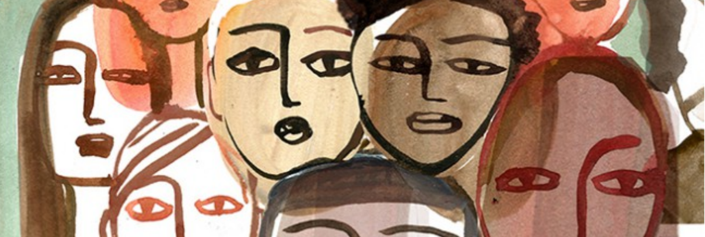
Standpoint Theory
Knowledge stems from social position or “standpoint”
Marginalized people have access to knowledge that is not available to those with privilege
All forms of inquiry and change should begin with the lives of the marginalized
Reframe “objectivity” as “collective subjectivity”
Navigate the dominant narrative by creating new ones
Advocate for solutions that come from marginalized groups

Slide 22
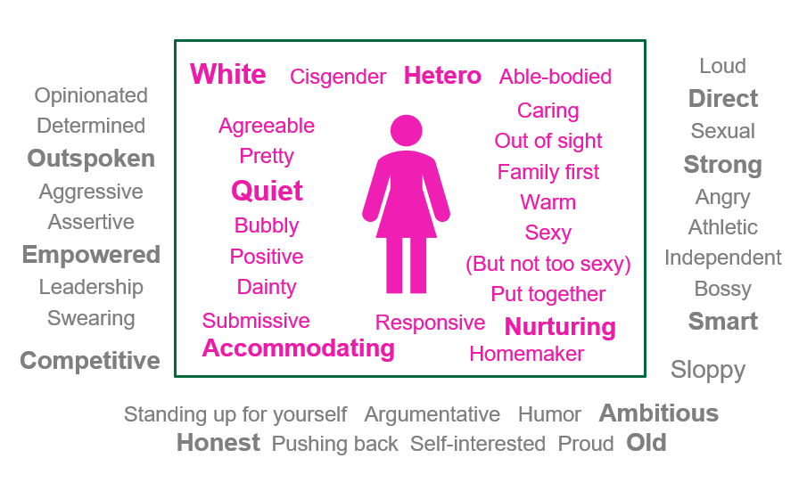
Boxed in by Idealized Femininity
Home Edition

Slide 23
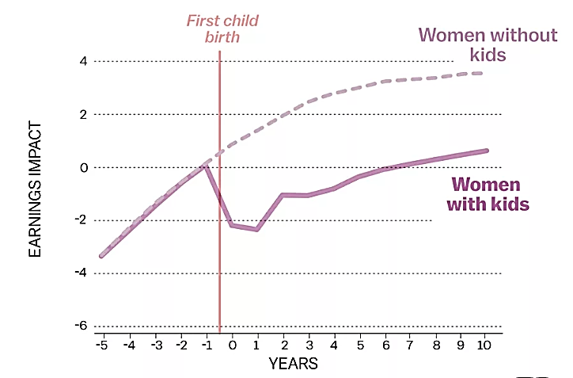
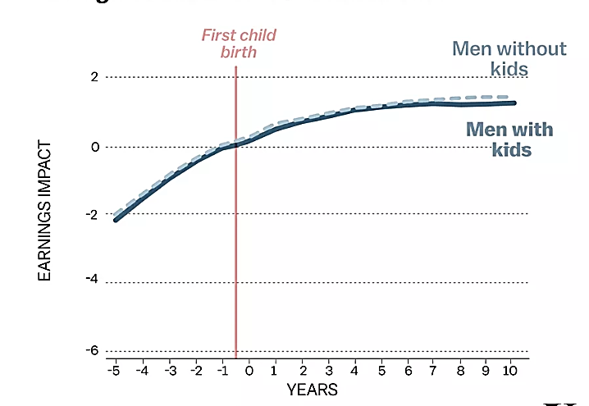
Wage Gap
Kids Impact Women’s Earnings But Not Men’s
Kliff, Sarah. (2018). “A Stunning Chart Shows the True Cause of the Gender Wage Gap” https://www.vox.com/2018/2/19/17018380/gender-wage-gap-childcare-penalty

Slide 24
3 Tactics That Actually Work
Advocate
Focus on performance and results for hiring, evaluation, salary, and promotion decisions
Reframe
Identify biases that limit women and other marginalized groups
Engage men/senior leaders in mentorship and sponsorship to increase visibility and access
Navigate

Slide 25
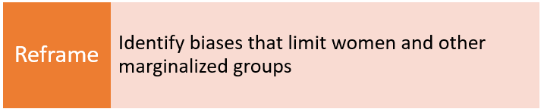
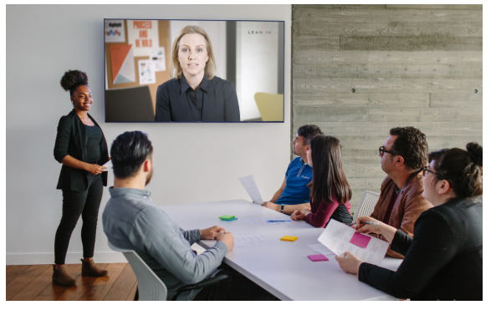
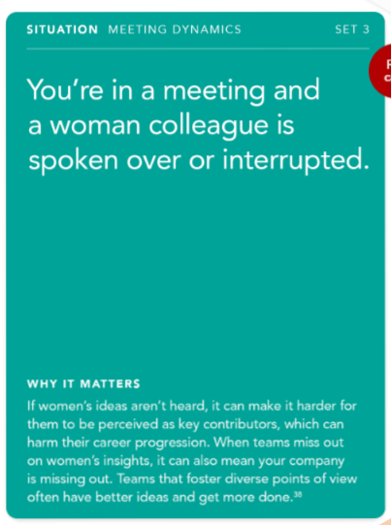
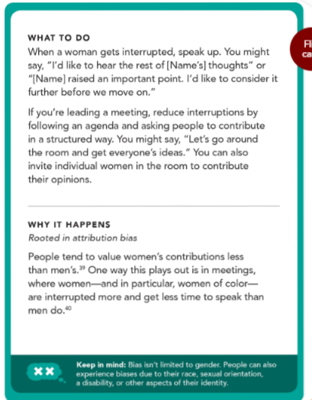
50 Ways to Fight Bias by Lean In

Slide 26
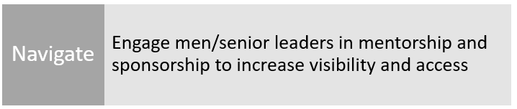
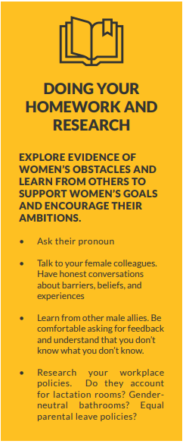
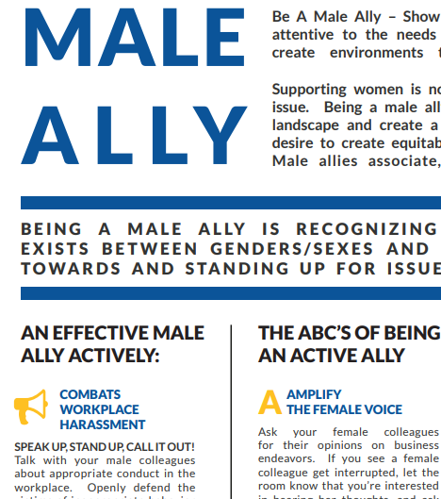
Male Allyship Awareness by AFP

Slide 27
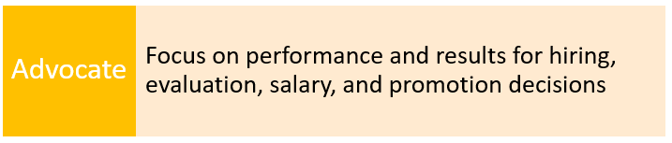
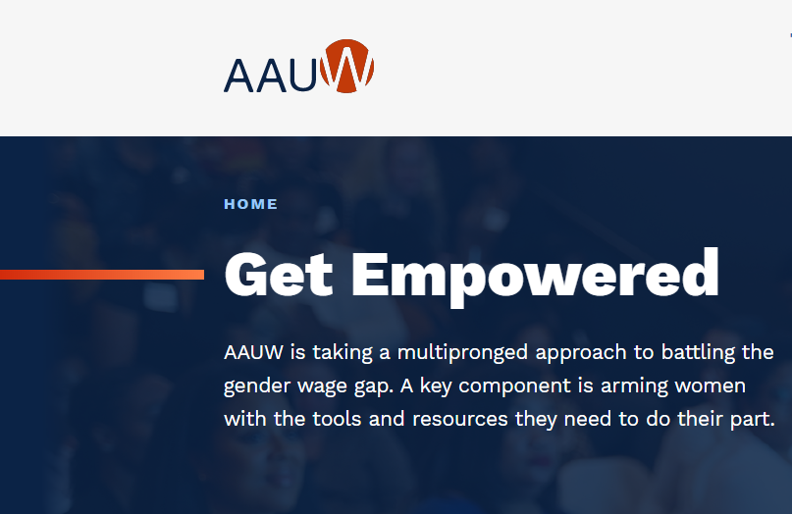
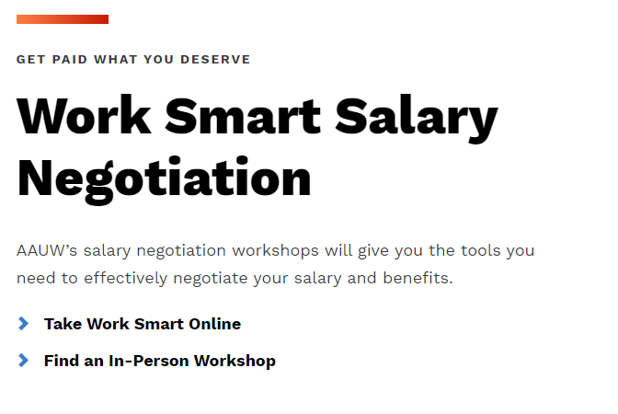
Get Empowered by AAUW

Slide 28
From Inclusion to Belonging
Diversity
Race
Gender
Class
Inclusion
Affirmed
Belonging
Relationship
Welcomed
Valued

Slide 29
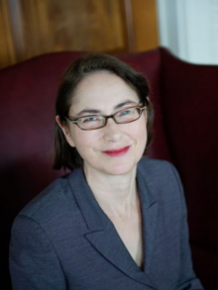
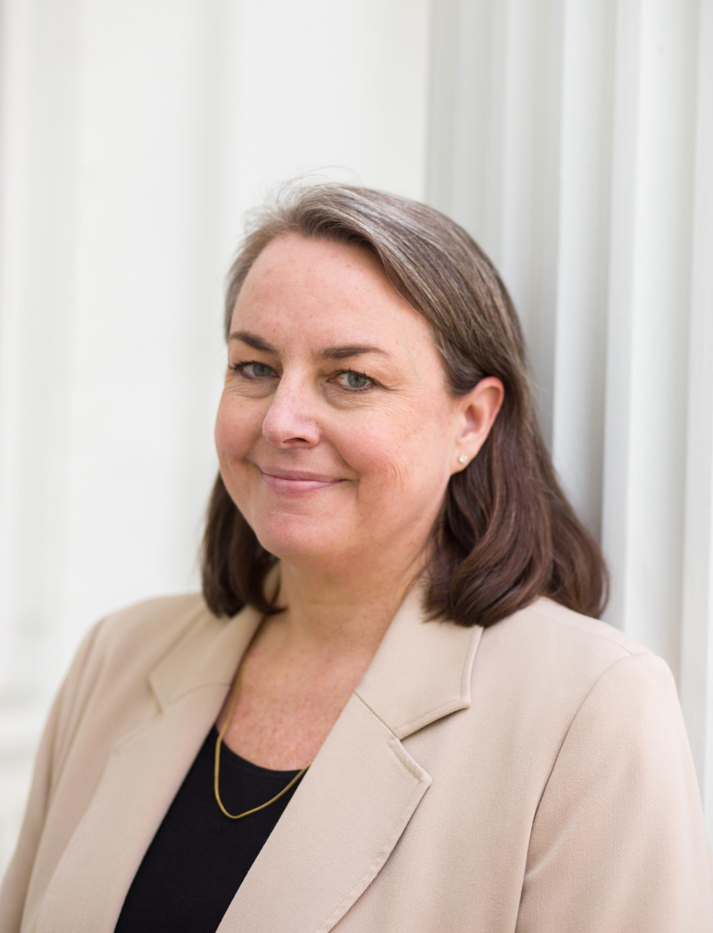
Karen Engelbourg
Senior Vice President
Development & Alumni Relations
Boston University
Ann Root Keith
Chief Operating Officer
Advancement Division
Dartmouth College

Slide 30
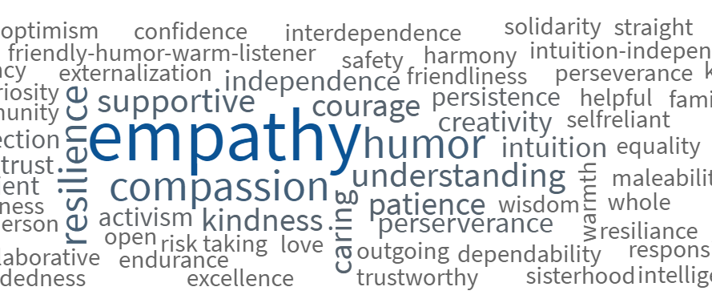
What values/superpowers guide your leadership?

Slide 31
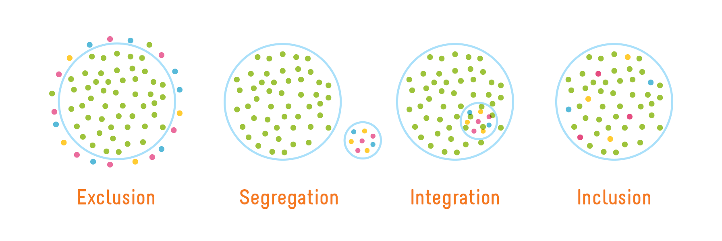
From Exclusion to Inclusion
Image credit: Playcore https://www.playcore.com/inclusive-play-matters-1
Notes:
AKO
Amplify is a women and GENDER initiative. Everyone is impacted by gender. Not everyone identifies with a gender that aligns with their assigned sex at birth.

Slide 32
Intersectionality or bust
gender
class
race
intersectionality
Image credit: Jennifer L. Le, Ph.D.
Image credit: Jennifer L. Le, Ph.D.
Notes:
AKO
Identities are not discrete qualities. They overlap with each other to create unique experiences. For example, when we’re talking about women’s issues – let’s take sexual harassment – which is really a men’s issue but whatevs. Age can play a big role in how that’s interpreted.

Slide 33
Leadership Panel
Applying the Amplify skills
Reframing
To look at something in a new way
Navigating
To avoid or go around obstacles
Advocating
To create change for self and others
In what ways have you advocated for yourself and/or other women?
When have you navigated exclusion based on your gender and/or other identity?
How have you reframed difficult challenges into inspiring opportunities?
Notes:
AKO

Slide 34

Thank you!

Slide 35
Amplify Leadership Panel

