Slide 1

Amplify
Women and Gender Initiative
Notes:
Alexis

Slide 2

Zoom Chat
Did anyone send their supervisor email?
How did it go?
Notes:
Alexis
12-12:02

Slide 3
Amplify Updates
Amplify Allies and Partners Event (6/25/21)
Amplify website (Outlook calendar invite)
Juneteenth plans
Mid-Program Feedback
Notes:
Alexis
12:02-05

Slide 4
Session Schedule
Every Friday from 12 Noon to 1:30 p.m. from April 30 – June 18, 2021
Session 1 (4/30/21) Amplifying Yourself and Others
Session 2 (5/7/21) Deconstructing Gender and Leadership
Session 4 (5/21/21) Cracking the Confidence Code
Session 3 (5/14/21) Expanding Identity to Values and Strengths
Session 5 (5/28/21) Cultivating Resilience
Session 6 (6/4/21) Building Inclusive Organizations
Session 7 (6/11/21) Creating Change through Community
Session 8 (6/18/21) Sustaining a Movement
Notes:
Alexis
12:05

Slide 5

Cultivating
Resilience
Session 5
Review Session 4
Self-Compassion
Zoom Breakouts
Practice Exercise
Notes:
Alexis
12:06

Slide 6
Session 4:
Cracking the
Confidence Code
Notes:
Alexis transitions to Amy at 12:06

Slide 7
The Confidence Myth
Competence + Confidence → Action
Kay, K., & Shipman, C. (2014). The Confidence Code: The Science and Art of Self-Assurance--What Women Should Know.
Mohr, Tara. (2014). Playing Big: Find Your Voice, Your Mission, Your Message
Notes:
Amy 12:06
Last week, we busted the Confidence Myth that says you have to FEEL confident before taking action.

Slide 8
The Confidence Myth
Competence + Confidence → Action
Kay, K., & Shipman, C. (2014). The Confidence Code: The Science and Art of Self-Assurance--What Women Should Know.
Mohr, Tara. (2014). Playing Big: Find Your Voice, Your Mission, Your Message
Notes:
Amy 12:07
Given that people with marginalized and minoritized identities tend to feel less confident, due to no fault of their own mind you, the Confidence Myth is especially challenging and keeps many of us feeling stuck.
This can cause us to waste valuable time when we could be taking action.

Slide 9
The Confidence Myth
Competence + Action → Confidence
Kay, K., & Shipman, C. (2014). The Confidence Code: The Science and Art of Self-Assurance--What Women Should Know.
Mohr, Tara. (2014). Playing Big: Find Your Voice, Your Mission, Your Message
Notes:
Amy 12:08
And this is important because it’s action that actually makes us feel more confident. Not the other way around.
These actions don’t have to be heroic or grand. They are often small and involve only a moderate amount of risk.

Slide 10
Confidence Continuum
Step 1
Step 2
Chart along a continuum
Step 3
Step 4
Write down action steps
Identify a goal
Rank order by risk/fear
Step 5
Take 1 action* in 1 week
*The action must involve another person (email, meeting, phone call, etc.)
Notes:
Amy 12:09
To help you identify an action, we learned about the Confidence Continuum.
So out of curiosity, we’d like to get a sense of how many of you experimented with the Confidence Continuum and took the “one action in one week”

Slide 11

Zoom Poll
Did you take your 1 action?
Yes!!
Sort of?
It’s on my To Do List!
Nope. And I feel zero guilt about it.
Notes:
Amy 12:10-12
*Facilitate the poll and make a few comments when results are shared.

Slide 12

Corinne Barber
Brown University
Notes:
Amy 12:12-16
And now we’re going to hear from Corinne Barber, an Amplify Lead from Brown University.
Corinne is going to talk about her experiences with confidence and taking action.
Welcome Corinne!

Slide 13
Cultivating
Resilience*
*Self-Compassion
Notes:
Alexis
12:17

Slide 14


Resilience vs. Self-Compassion
Resilience
Process of adapting well in the face of trauma
Self-Compassion
Emotionally-supportive attitude toward self
Notes:
Alexis
12:18-20

Slide 15

Self-Compassion
Synonyms: self-love, self-acceptance, self-preservation
Brené Brown
In a society that says, ‘Put yourself last,’ self-love and self-acceptance are almost revolutionary.
Notes:
Alexis
12:20-22

Slide 16
Caregivers
(children, elderly parents, sick family members, fur babies, etc.)
Self-Compassion
Synonyms: self-love, self-acceptance, self-preservation
Drop the ball
Forgiveness
Notes:
Alexis
12:25-26

Slide 17

Self-Compassion
Synonyms: self-love, self-acceptance, self-preservation
Audre Lorde
Caring for myself is not self-indulgence, it is self-preservation, and that is an act of political warfare.
Notes:
Alexis
12:20-22

Slide 18
Black, Indigenous, and People of Color
Self-Compassion
Synonyms: self-love, self-acceptance, self-preservation
Rest
Joy
Notes:
Alexis
12:23-24

Slide 19
LGBTQ
Self-Compassion
Synonyms: self-love, self-acceptance, self-preservation
Defining your LGBTQ self
Being more than your gender and sexual orientation
Singh, A. A. (2018). The Queer and Transgender Resilience Workbook.
Notes:
Alexis
12:24-25

Slide 20

Confidence Continuum
Planning Mtgs.
Registration Process
Retreat Agenda
Retreat Day 1
Retreat Day 2
Self-Compassion Safety Net
Notes:
Alexis 12:22-23

Slide 21
Self-Compassion Safety Net
Common Humanity vs. Isolation
Mindfulness vs. Over-identification
Self-kindness vs. Self-judgment
https://self-compassion.org/the-three-elements-of-self-compassion-2/
Notes:
Alexis 12:23-26

Slide 22
Self-Compassion Safety Net
Common Humanity vs. Isolation
View our personal experiences as part of a much larger human experience
Mindfulness vs. Over-identification
Take a balanced approach to our emotions, neither suppressing nor overreacting
Self-kindness vs. Self-judgment
Accept and forgive ourselves when we suffer, fail, or feel inadequate
https://self-compassion.org/the-three-elements-of-self-compassion-2/
Notes:
Alexis 12:26

Slide 23
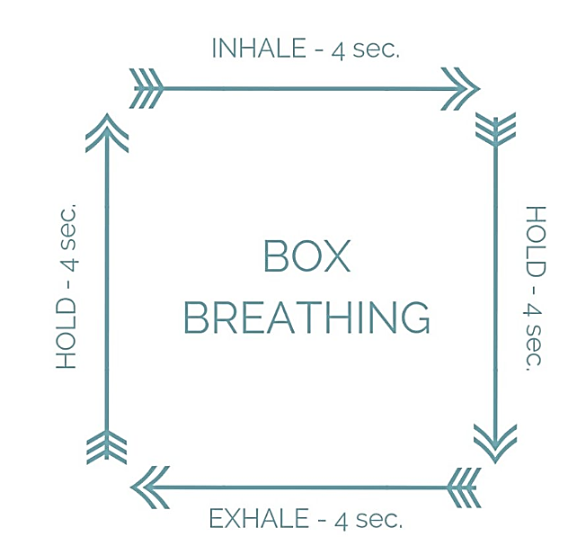
Mindfulness vs. Over-identification
Name
5 Things
Notes:
Alexis 12:27-29

Slide 24
Self-Compassion Safety Net
Common Humanity vs. Isolation
View our personal experiences as part of a much larger human experience
Mindfulness vs. Over-identification
Take a balanced approach to our emotions, neither suppressing nor overreacting
Self-kindness vs. Self-judgment
Accept and forgive ourselves when we suffer, fail, or feel inadequate
https://self-compassion.org/the-three-elements-of-self-compassion-2/
Notes:
Alexis 12:29

Slide 25
Common Humanity vs. Isolation
Taking and Sending Meditation
Rest your mind for a second of stillness
Breathe in all the feels (e.g., sadness, anger, fear)
Breathe out all the good (e.g., happiness, peace, love)
Focus on your personal situation
  Breathe in all the feels/breathe out all the good
Expand your focus to others
  Breathe in all the feels/breathe out all the good
https://www.lionsroar.com/how-to-practice-tonglen/
Notes:
Alexis 12:29-32

Slide 26
Self-Compassion Safety Net
Common Humanity vs. Isolation
View our personal experiences as part of a much larger human experience
Mindfulness vs. Over-identification
Take a balanced approach to our emotions, neither suppressing nor overreacting
Self-kindness vs. Self-judgment
Accept and forgive ourselves when we suffer, fail, or feel inadequate
https://self-compassion.org/the-three-elements-of-self-compassion-2/
Notes:
Alexis 12:33

Slide 27

Self-Kindness vs. Self-Judgment
Letter from Your Future Self
20 Years from Today
Dear (Your First Name),
This is your future self, and this is what I’d like you to know…
Notes:
Alexis 12:34-6

Slide 28
Self-Compassion Safety Net
Revisit your Confidence Continuum and practice one of the elements.
Common Humanity vs. Isolation
Taking & Sending Meditation
Mindfulness vs. Over-identification
1. Box Breathing
Inhale
Self-kindness vs. Self-judgment
Letter from your Future Self
Hold
Exhale
Hold
4 seconds each:
Breathe in the bad stuff
Breathe out the good stuff
Focus on self
Expand to others
Dear (Your Name), This is your future self, and this is what I’d like you to know
2. Name 5 Things
https://self-compassion.org/the-three-elements-of-self-compassion-2/
Notes:
Alexis 12:35-44

Slide 29

Zoom Chat
& Breakouts
What was that like?
Notes:
12:22-30

Slide 30
Confidence Continuum
Step 1
Step 2
Chart along a continuum
Step 3
Step 4
Write down action steps
Identify a goal
Rank order by risk/fear
Step 5
Take 1 action in 1 week
Deploy as needed
Self-Compassion
Safety Net

Slide 31
Confidence Continuum
Step 1
Step 2
Chart along a continuum
Step 3
Step 4
Write down action steps
Identify a goal
Rank order by risk/fear
Step 5
Take 1 action in 1 week
Deploy as needed
Self-Compassion
Safety Net

Slide 32
Applying the Amplify Skills
Navigating: To avoid or go around obstacles
Advocating: To create change for self and others
How can self-compassion help you reframe a current challenge?
How can self-compassion help you advocate for something you need?
Reframing: To look at something in a new way
How can self-compassion help you navigate a current obstacle?
Notes:
Alexis
Alexis 12:45

Slide 33


Session 6:
Building Inclusive Organizations
Image Credit: Deloitte Insights
Notes:
AKO

Slide 34
Zoom Chat
& Breakouts
What have you been doing for self-care this year?
Zoom Breakouts
Take turns introducing yourself and sharing your answers
Person with birthday closest to today goes first (Happy Birthday!)

