Slide 1

Amplify
Women and Gender Initiative

Slide 2

Amplifying
Yourself
& Others
Session 1 | April 30, 2021

Slide 3
Amplify Overview

Slide 4

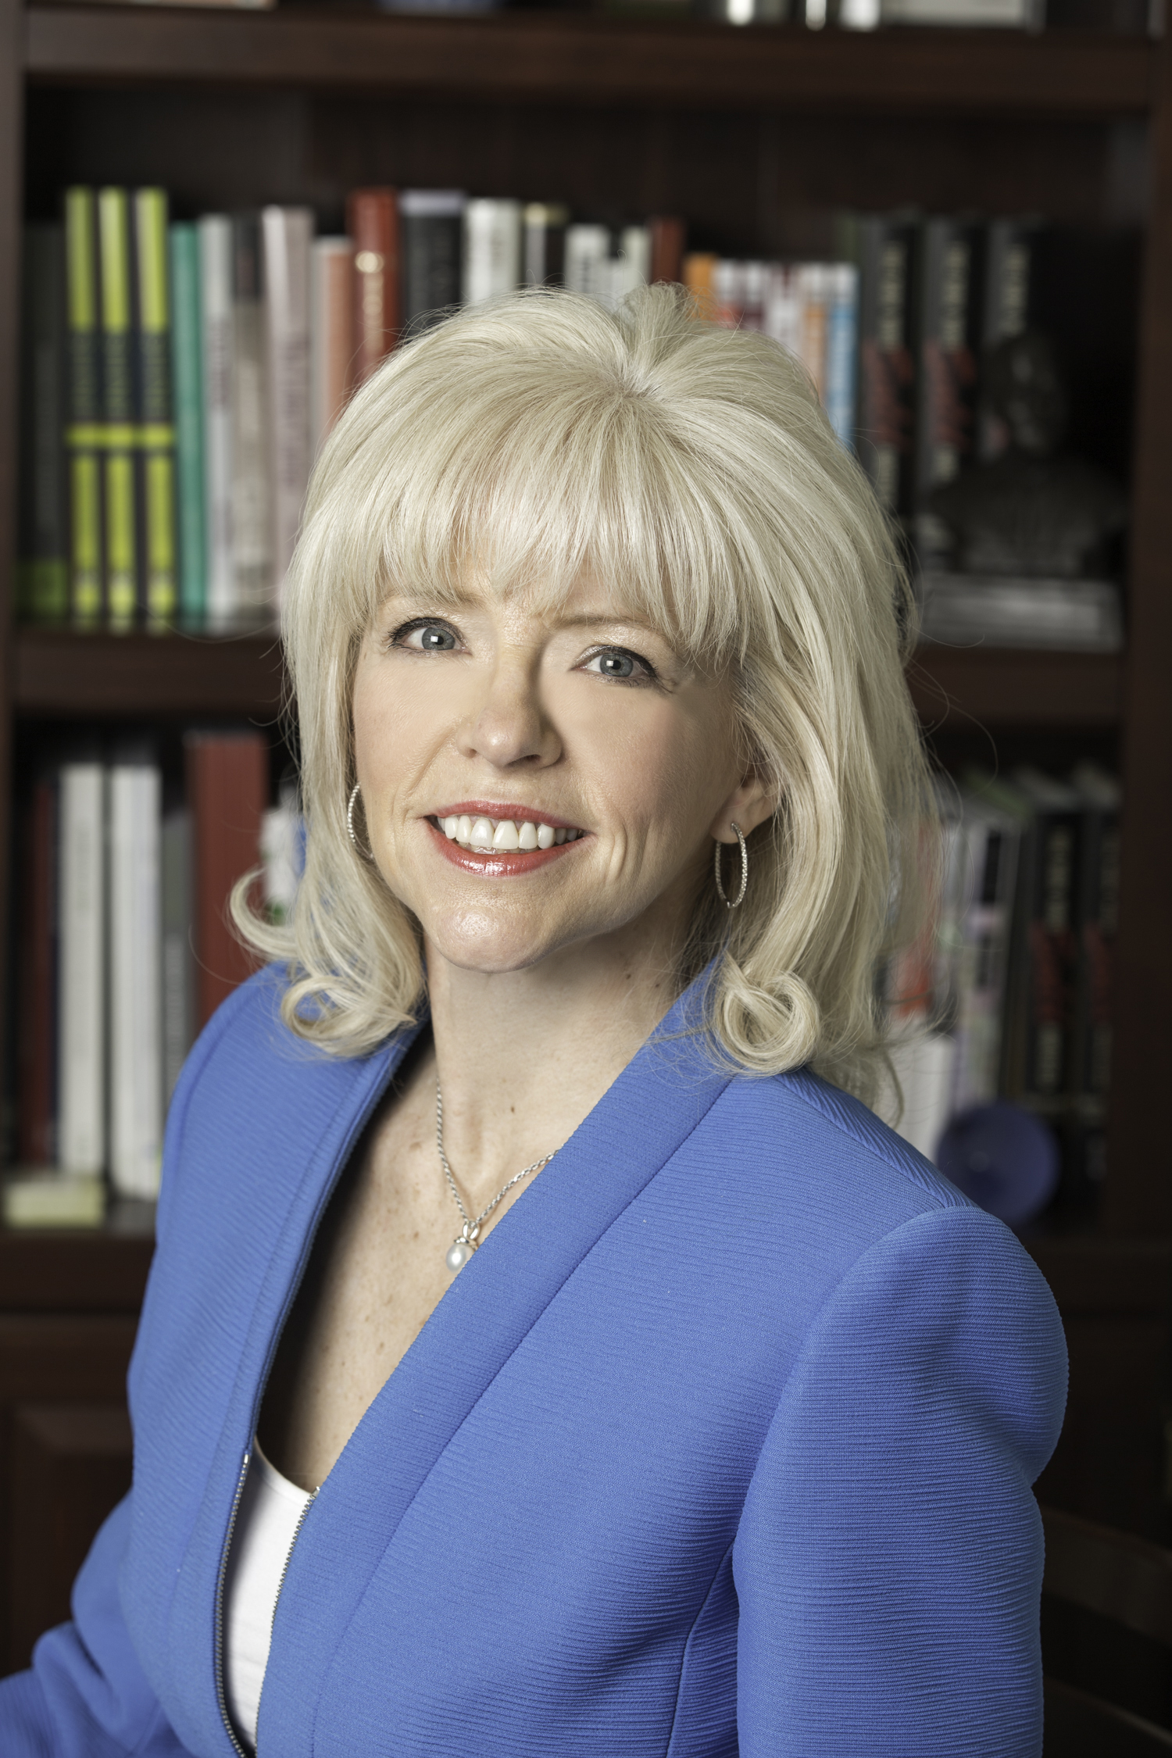
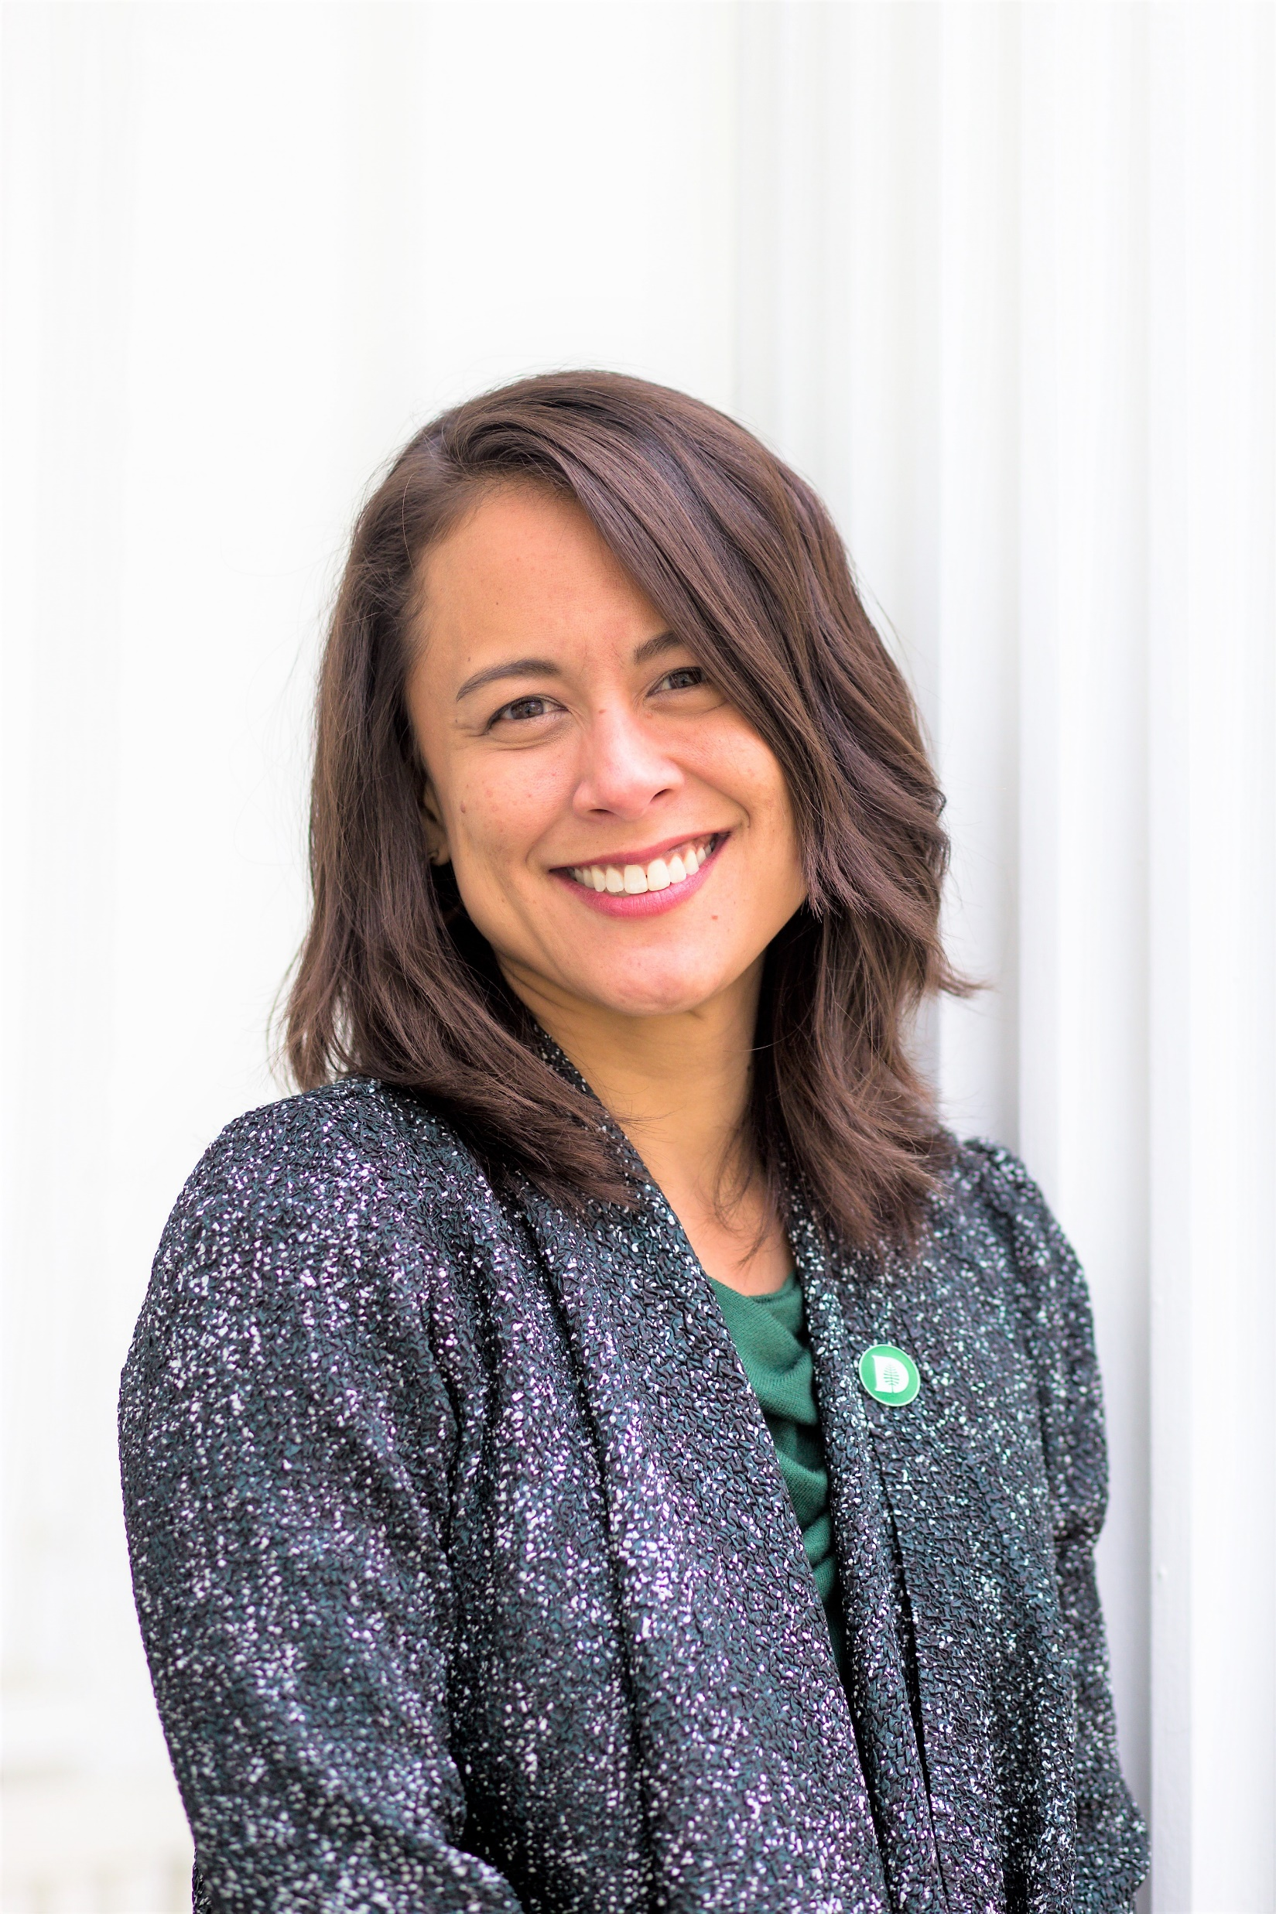
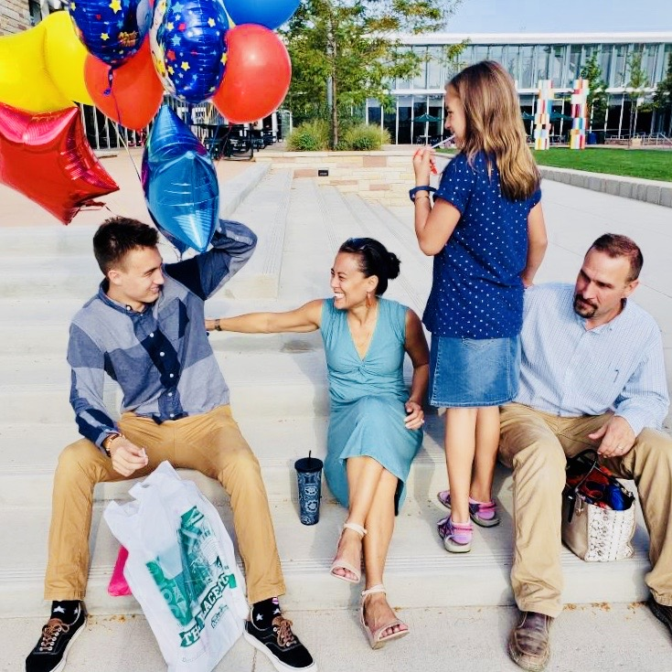
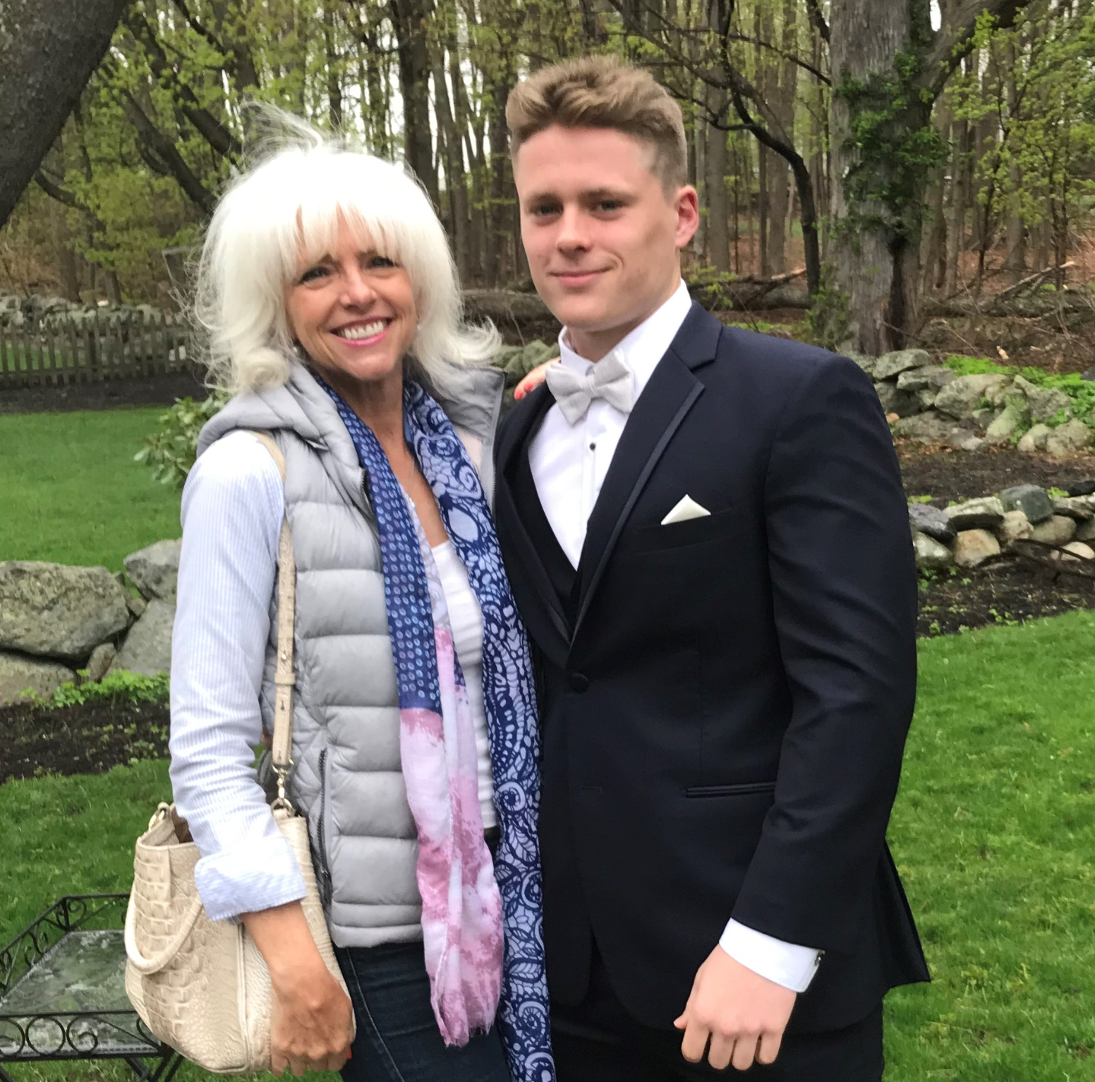
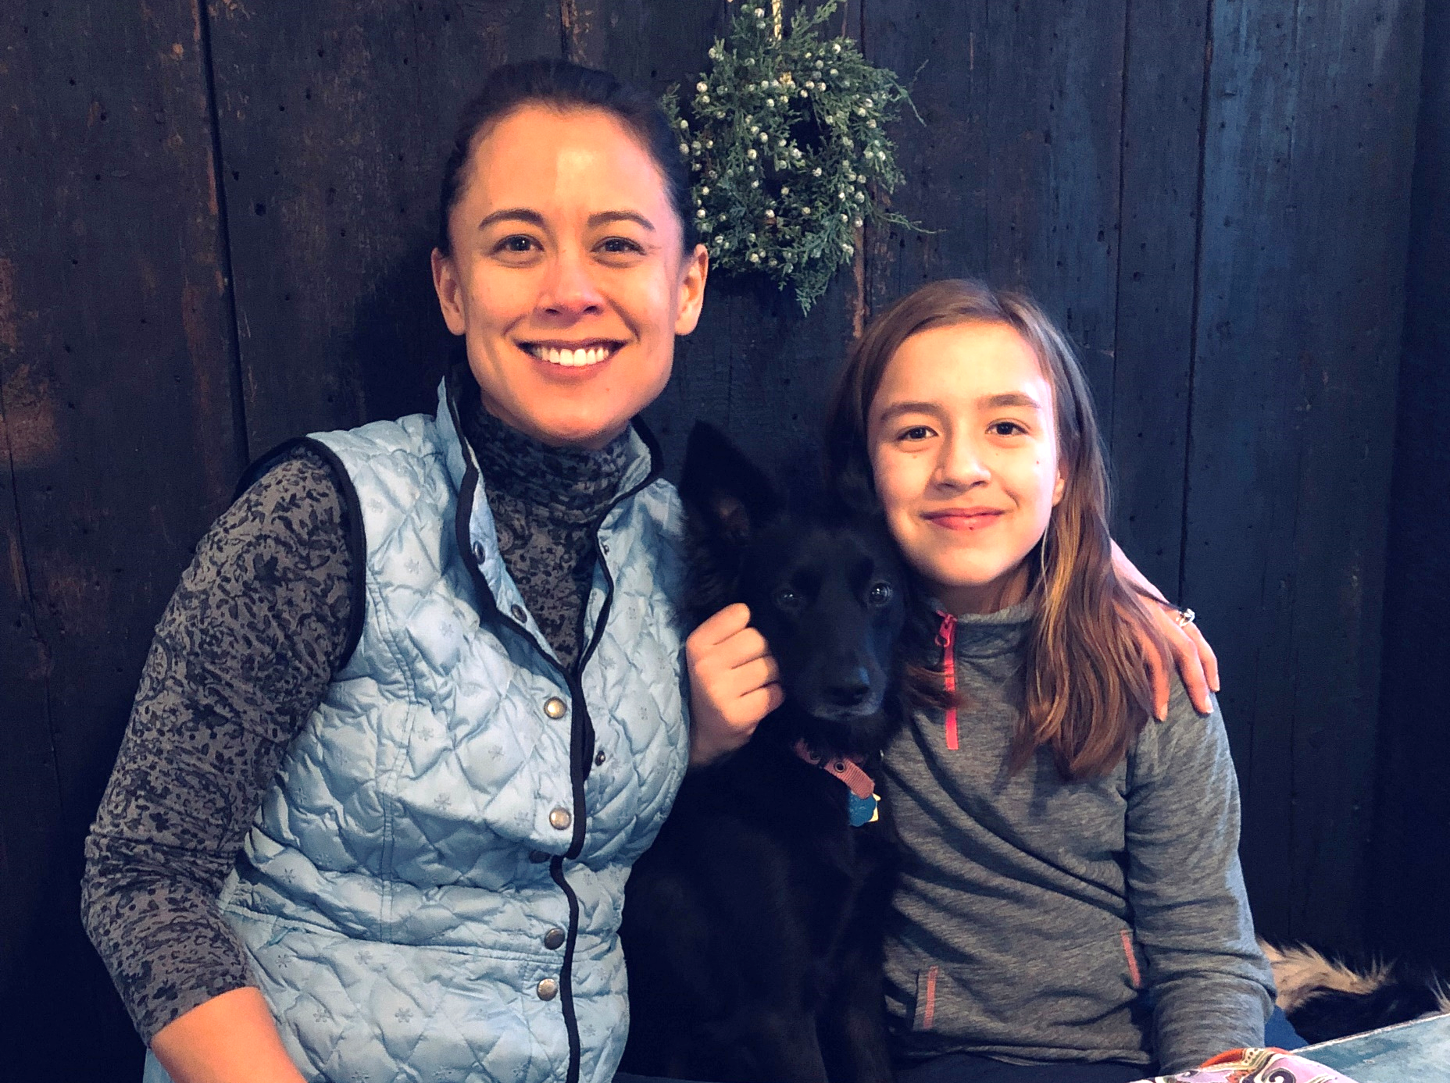
Program Managers
Amy Bronson
Boston University
Alexis Kanda-Olmstead
Dartmouth College

Slide 5
Corinne Barber, Brown University
Jen Durgin, Dartmouth College
Betsy Fountain, Boston College
Dvora Greenberg Koelling, Dartmouth College
Savannah Kacher, Scripps College (CASE DVII)
Kate Lawless, Williston Northampton School
Josephine Madhok, Boston University
Jane Martin, Boston University
Nicole Missino, Clark University
Valerie O'Brien, Boston University
Jenni Peterson, New York University (CASE DII)
Kati Reusche, Boston University
Susan Richardson, Boston University
Tia Rogers, Brown University
Julia Serazio, Boston University
Emma Smyth, Dartmouth College
Amplify Leads

Slide 6
104 Women from 8 CASE Institutions
Institution | Number
Boston College | 7
Boston University | 40
Brown University | 15
Clark University | 7
Dartmouth College | 18
New York University | 6
Scripps College | 8
Williston Northampton School | 3

Slide 7
Amplify Program Format (90 minutes)
Presentation
Alexis and Amy
Activities
Alexis and Amy
Discussion
Your Lead
LARGE GROUP
45 Minutes
Amplify Zoom Invite
SMALL GROUP
45 Minutes
Lead Zoom Invite

Slide 8

Amplify
to enlarge or expand, increase in volume, cause to become more intense
synonym: give credit, advocate
antonym: ignore, silence

Slide 9


Slide 10
Session Schedule
Every Friday from 12 Noon to 1:30 p.m. from April 30 – June 18, 2021
Session 1 (4/30/21) Amplifying Yourself and Others
Session 2 (5/7/21) Deconstructing Gender and Leadership
Session 4 (5/21/21) Cracking the Confidence Code
Session 3 (5/14/21) Expanding Identity to Values and Strengths
Session 5 (5/28/21) Cultivating Resilience
Session 6 (6/4/21) Building Inclusive Organizations
Session 7 (6/11/21) Creating Change through Community
Session 8 (6/18/21) Sustaining a Movement

Slide 11
Guiding Framework

Slide 12
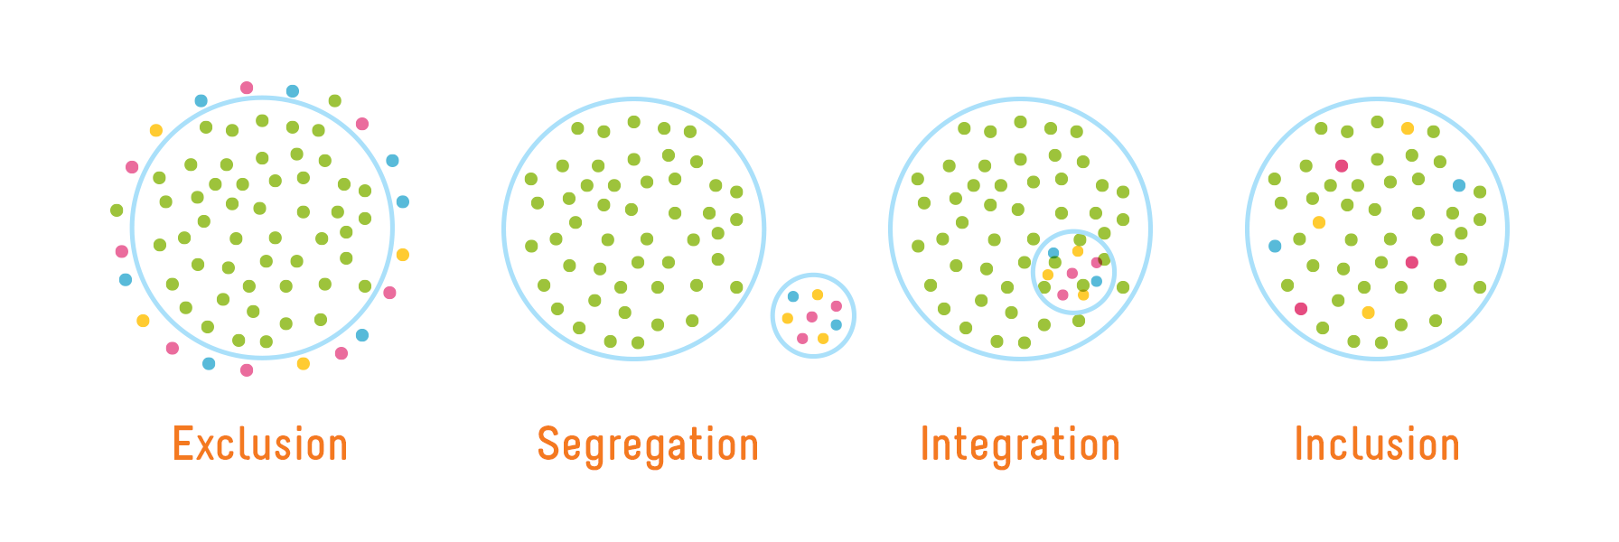
Inclusion of all genders
Image credit: Playcore https://www.playcore.com/inclusive-play-matters-1

Slide 13
Intersectionality is reality
gender
class
race
intersectionality
Image credit: Jennifer L. Le, Ph.D.
Image credit: Jennifer L. Le, Ph.D.

Slide 14
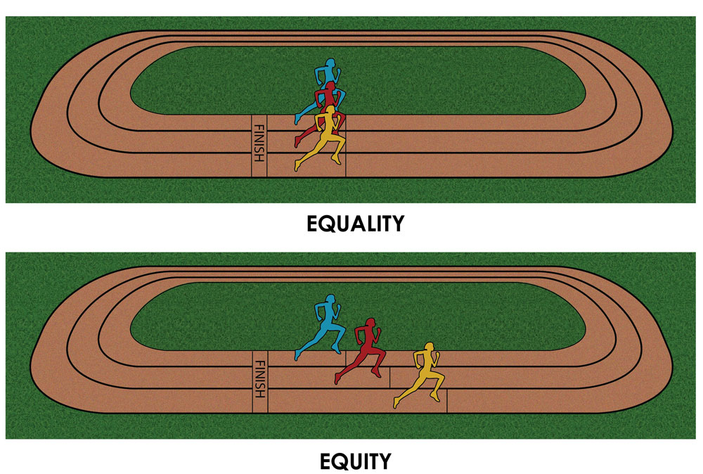
Equity to achieve equality
Equality : Treating everyone the same to ensure fairness.
The end goal.
Equity : Treating everyone differently to ensure fairness.
The means to get there.
Graphic by Paul Kuttner (2015) Cultural Organizing http://culturalorganizing.org/the-problem-with-that-equity-vs-equality-graphic/

Slide 15
Amplify Aspirations
Practice courage, compassion, and curiosity
Focus on productive thoughts, feelings, and actions
Elevate efforts to larger systems and structures
Share and listen to increase understanding
Assume positive intent, own negative impact
Share themes, not stories
Educate yourself
Challenge ideas, not people
Expect and celebrate imperfection
Monitor and adjust your level of participation
Keep confidences and protect people’s privacy
Treat everyone as an ally and partner
See everything through an intersectional lens
Take care of yourself
Have fun, laugh, and play

Slide 16
Amplify Aspirations
Practice courage, compassion, and curiosity
Focus on productive thoughts, feelings, and actions
Elevate efforts to larger systems and structures
Share and listen to increase understanding
Assume positive intent, own negative impact
Share themes, not stories
Educate yourself
Challenge ideas, not people
Expect and celebrate imperfection
Monitor and adjust your level of participation
Keep confidences and protect people’s privacy
Treat everyone as an ally and partner
See everything through an intersectional lens
Take care of yourself
Have fun, laugh, and play

Slide 17
Amplify Superpowers

Slide 18
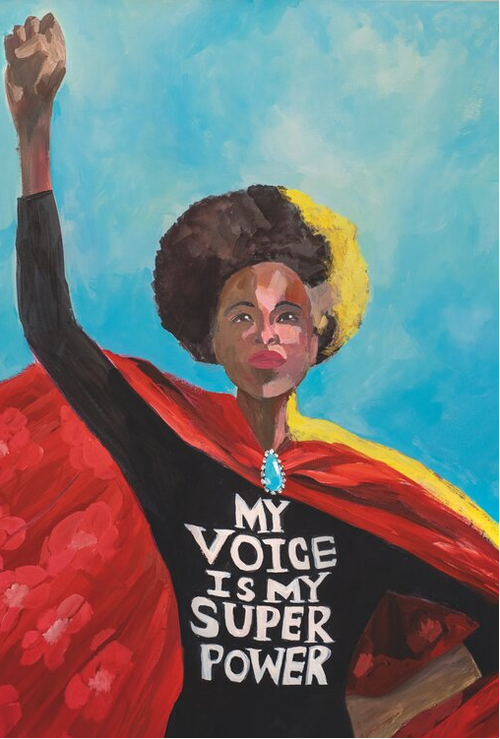

“We all leap forward when one woman tries | When she defies with her rallying cries.”
Amanda Gorman
Gayle Kabaker, courtesy of Assouline

Slide 19
What’s Your Superpower?

Slide 20
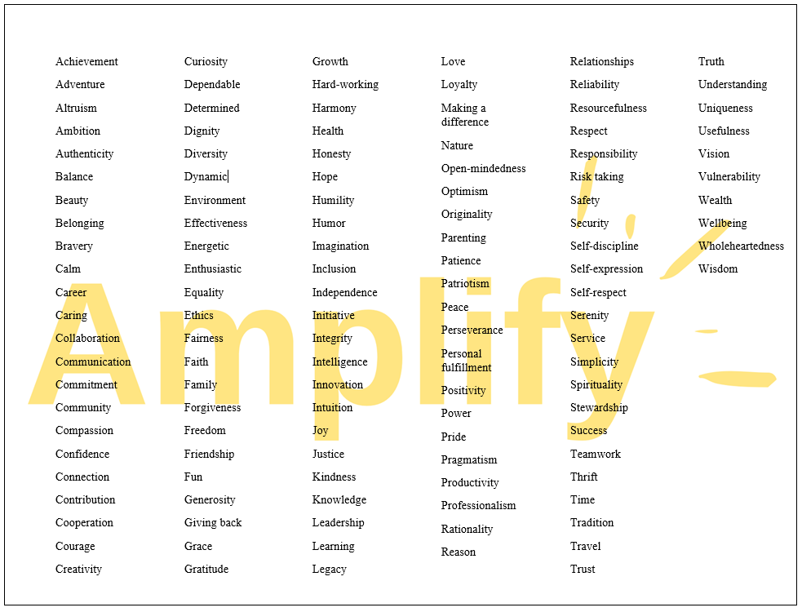

Slide 21

Your Why for Amplify
Journal Reflection for Small Group Discussion
Why did you decide to join Amplify?
How might your superpower help you achieve your “why”?

Slide 22
Amplify Strategies & Skills

Slide 23
Amplify Strategies
Individual Development
Leadership Development
Organizational Development

Slide 24
Amplify Skills
Reframing
To look at something in a new way
Navigating
To avoid or go around obstacles
Advocating
To create change for self and others

Slide 25
Journal
Select one of the Amplify skills. In what ways have you used it to get where you are today?
Reframing
To look at something in a new way
Navigating
To avoid or go around obstacles
Advocating
To create change for self and others

Slide 26
Small Group Prep

Slide 27
3B’s
Bummer
Boast
BTW

Slide 28
3 B’s Prep
Journal Reflection for Small Group Discussion
Bummer: Concern/disappointment
Boast: Achievement/accomplishment
BTW: Upcoming/FYI

Slide 29
Session 2:
Deconstructing Gender and Leadership

