Slide 1

Amplify
Women and Gender Initiative
Notes:
To Do:
Need to assign tables and make nametags. How will women find their table?
Room Set-Up
*Rolling PowerPoint with pro-woman music playing in background
Table Set-Up:
*Tent cards with names and institution
*Yellow binder preloaded with content
*Journal and pen
*List of values/superpowers on table
Binder Content:
*Bio sheet - Leads, Program Leads, and special guests
*Things to do in Boston
*Cover sheet for binder
*Retreat agenda
*Key dates
*Roles and responsibilities
*Social Justice Glossary
*Facilitation tips

Slide 2

Zoom Chat
What one word describes how you’re doing today?
Notes:
AB (2-3 min)
Amy will greet and ask people to respond to the question in the chat
Alexis will manage any Zoom issues (e.g., joining the call, muting themselves, etc.)
Patricia will post the question “What’s one word that describes how you’re doing today?” in the chat.
Please re-post this every few minutes because new participants won’t see the original question

Slide 3

Amplify Sessions
Session 1 (5/1/20) Amplifying Yourself and Others
Session 2 (5/8/20) Deconstructing Gender and Leadership
Session 3 (5/15/20) Expanding Identity to Values and Strengths
Session 4 (5/22/20) Cracking the Confidence Code
Session 5 (5/29/20) Cultivating Resilience
Session 6 (6/5/20) Building Inclusive Organizations
Session 7 (6/12/20) Creating Change through Community
Session 8 (6/19/20) Sustaining a Movement
Make-up sessions will take place Wednesdays at 4 p.m. Zoom info on the website.
Notes:
AKO

Slide 4
Creating Change through Community
Session 7 • June 12, 2020
Inclusive Organizations
From Inclusion to Belonging
Women’s Communities
Men as Allies and Partners

Slide 5
Building
Inclusive
Organizations

Slide 6
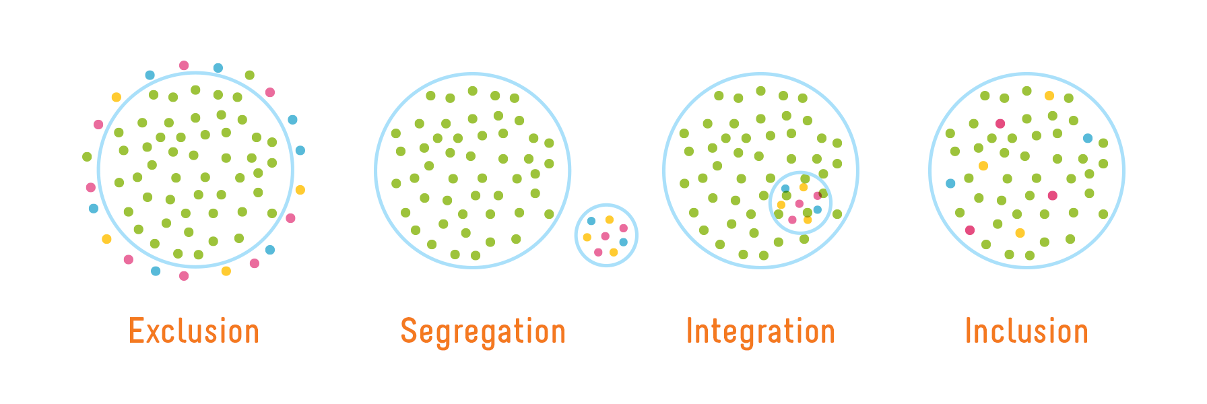
Inclusive Organizations
Image credit: Playcore https://www.playcore.com/inclusive-play-matters-1
Notes:
AKO
Amplify is a women and GENDER initiative. Everyone is impacted by gender. Not everyone identifies with a gender that aligns with their assigned sex at birth.

Slide 7
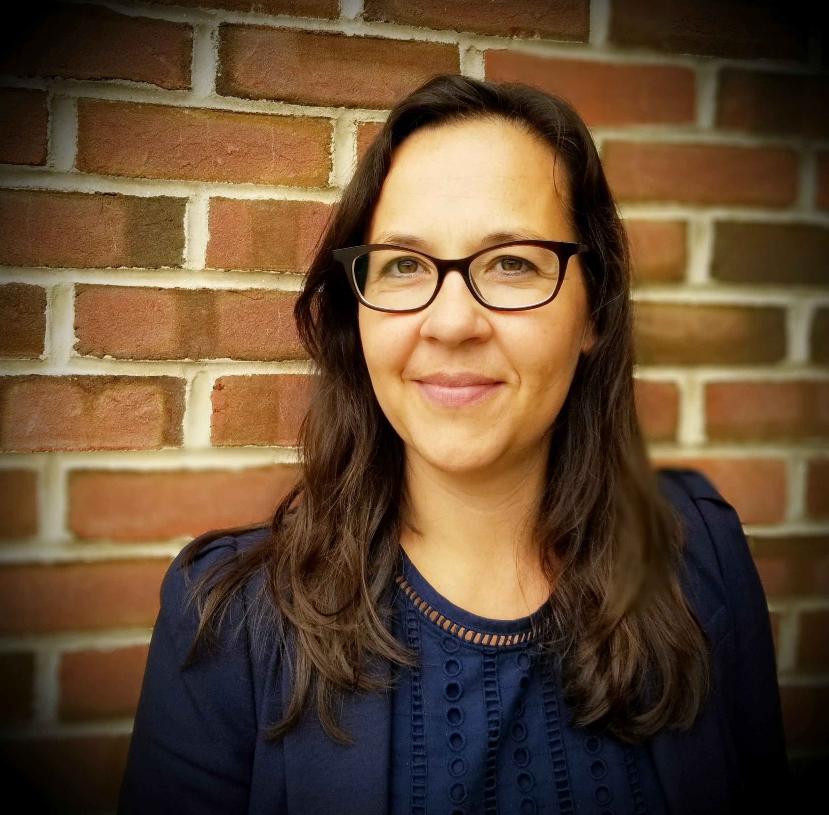
Kate Norton
Dartmouth College
Notes:
AKO

Slide 8
3 Tactics That Actually Work
Advocate
Focus on performance and results for hiring, evaluation, salary, and promotion decisions
Get Empowered by AAUW
Reframe
Identify biases that limit women and other marginalized groups
50 Ways to Fight Bias by Lean In
Engage men/senior leaders in mentorship and sponsorship to increase visibility and access
Male Allyship Awareness by AFP
Navigate

Slide 9
Creating Change through Community

Slide 10
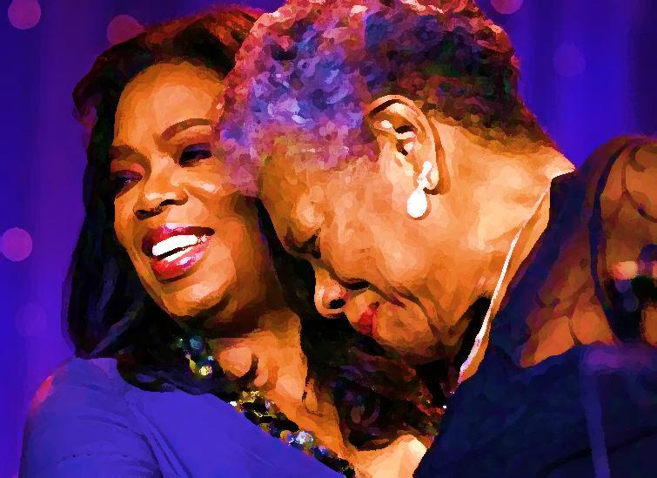
Oprah Winfrey
and Maya Angelou
I come as one, but I stand as 10,000.
Adapted from “Our Grandmothers” by Maya Angelou

Slide 11

Verb am·pli·fied, am·pli·fy·ing.
enlarge or expand, increase in volume
cause to become more intense
synonym: give credit, advocate
antonym: ignore, silence
Notes:
AKO

Slide 12
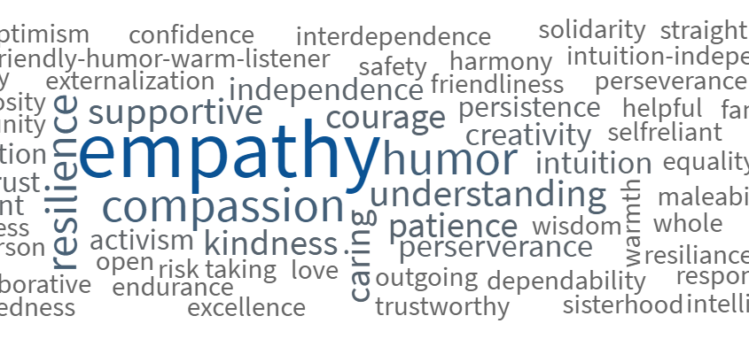
Community Strengths

Slide 13
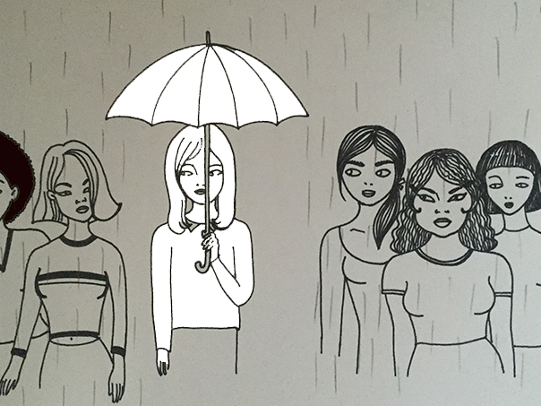
Women’s Communities

Slide 14
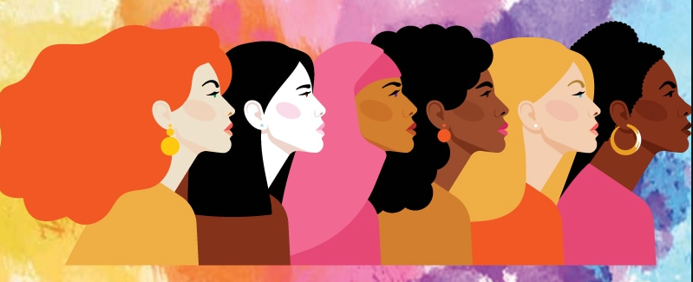
Horizontal Hostility
A manifestation of internalized oppression
Marginalized people believe, act on, or enforce dominant systems of oppression against each other
Can occur within marginalized communities or between marginalized communities

Slide 15

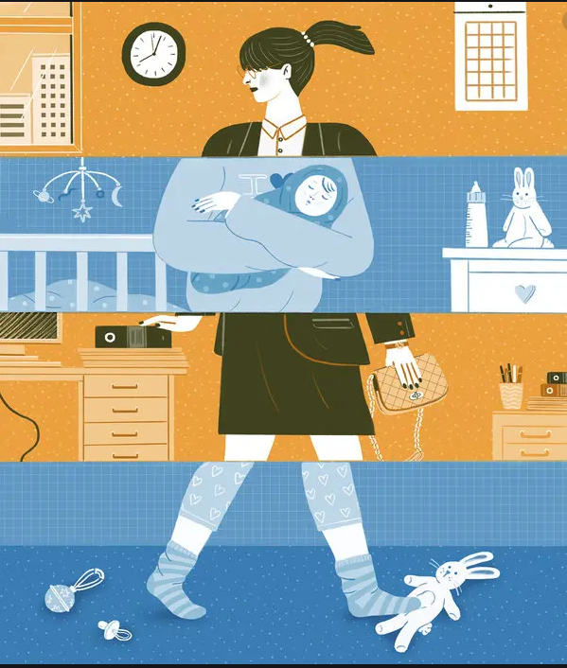
Women & Gender Examples
Racism within the Women’s Movement
Resistance to intersectional feminism
Exclusion of transgender women
Conflict over status and roles
  Mommy Wars
  Queen Bee Phenomenon

Slide 16

Zoom Poll
Have you ever experienced horizontal hostility from other women?
Have you ever perpetuated it?
Notes:
AB (2-3 min)
Amy will greet and ask people to respond to the question in the chat
Alexis will manage any Zoom issues (e.g., joining the call, muting themselves, etc.)
Patricia will post the question “What’s one word that describes how you’re doing today?” in the chat.
Please re-post this every few minutes because new participants won’t see the original question

Slide 17
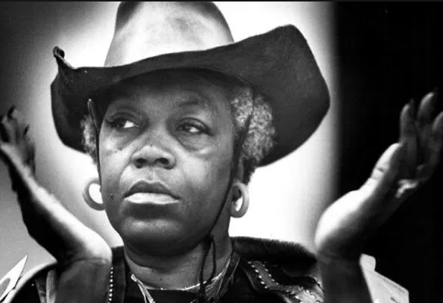
Florynce Kennedy
Lawyer, Civil Rights and Women’s Rights Advocate
Horizontal hostility…is misdirected anger that rightly should be focused on the external causes of oppression.

Slide 18
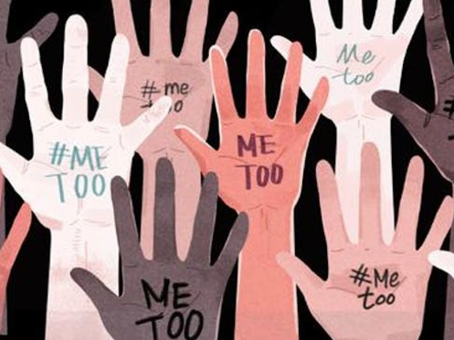
Men as Allies and Partners

Slide 19
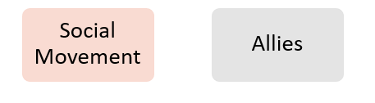
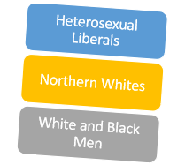
A person who uses their privilege to advocate for marginalized groups
Ally
Social Movement
Civil Rights
LGBT Rights
Allies
Northern Whites
Heterosexual Liberals
Women’s Suffrage
White and Black Men

Slide 20

Men and the #MeToo Workplace
60% of men managers cited discomfort with common work activities such as mentoring, working alone, or socializing
30% of men say they’ve avoided mentoring and socializing
Hesitant to spend time with junior women
9x more likely to hesitate to travel together for work
6x more likely to hesitate to have work dinners
More uncomfortable working with a woman
Senior-level men are:
12x more likely to hesitate to have 1:1 mtgs
LeanIn.Org 2019 Working Relationships in the #MeToo Era: https://leanin.org/mentor-her
Notes:
Men managers are uncomfortable working with a woman
60% cited discomfort with common work activities (32% increase)
30% of men say they’ve avoided mentoring and socializing with women
Senior-level men are hesitant to spend time with junior women
12x more likely to hesitate to have 1-on-1 meetings
9x more likely to hesitate to travel together for work
6x more likely to hesitate to have work dinners

Slide 21

Need for Men in the Movement
Women get less meaningful feedback from their managers
Women are less likely to have a sponsor
Women get less access to senior leaders
  Almost 60% of women of color have never had an informal interaction with a senior leader
LeanIn.Org 2019 Working Relationships in the #MeToo Era: https://leanin.org/mentor-her
Notes:
60% of managers who are men in the US are uncomfortable participating in a common work activity with a woman, such as mentoring, working alone, or socializing together.
32% jump from last year.
1/3 of men say they’ve avoided mentoring/socializing because they were nervous about how it would look
We need to actively support women at work, including by mentoring and sponsoring them. Men—who are the majority of managers and senior leaders—can help make this happen

Slide 22
From Inclusion to Belonging
Diversity
Race
Gender
Class
Inclusion
Affirmed
Belonging
Relationship
Welcomed
Valued

Slide 23

Zoom
Breakouts
Ask | Answer | Amplify
You will be placed into a breakout room with one other woman whom you do not know
If you find yourself alone in a room, please stay there. It may take a few minutes to pair you up.
If you find yourself with someone you already know well, 1 of you should return to the main session to be rematched.
If more than 2 women show up, please identify who will return to the main session to be rematched.
Notes:
AB (2-3 min)
Amy will greet and ask people to respond to the question in the chat
Alexis will manage any Zoom issues (e.g., joining the call, muting themselves, etc.)
Patricia will post the question “What’s one word that describes how you’re doing today?” in the chat.
Please re-post this every few minutes because new participants won’t see the original question

Slide 24
Zoom
Breakouts
Ask | Answer | Amplify
Round 1: Ask and Answer
(5 minutes)
You will take turns doing the activity
Woman 1 asks the questions below, listens, and affirms what is said. Do not speak, ask further questions, etc.
Repeat the process with Woman 2
Questions
What I’m curious to know about you is…
Now that I know this, I’m curious about…
Notes:
AB (2-3 min)
Amy will greet and ask people to respond to the question in the chat
Alexis will manage any Zoom issues (e.g., joining the call, muting themselves, etc.)
Patricia will post the question “What’s one word that describes how you’re doing today?” in the chat.
Please re-post this every few minutes because new participants won’t see the original question

Slide 25
Zoom
Breakouts
Ask | Answer | Amplify
Round 2: Amplify
(5 minutes)
You will take turns doing the activity
Woman 1 amplifies the other by finishing the statements below.
Repeat the process with Woman 2.
Discuss until you are prompted to return to the main session.
Amplifications
I appreciate how you…
The superpowers that I see in you are…
Notes:
AB (2-3 min)
Amy will greet and ask people to respond to the question in the chat
Alexis will manage any Zoom issues (e.g., joining the call, muting themselves, etc.)
Patricia will post the question “What’s one word that describes how you’re doing today?” in the chat.
Please re-post this every few minutes because new participants won’t see the original question

Slide 26

Journal
Private Reflection
What was it like to ask the questions? To answer them?
How might this activity help you create community with other women, allies, and partners?

Slide 27

Allies & Partners
Join us to explore how you can support gender equity in Advancement
Date: What works?
Time: What works?
Zoom Link: TBD
Hosted by Alexis Kanda-Olmstead, Dartmouth College, and
Amy Bronson, Boston University

Slide 28
Amplify Sessions
Session 1 (5/1/20) Amplifying Yourself and Others
Session 2 (5/8/20) Deconstructing Gender and Leadership
Session 3 (5/15/20) Expanding Identity to Values and Strengths
Session 4 (5/22/20) Cracking the Confidence Code
Session 5 (5/29/20) Cultivating Resilience
Session 6 (6/5/20) Building Inclusive Organizations
Session 7 (6/12/20) Creating Change through Community
Session 8 (6/19/20) Sustaining a Movement
Make-up sessions will take place Wednesdays at 4 p.m. Zoom info on the website.
Notes:
AKO

Slide 29

Session 8:
Sustaining a Movement
Notes:
AKO

Slide 30
Amplify
Women and Gender Initiative
Notes:
To Do:
Need to assign tables and make nametags. How will women find their table?
Room Set-Up
*Rolling PowerPoint with pro-woman music playing in background
Table Set-Up:
*Tent cards with names and institution
*Yellow binder preloaded with content
*Journal and pen
*List of values/superpowers on table
Binder Content:
*Bio sheet - Leads, Program Leads, and special guests
*Things to do in Boston
*Cover sheet for binder
*Retreat agenda
*Key dates
*Roles and responsibilities
*Social Justice Glossary
*Facilitation tips

Slide 31

What did you get? What will you give?
Notes:
AKO

