Slide 1

Amplify
Women and Gender Initiative
Notes:
To Do:
Need to assign tables and make nametags. How will women find their table?
Room Set-Up
*Rolling PowerPoint with pro-woman music playing in background
Table Set-Up:
*Tent cards with names and institution
*Yellow binder preloaded with content
*Journal and pen
*List of values/superpowers on table
Binder Content:
*Bio sheet - Leads, Program Leads, and special guests
*Things to do in Boston
*Cover sheet for binder
*Retreat agenda
*Key dates
*Roles and responsibilities
*Social Justice Glossary
*Facilitation tips

Slide 2
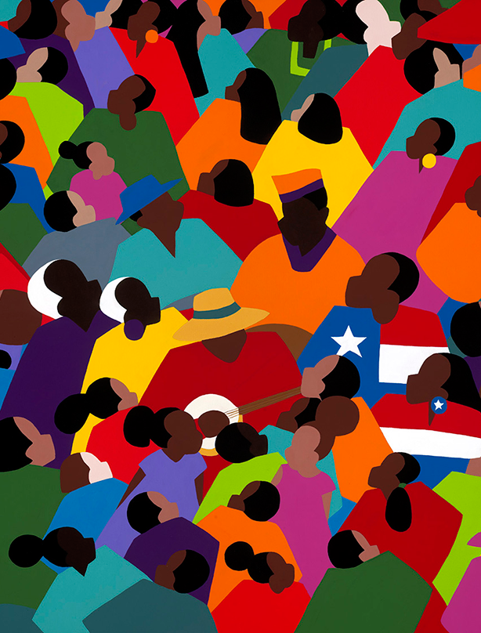
Juneteenth
Saint James, Synthia (b. 1949). Juneteenth.
Copyright 2010 Synthia SAINT JAMES. www.synthiasaintjames.com

Slide 3

Frederick Douglass
leader of the abolitionist movement
Power concedes nothing without a demand. It never did and it never will.
Find out just what any people will quietly submit to and you have found out the exact measure of injustice and wrong which will be imposed upon them…
Image Credit: FEE Tim Webster

Slide 4

Zoom Chat
What will you no longer “quietly submit to”?
Notes:
AB (2-3 min)
Amy will greet and ask people to respond to the question in the chat
Alexis will manage any Zoom issues (e.g., joining the call, muting themselves, etc.)
Patricia will post the question “What’s one word that describes how you’re doing today?” in the chat.
Please re-post this every few minutes because new participants won’t see the original question

Slide 5

Sustaining a
Movement
Session 8 • June 19, 2020
Allies & Partners Event
Inclusive Recruitment and Hiring
Sustaining a Movement
Closing Activity

Slide 6


Allies & Partners
Join us to explore how you can support gender equity in Advancement
Date: Friday, July 17, 2020
Time: 1:00-1:45 p.m.
Zoom Link: https://dartmouth.zoom.us/j/94368501257
Password: 774941
Hosted by Alexis Kanda-Olmstead, Dartmouth College, and
Amy Bronson, Boston University

Slide 7
Allies & Partners
Date: Friday 7/17/20
Time: 1:00-1:45 p.m.
General Info
Amplify Leads and Participants forward invitation; unlimited number of invites; all genders welcome
Please coordinate duplicate invites in your small group
Open to anyone in your college/university (e.g., leaders, supervisor/ees, colleague, etc.)
RSVP to you; then you send Zoom event info to them
Pro Tip: Send pre-event email with info about Amplify and/or schedule post-event follow-up meeting

Slide 8
Allies & Partners
Date: Friday 7/17/20
Time: 1:00-1:45 p.m.
Agenda
Amplify Overview
Role of Allies and Partners
Lead and Participant Testimonials
Future Directions
Ways to Support

Slide 9
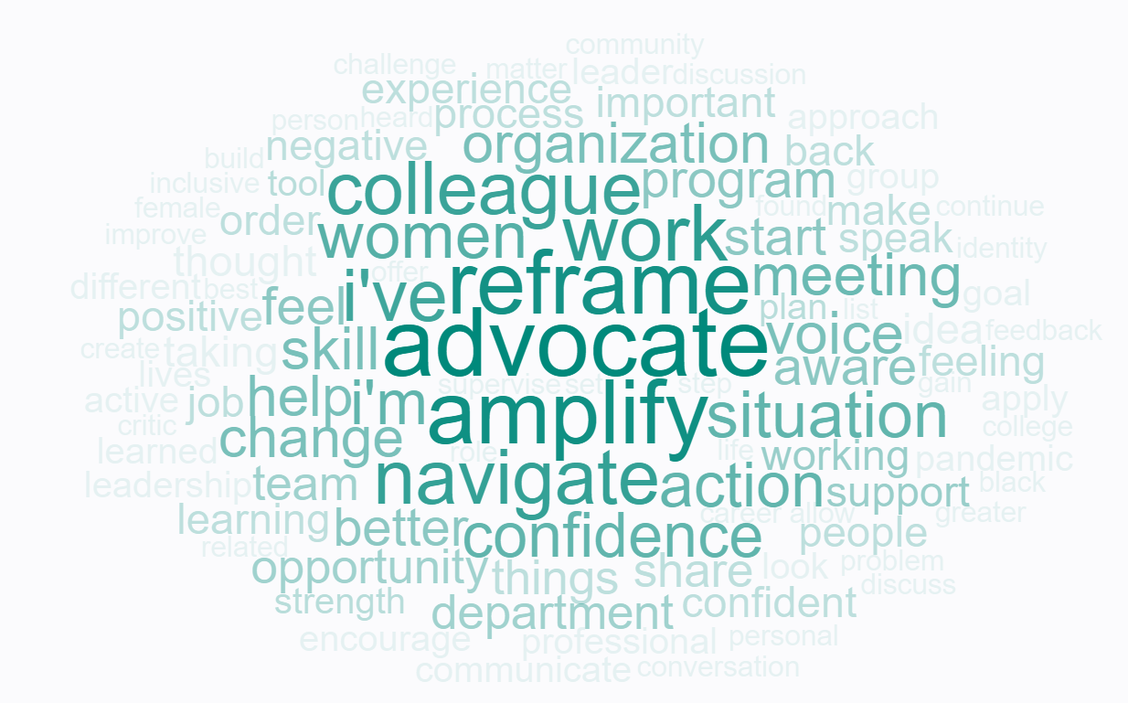

Slide 10

Inclusive Recruitment & Hiring Check List
Does your organization:
View diverse lived experiences as a value-add?
Screen job descriptions for gendered or other forms of biased language?
Include an explicit statement of DEI values in the job posting?
Increase the pool by reducing the number of “required qualifications”?
Allow for transferable skills to encourage cross-industry applicants?

Slide 11
Inclusive Recruitment & Hiring Check List
Does your organization:
Emphasize diversity and inclusion goals with search committees?
Educate screeners and interviewers about implicit bias?
Use a standardized set of interview questions to ensure consistency?
Create rubrics to evaluate resumes and interviews?
Have a plan to onboard, grow, mentor, and retain diverse talent once hired?

Slide 12
Amplify Sessions
Session 1 (5/1/20) Amplifying Yourself and Others
Session 2 (5/8/20) Deconstructing Gender and Leadership
Session 3 (5/15/20) Expanding Identity to Values and Strengths
Session 4 (5/22/20) Cracking the Confidence Code
Session 5 (5/29/20) Cultivating Resilience
Session 6 (6/5/20) Building Inclusive Organizations
Session 7 (6/12/20) Creating Change through Community
Session 8 (6/19/20) Sustaining a Movement
Make-up sessions will take place Wednesdays at 4 p.m. Zoom info on the website.
Notes:
AKO

Slide 13
Sustaining a
MOVEMENT

Slide 14
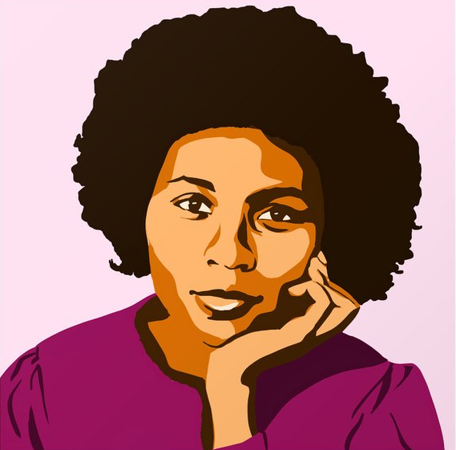
bell hooks
author, professor, activist
One of the most vital ways we sustain ourselves is by building communities of resistance, places where we know we are not alone.
Image: SD Ryan https://society6.com/sdryan

Slide 15
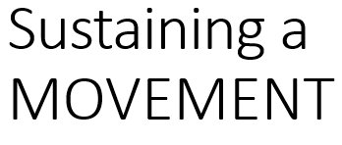
Within Your Group
Continue group learning (accessible content, shared leadership)
Engage in peer mentoring and career coaching
Create a Confidence Continuum and check-in every 2 weeks
Develop additional skills and competencies (e.g., public speaking) together
Implement the “3 Strategies that Work” in your organization (LeanIn gender bias, AFP male allies, AAUW salary negotiation)
Share Amplify with other women (e.g., Bring a Friend)

Slide 16
Within Advancement
Help us recruit for next year’s group of Leads and Participants
Talk about, sponsor, and “boast” about Amplify to your colleagues and leadership
Ask your organization to cover your Amplify fee of $99
Stay connected with other Amplifiers via LinkedIn
  Add Amplify to your LinkedIn profile (badge forthcoming)
  Join the Amplify LinkedIn group (invite forthcoming from your Lead or you can look it up: “Amplify Women & Gender Initiative”

Slide 17

Group Photo!

Slide 18
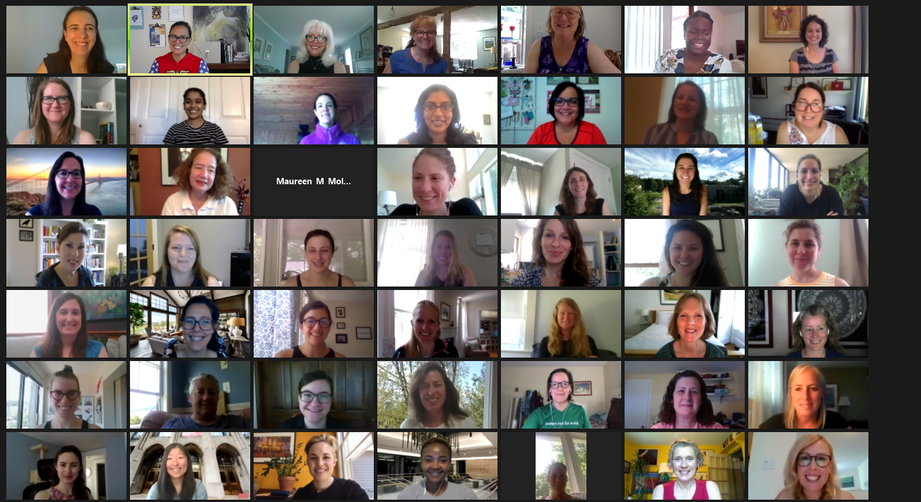

Slide 19
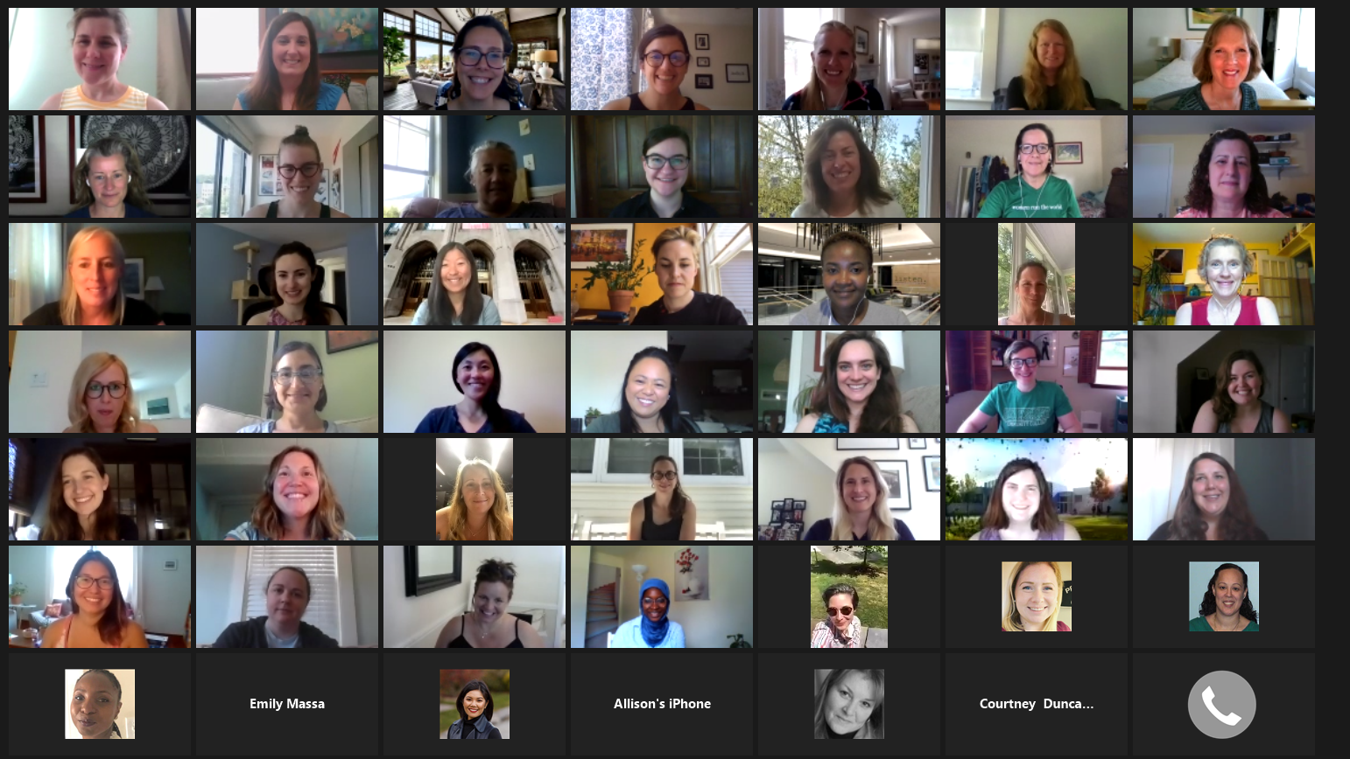

Slide 20

Within Your Organization
Intrapreneurs: Dreamers Who Do
Bring beneficial but revolutionary ideas to fruition
Operate in large, highly-structured organizations
Utilize existing resources to innovate
Also known as Changemakers, Everyday Activists, and Amplifiers
https://www.forbes.com/sites/jordandaykin/2019/01/08/intrapreneurship/#2b6cf4f74ea3

Slide 21
Make the Business Case
Negotiate the System
Build Your Community
Unlock Resources
Foster Personal Resilience
Intrapreneurs Toolkit
https://www.leagueofintrapreneurs.com/2017/02/06/league-intrapreneurs-toolkit-sharing-lessons-field/

Slide 22
Make the Business Case
Negotiate the System
Build Your Community
Unlock Resources
Foster Personal Resilience
Intrapreneurs Toolkit
https://www.leagueofintrapreneurs.com/2017/02/06/league-intrapreneurs-toolkit-sharing-lessons-field/

Slide 23
Intrapreneurs Toolkit
Make the Business Case
Assess perceived pain points
Connect with organizational priorities
Practice your pitch and use their language
Establish proof of concept
https://www.leagueofintrapreneurs.com/2017/02/06/league-intrapreneurs-toolkit-sharing-lessons-field/

Slide 24
Unlock Resources
Do more with less (MVP)
Prototype/test/repeat
Channel passion as a resource
Self-impose constraints
Intrapreneurs Toolkit
https://www.leagueofintrapreneurs.com/2017/02/06/league-intrapreneurs-toolkit-sharing-lessons-field/

Slide 25
Negotiate the System
Map the players
Work with the grain
Establish partnerships
Be patient
Intrapreneurs Toolkit
https://www.leagueofintrapreneurs.com/2017/02/06/league-intrapreneurs-toolkit-sharing-lessons-field/

Slide 26
Within Yourself

Slide 27
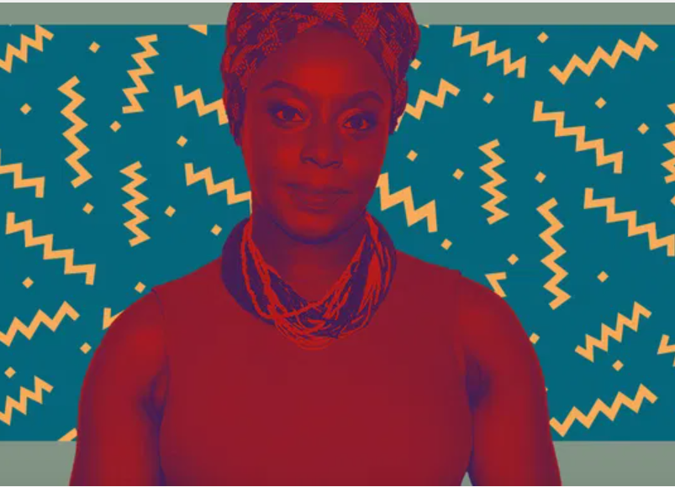
Reframe
How can I look at this in a new way?
Which beliefs no longer serve me?
Where is the learning?
What is the opportunity?
Chimamanda Ngozi Adichie
Nigerian author
Culture does not make people. People make culture.
If it is true that the full humanity of women is not our culture, then we can and must make it our culture.

Slide 28
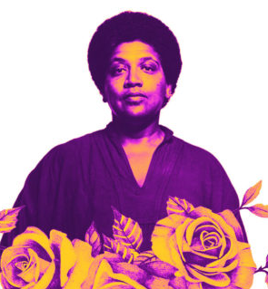
Navigate
Tap into your superpowers
Embrace your community strengths
Use your Identity Shield
Audre Lorde
black, lesbian, mother, warrior, poet
Caring for myself is not self-indulgence, it is self-preservation, and that is an act of political warfare.

Slide 29
Advocate
Reject “Idealized Femininity”
Challenge gender roles
Accept nothing less than gender equity
Frederick Douglass
leader of the abolitionist movement
champion of women’s rights
Power concedes nothing without a demand. It never did and it never will.
Find out just what any people will quietly submit to and you have found out the exact measure of injustice and wrong which will be imposed upon them…

Slide 30
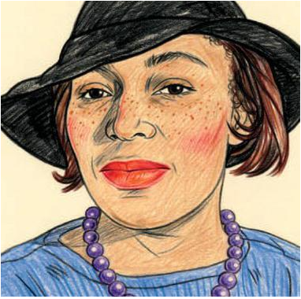
Confidence Continuum
Identify a goal
Write down action steps
Rank order by risk/fear
Chart along a continuum
Take 1 action in 1 week
Zora Neale Hurston
author, anthropologist
Grab the broom of anger and drive off the beast of fear.

Slide 31
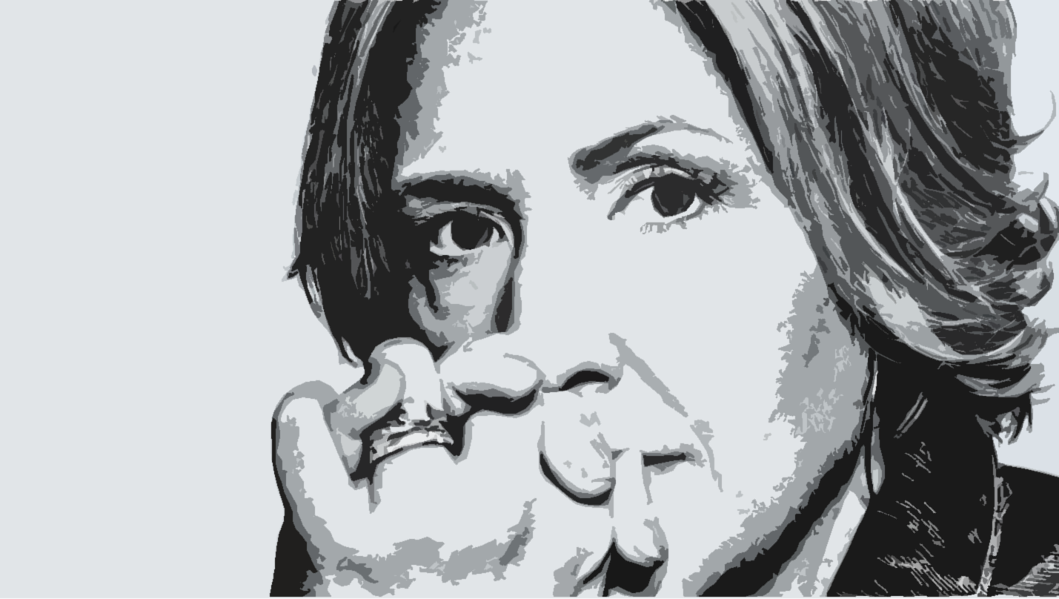
Self-Compassion
Do 5 minutes of Box Breathing
Practice Giving & Receiving meditation
Write a love letter to yourself
Brené Brown
Researcher, Professor, Storyteller
In a society that says, ‘Put yourself last,’ self-love and self-acceptance are almost revolutionary.

Slide 32
Amplify a Woman
Send a card or email of appreciation
Practice the 3 B’s
Acknowledge her superpowers
Share her boast or BTW with others
Audre Lorde
black, lesbian, mother, warrior, poet
The true focus of revolutionary change is never merely the oppressive situations which we seek to escape, but that piece of the oppressor which is planted deep within each of us…

Slide 33
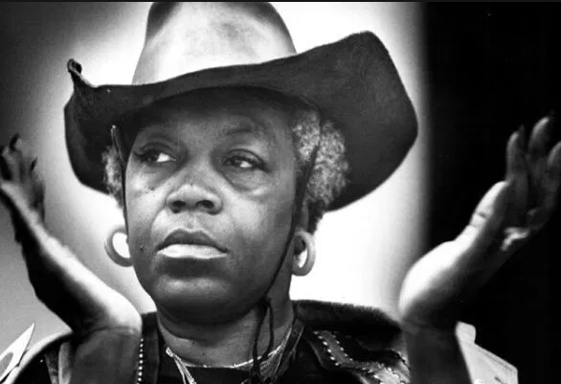
Change
Build inclusive teams and organizations
Support women and other marginalized people
Focus efforts on external causes of oppression
Florynce Kennedy
Lawyer, Civil Rights & Women’s Rights Advocate
Horizontal hostility…is misdirected anger that rightly should be focused on the external causes of oppression.

Slide 34
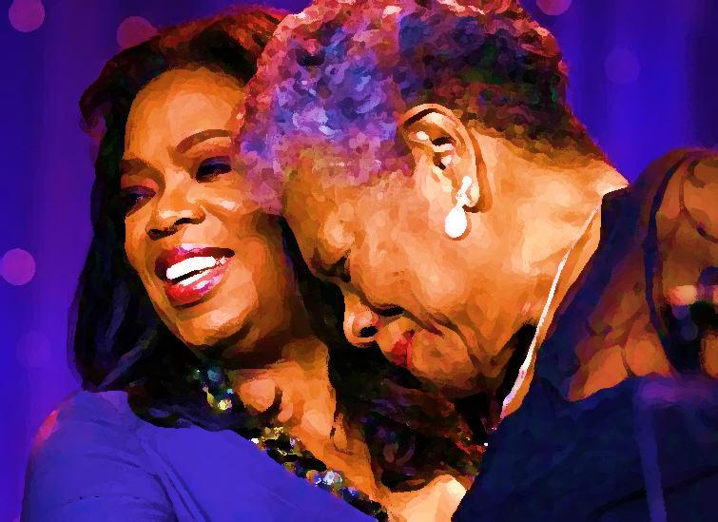
Community
See beyond difference
Enlist partners and allies
Practice Ask | Answer | Amplify
  What I’m curious to know about you is…
  Now that I know this, I’m curious about…
  I appreciate how you…
  The superpowers I see in you are…
Oprah Winfrey, media goddess
and Maya Angelou, poet, civil rights activist
I come as one, but I stand as 10,000.

Slide 35
Sustain
Stay in touch with each other
Practice intrapreneurship
Share Amplify with the world
bell hooks
author, professor, activist
One of the most vital ways we sustain ourselves is by building communities of resistance, places where we know we are not alone.

Slide 36

What did you get? What will you give?
Notes:
AKO

Slide 37
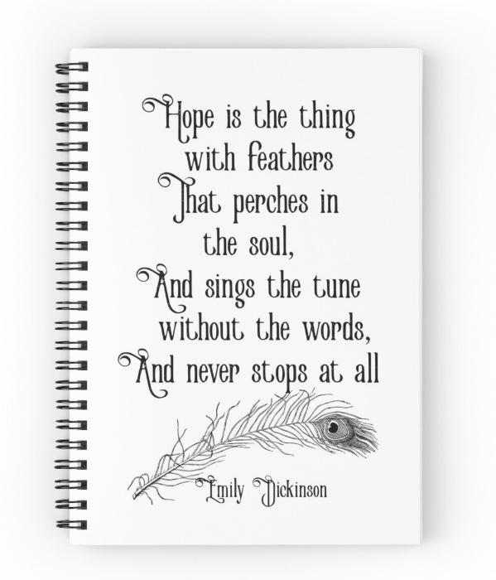

Slide 38
Broken wings make broken women
(Or perhaps it is the other way around?)
Written by Alexis Kanda-Olmstead

Slide 39
Living in a man’s world is like being dropped from the sky, expected to fly.
This is how you do it, they say, Open your wings. It’s easy. Watch.
But I don’t have wings, so I land hard, the breath knocked from my lungs.
On the ground is where we find each other. Delicate hands reaching out to touch, eyes looking up to wonder.
Why are they flying, and we are not? What have we done wrong?
We scrap together makeshift wings. Tying together branches, whatever we can find. The younger ones throw themselves into the air, over and over. Kites desperate to catch the wind, only to bounce and crash across the ground.
“It’s all about confidence,” others say, flying like Icarus into the sky. We never see them again.
The older ones sit down and watch, mending wings, sighing, and giving advice.

Slide 40
Things are getting better, they say.
You should be grateful, they say.
It could be much worse, they warn.
I am becoming one of the older ones. Tired of watching, my hands cramped from binding and patching. I look at the wings in my lap, broken and splintered. They are too heavy, too big. Fit to another.
They are not our wings. No amount of confidence or effort could make them fly. Broken wings make broken women. Or perhaps it is the other way around?
I gather the wings. Carry them away. Set them down gently and build a pyre. The other women notice the light, curious. They move toward its brightness, dragging their wings behind, and then lift them up as an offering to the flames.
Together we stand, blinking back the heat, hotter and hotter. A circle of women around burning wings. The air expands, and like bits of twirling ash, we begin to rise.
Straight up.

Slide 41
We are flying.

Slide 42
Amplify
Women and Gender Initiative
Notes:
To Do:
Need to assign tables and make nametags. How will women find their table?
Room Set-Up
*Rolling PowerPoint with pro-woman music playing in background
Table Set-Up:
*Tent cards with names and institution
*Yellow binder preloaded with content
*Journal and pen
*List of values/superpowers on table
Binder Content:
*Bio sheet - Leads, Program Leads, and special guests
*Things to do in Boston
*Cover sheet for binder
*Retreat agenda
*Key dates
*Roles and responsibilities
*Social Justice Glossary
*Facilitation tips

Slide 43
Intrapreneurs Toolkit
Foster Resilience
Stay mission focused
Spend time with supporters
Don’t be a martyr
Practice mindfulness

Slide 44
Build your community
Identify key influencers
Find a leader to champion
Deepen your network
Be a graceful warrior
Intrapreneurs Toolkit

Slide 45
Amplify Strategies
Individual Development
Leadership Development
Organizational Development
Notes:
AKO
Amplify is built upon an interrelated framework of strategies that operate together. As I develop my individual capacity, I develop my capacity as a leader. As I develop my capacity as a leader, I develop my organizations capacity for change.
Individual Development – We are specifically addressing internalized oppression which plays out as the oft-cited Imposter Syndrome, where women feel like frauds regardless of their competence, to the conflict women experience around their identities and life choices. Amplify will provide tools to recognize and change our perceptions of ourselves and other women.
Leadership Development – We are specifically addressing the identity of leader, our confidence as leaders, and the concept of leadership as a whole. Research indicates that although women are talented leaders, their confidence lags significantly behind that of men. This is because traditional leadership is a highly-gendered concept that skews towards masculinity. Amplify will help women redefine leadership in gender-expansive ways so that it works for, not against, their identities.
Organizational Development - Too often, women’s programs occur in isolation without the critical support of other women and allies. Amplify creates a shared learning experience for women within their places of work. By developing community with other members and allies, Amplify provides the resources women need to sustain their own growth and that of their organizations. The organization is also a learning lab and place for change.

Slide 46
Amplify Skills
Reframing
To look at something in a new way
Navigating
To avoid or go around obstacles
Advocating
To create change for self and others
Notes:
AKO
We will achieve this vision by focusing on three key skills:
Reframing: Looking at something in new ways. How can we take our current reality and reconceptualize it into something productive and inspiring? How can we take the old stories we tell ourselves and update them into a brave new story? What outdated concepts or beliefs need to be revisited?
Examples:
Failure becomes learning experience.
Weaknesses become strengths.
Tragedy becomes triumph.
Navigating: To avoid or go around obstacles. Women are constantly having to navigate double standards (e.g., a man can be direct but a woman cannot), gender roles (e.g., office housework or actual housework), and conflicts (e.g., you can be a good employee or a good mom, but you can’t be both).
Examples:
Support but not own office social activities.
Change mindset about keeping a clean house and get over guilt about not going to all of my kids’ activities.
Advocating: To create change for self and others.
Example: Doesn’t have to look like joining a protest. It could be a simple act of taking time for yourself like when I started going to Spin class. It could be covert (salary with Lindsey example) or more overt (AFP will pay me).

Slide 47
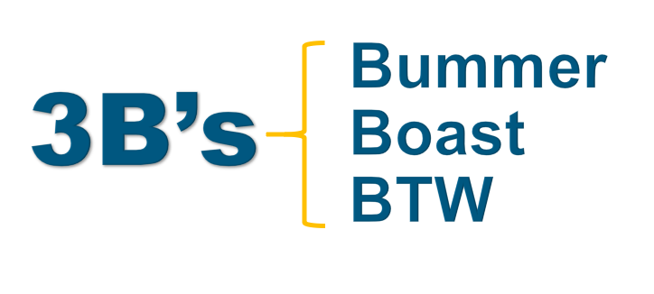
What did you learn?
How did it feel to share/listen?
How does this apply to your role as a Lead?

Slide 48
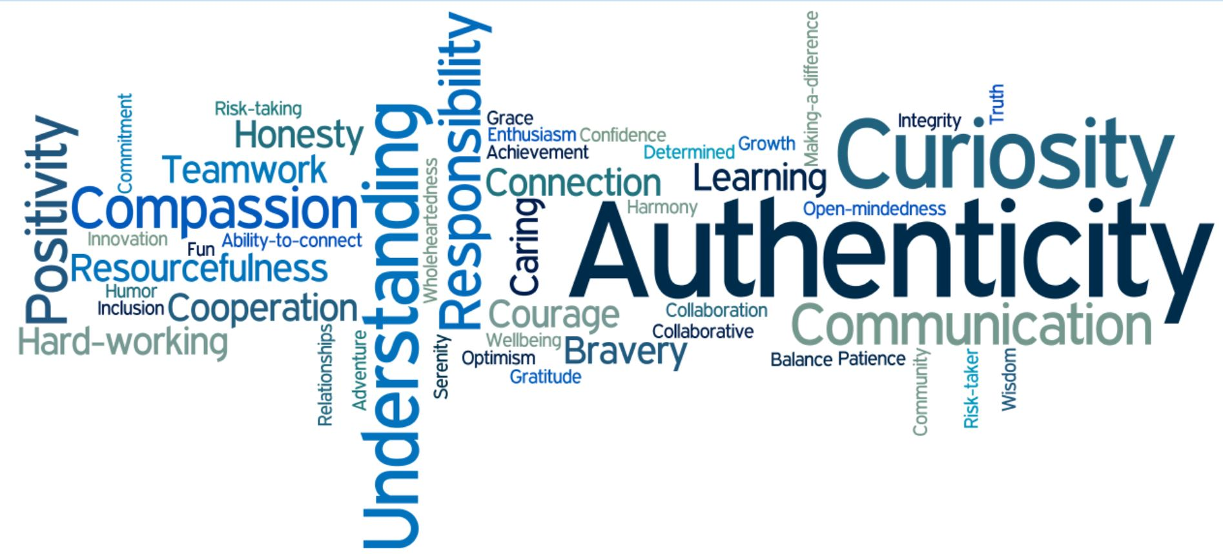
Your
Superpowers
Notes:
AKO

Slide 49
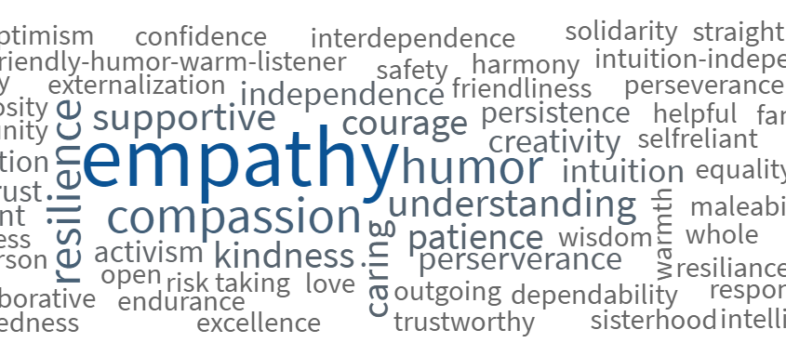
Community Strengths

Slide 50

The Confidence Myth
Competence + Confidence → Action
This Before That
Endless Polishing
Designing at the Whiteboard
Evermore Education
Competence + Action → Confidence
Kay, K., & Shipman, C. (2014). The Confidence Code: The Science and Art of Self-Assurance--What Women Should Know.
Mohr, Tara. (2014). Playing Big: Find Your Voice, Your Mission, Your Message

Slide 51
Confidence Continuum
Step 1
Step 2
Chart along a continuum
Step 3
Step 4
Write down action steps
Identify a goal
Rank order by risk/fear
Step 5
Take 1 action in 1 week
Deploy as Needed
Self-Compassion
Safety Net

Slide 52
From Inclusion to Belonging
Diversity
Race
Gender
Class
Inclusion
Affirmed
Belonging
Relationship
Welcomed
Valued

Slide 53

Creating Change through Community

