Slide 1

Amplify
Women and Gender Initiative
Notes:
To Do:
Need to assign tables and make nametags. How will women find their table?
Room Set-Up
*Rolling PowerPoint with pro-woman music playing in background
Table Set-Up:
*Tent cards with names and institution
*Yellow binder preloaded with content
*Journal and pen
*List of values/superpowers on table
Binder Content:
*Bio sheet - Leads, Program Leads, and special guests
*Things to do in Boston
*Cover sheet for binder
*Retreat agenda
*Key dates
*Roles and responsibilities
*Social Justice Glossary
*Facilitation tips

Slide 2
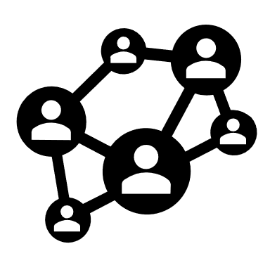
Zoom
Chat & Discussion
What have you been doing for self-care?
Notes:
AB (2-3 min)
Amy will greet and ask people to respond to the question in the chat
Alexis will manage any Zoom issues (e.g., joining the call, muting themselves, etc.)
Patricia will post the question “What’s one word that describes how you’re doing today?” in the chat.
Please re-post this every few minutes because new participants won’t see the original question

Slide 3

Birthdays, Celebrations & Milestones
Notes:
AKO

Slide 4

Amplify Sessions
Session 1 (5/1/20) Amplifying Yourself and Others
Session 2 (5/8/20) Deconstructing Gender and Leadership
Session 3 (5/15/20) Expanding Identity to Values and Strengths
Session 4 (5/22/20) Cracking the Confidence Code
Session 5 (5/29/20) Cultivating Resilience
Session 6 (6/5/20) Building Inclusive Organizations
Session 7 (6/12/20) Creating Change through Community
Session 8 (6/19/20) Sustaining a Movement
Make-up sessions will take place Wednesdays at 4 p.m. Zoom info on the website.
Notes:
AKO

Slide 5
Cultivating
Resilience
Session 5 • May 29, 2020
Review Session 4
Self-Compassion
Practices
Debrief

Slide 6
Session 4:
Cracking the
Confidence Code
Notes:
AKO to ask women to intro selves at tables with value/superpower, and tell founding story

Slide 7
Competence + Action → Confidence
Reframing
To look at something in a new way
Navigating
To avoid or go around obstacles
Advocating
To create change for self and others

Slide 8
Confidence Continuum
Step 1
Step 2
Chart along a continuum
Step 3
Step 4
Write down action steps
Identify a goal
Rank order by risk/fear
Step 5
Take 1 action in 1 week

Slide 9

Zoom Poll
Did you complete your 1 action in 1 week?
Yes!!
Sort of?
Not yet but that’s okay
Notes:
AB (2-3 min)
Amy will greet and ask people to respond to the question in the chat
Alexis will manage any Zoom issues (e.g., joining the call, muting themselves, etc.)
Patricia will post the question “What’s one word that describes how you’re doing today?” in the chat.
Please re-post this every few minutes because new participants won’t see the original question

Slide 10
Cultivating
Resilience*
*through Self-Compassion
Notes:
AKO to ask women to intro selves at tables with value/superpower, and tell founding story

Slide 11
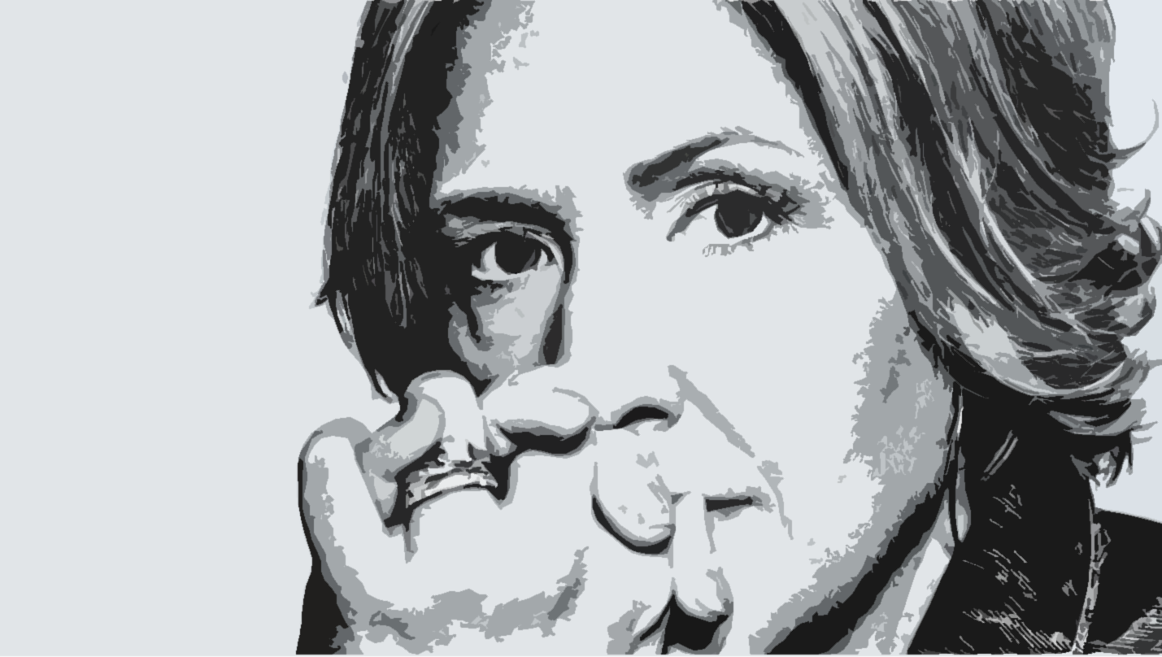
Brené Brown
Researcher, Professor, Storyteller
In a society that says, ‘Put yourself last,’ self-love and self-acceptance are almost revolutionary.
Image Credit: Fast Company

Slide 12
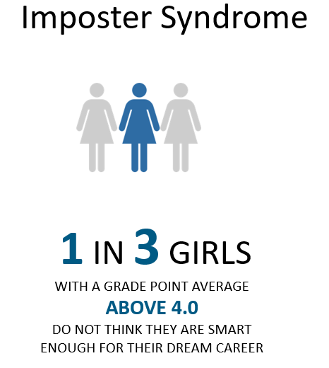
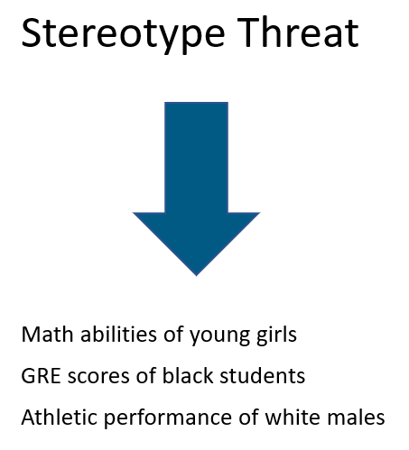
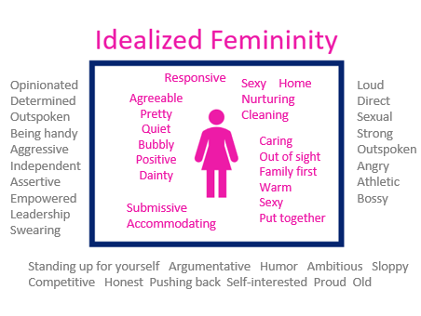
Inner Critic
Harsh
Familiar
Automatic
Dualistic
Rational
Consistent
Shaming
Exploitative
Cunning
Mohr, Tara. (2014). Playing Big: Find Your Voice, Your Mission, Your Message.

Slide 13


Resilience through Self-Compassion
Resilience
Process of adapting well in the face of significant sources of stress (trauma, tragedy, etc.)
Self-Compassion
Emotionally-supportive attitude toward self when confronted by personal inadequacies or situational difficulties

Slide 14

Confidence Continuum
Ask Amy
Email CASE
Market program
Launch application
Coordinate Retreat
Self-Compassion Safety Net

Slide 15
Self-Compassion Safety Net
Common Humanity vs. Isolation
Mindfulness vs. Over-identification
Self-kindness vs. Self-judgment
https://self-compassion.org/the-three-elements-of-self-compassion-2/

Slide 16
Self-Compassion Safety Net
Common Humanity vs. Isolation
View our personal experiences as part of a much larger human experience
Externalize rather than internalize our challenges
Mindfulness vs. Over-identification
Take a balanced approach to our emotions, neither suppressing nor overreacting
Reduce our anxiety and fear
Self-kindness vs. Self-judgment
Accept and forgive ourselves when we suffer, fail, or feel inadequate
Treat ourselves as we would treat our friends
https://self-compassion.org/the-three-elements-of-self-compassion-2/

Slide 17
Self-Compassion Safety Net
Common Humanity vs. Isolation
View our personal experiences as part of a much larger human experience
Externalize rather than internalize our challenges
Mindfulness vs. Over-identification
Take a balanced approach to our emotions, neither suppressing nor overreacting
Reduce our anxiety and fear
Self-kindness vs. Self-judgment
Accept and forgive ourselves when we suffer, fail, or feel inadequate
Treat ourselves as we would treat our friends
https://self-compassion.org/the-three-elements-of-self-compassion-2/

Slide 18
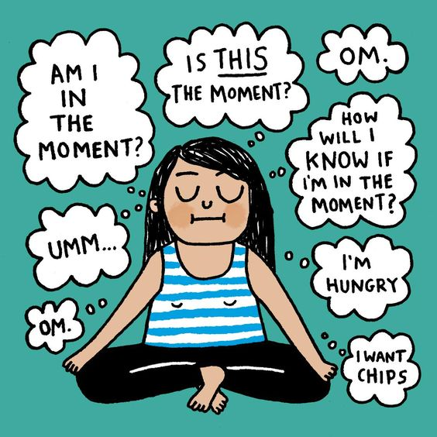
Mindfulness
https://yogalifestyles.com/

Slide 19
Mindfulness
Personal reflection
Journaling
Storytelling
Deep listening
But wait!
There’s more!
Personal reflection
Journaling
Storytelling
Deep listening
Retreats
Visual arts
But wait! There’s more!
http://www.contemplativemind.org/practices/tree

Slide 20
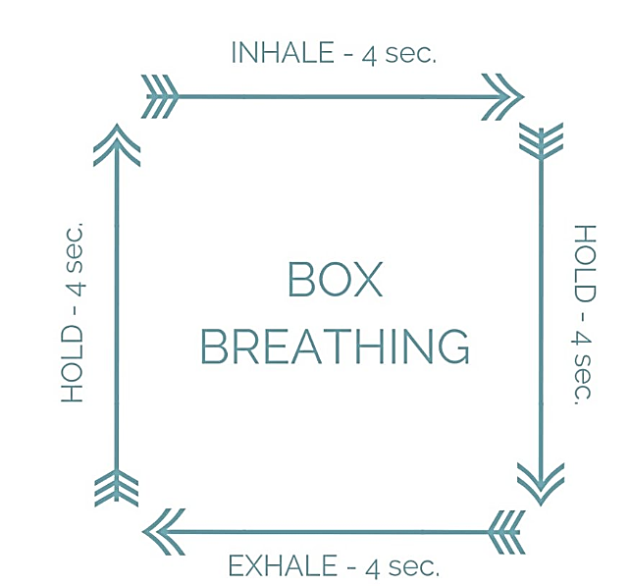

Slide 21
Self-Compassion Safety Net
Common Humanity vs. Isolation
View our personal experiences as part of a much larger human experience
Externalize rather than internalize our challenges
Mindfulness vs. Over-identification
Take a balanced approach to our emotions, neither suppressing nor overreacting
Reduce our anxiety and fear
Self-kindness vs. Self-judgment
Accept and forgive ourselves when we suffer, fail, or feel inadequate
Treat ourselves as we would treat our friends
https://self-compassion.org/the-three-elements-of-self-compassion-2/

Slide 22
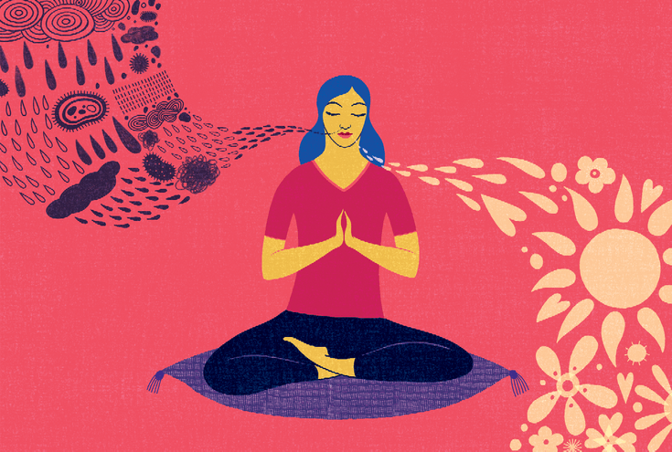
Taking and Sending Meditation (Tonglen Practice)
Rest your mind for a second of stillness
Breathe in all the feels (e.g., sadness, anger, fear)
Breathe out all the good (e.g., happiness, peace, love)
Focus on your personal situation
  Breathe in all the feels/breathe out all the good
Expand your focus to others
  Breathe in all the feels/breathe out all the good
https://www.lionsroar.com/how-to-practice-tonglen/

Slide 23
Self-Compassion Safety Net
Common Humanity vs. Isolation
View our personal experiences as part of a much larger human experience
Externalize rather than internalize our challenges
Mindfulness vs. Over-identification
Take a balanced approach to our emotions, neither suppressing nor overreacting
Reduce our anxiety and fear
Self-kindness vs. Self-judgment
Accept and forgive ourselves when we suffer, fail, or feel inadequate
Treat ourselves as we would treat our friends
https://self-compassion.org/the-three-elements-of-self-compassion-2/

Slide 24

Letter Writing
Dear (Your First Name),
This is your friend, Self-Compassion, and this is what I’d like you to know…

Slide 25
Self-Compassion Safety Net
(Pick One)
Common Humanity vs. Isolation
Taking & Sending Meditation
Mindfulness vs. Over-identification
Box Breathing
Inhale
Self-kindness vs. Self-judgment
Letter Writing
Hold
Exhale
Hold
4 seconds each:
Breathe in the bad stuff
Breathe out the good stuff
Focus on self
Expand to others
Dear (Your Name), This is your friend, Self-Compassion, and this is what I’d like you to know
https://self-compassion.org/the-three-elements-of-self-compassion-2/

Slide 26
Zoom
Breakouts
Debrief experience:
How did it go?
What did you learn?
How does it apply to anything Amplify-related?
Notes:
AB (2-3 min)
Amy will greet and ask people to respond to the question in the chat
Alexis will manage any Zoom issues (e.g., joining the call, muting themselves, etc.)
Patricia will post the question “What’s one word that describes how you’re doing today?” in the chat.
Please re-post this every few minutes because new participants won’t see the original question

Slide 27
Confidence Continuum
Step 1
Step 2
Chart along a continuum
Step 3
Step 4
Write down action steps
Identify a goal
Rank order by risk/fear
Step 5
Take 1 action in 1 week
Deploy as Needed
Self-Compassion
Safety Net

Slide 28

Session 6:
Building Inclusive Organizations
Image Credit: Deloitte Insights
Notes:
AKO

Slide 29
Amplify
Women and Gender Initiative
Notes:
AB (1 min)
Thank you for joining us today. Have a great time in you’re discussion session with your Amplify Lead.

