Slide 1

Amplifying
Yourself
& Others
Session 1 • May 1, 2020
Orient to Amplify
Engage with each other
Hear from Amplify Leads
Prep for discussion

Slide 2

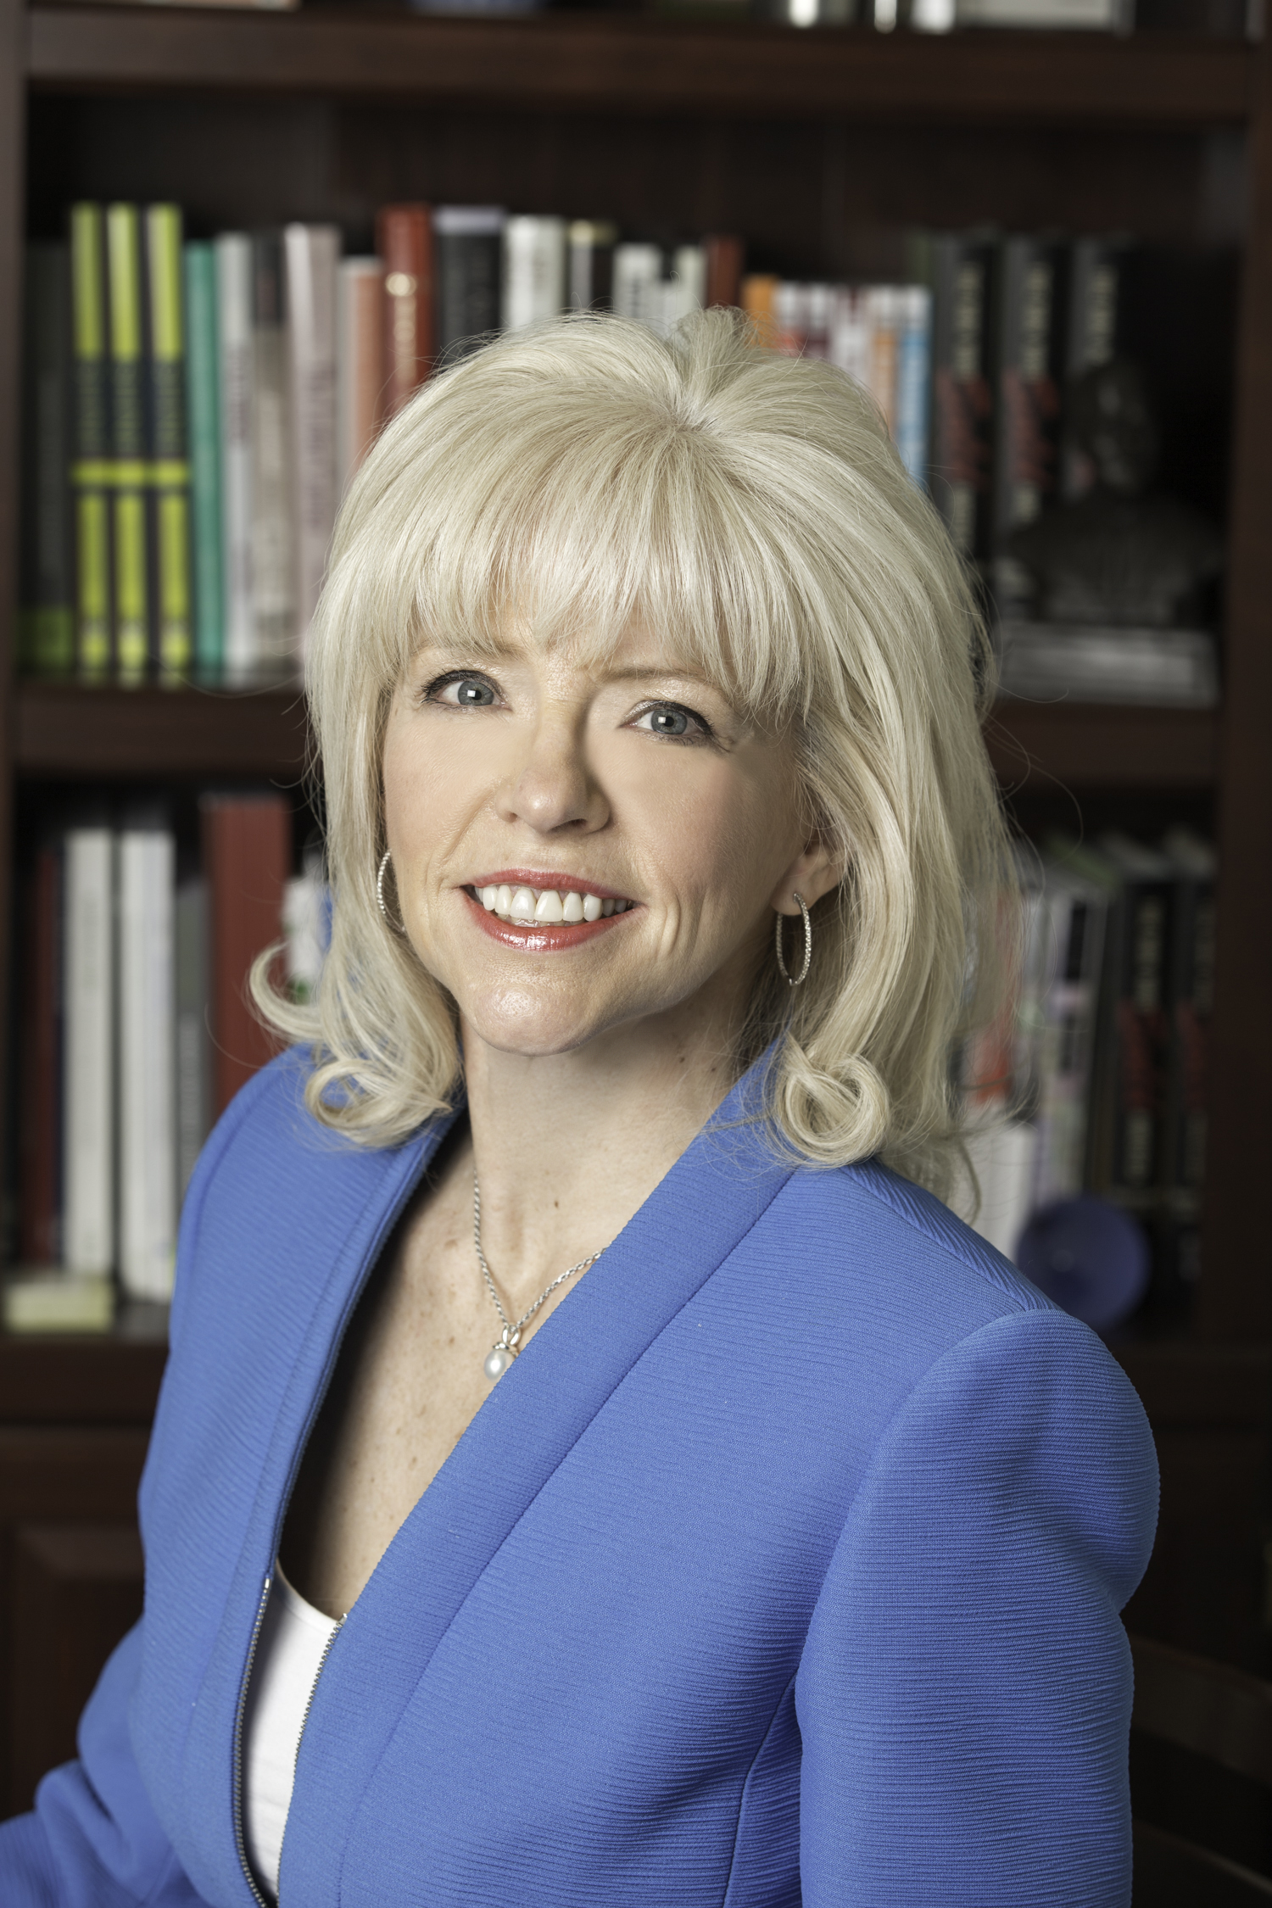
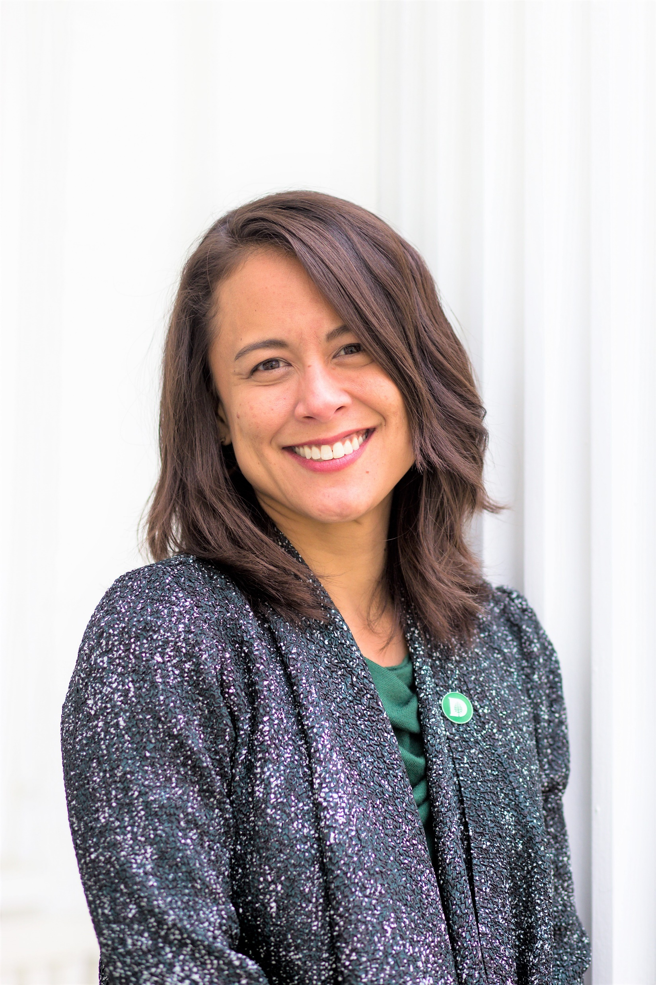
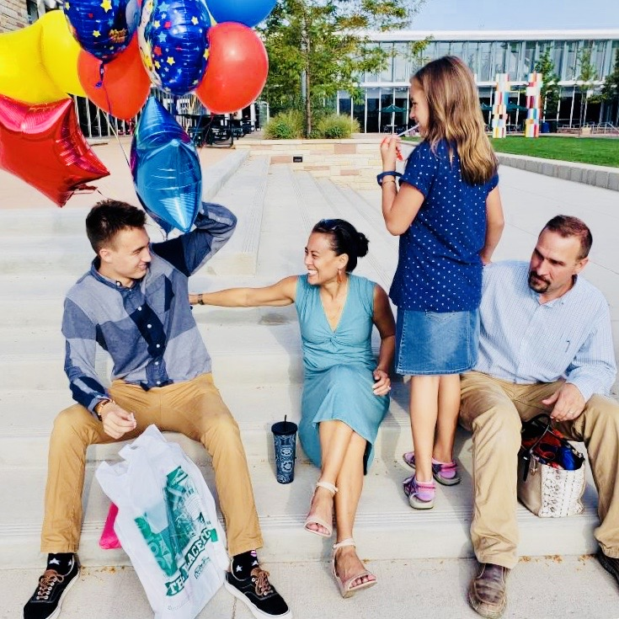
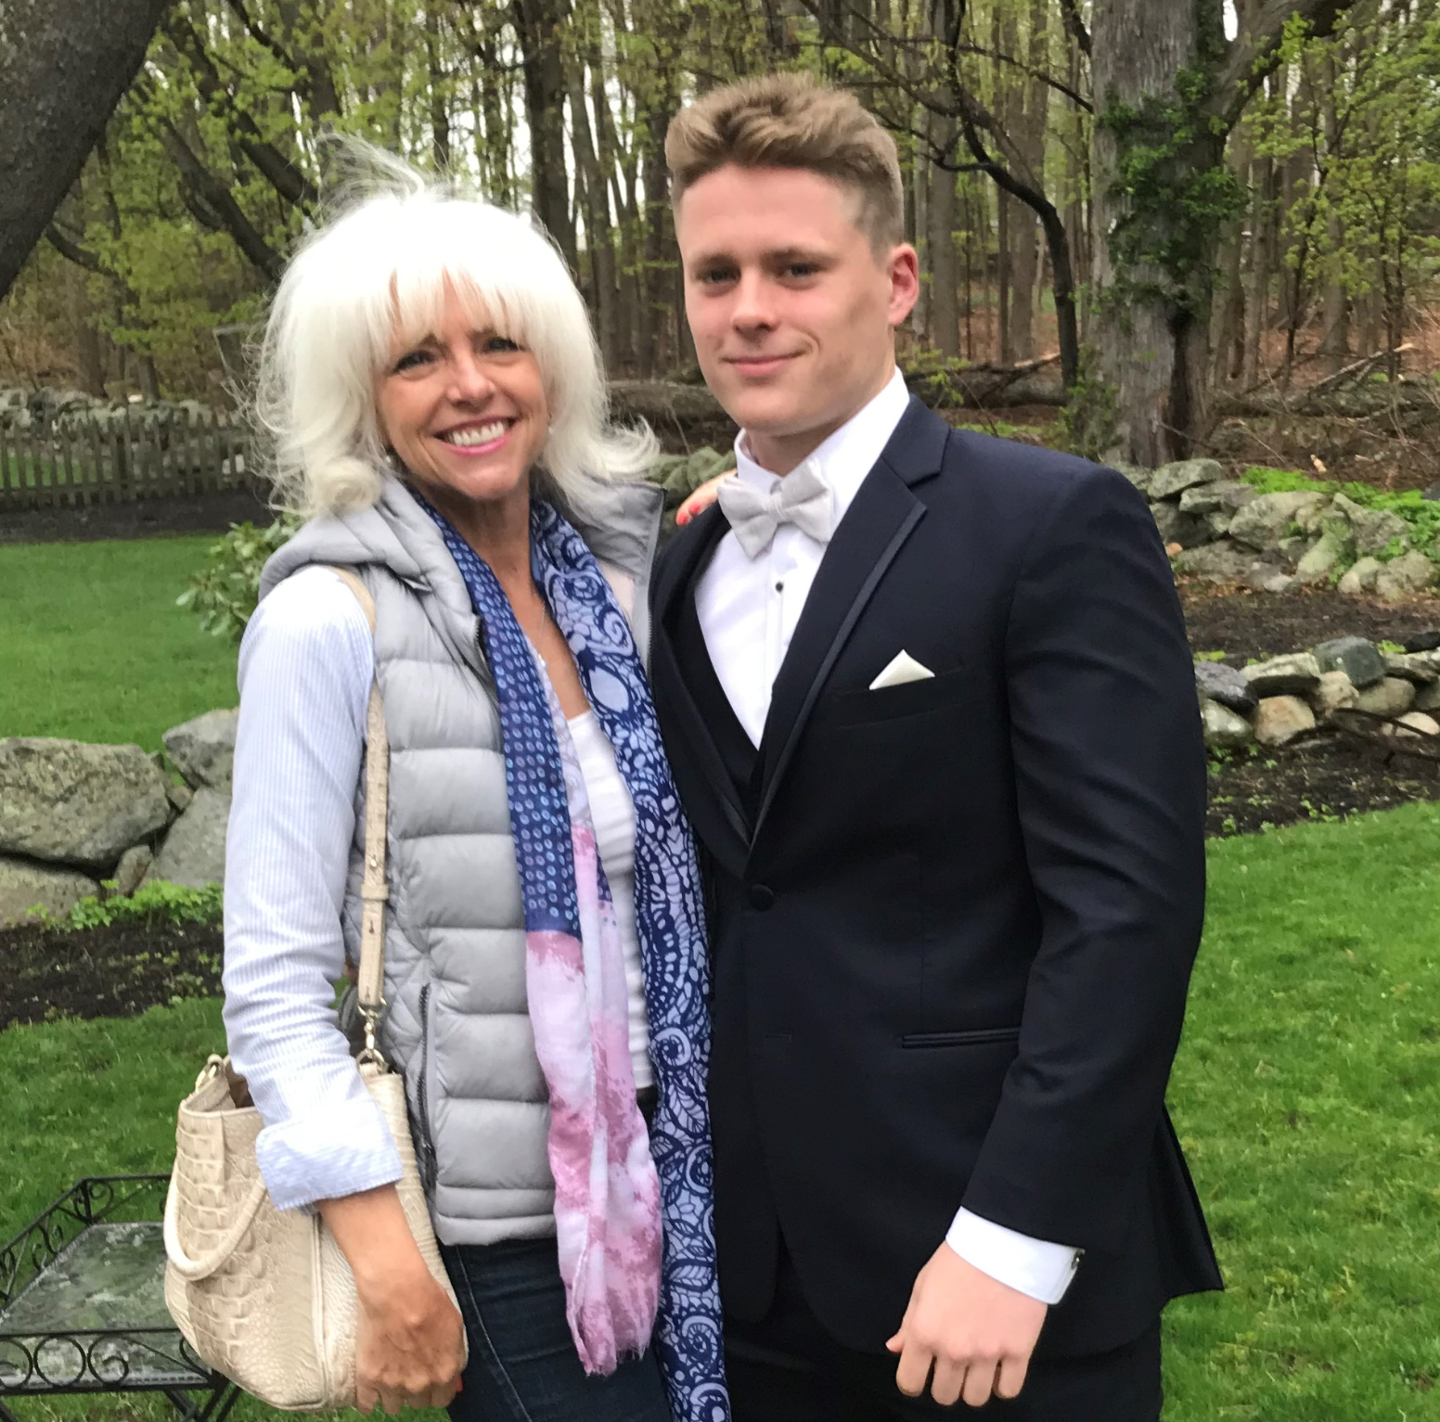
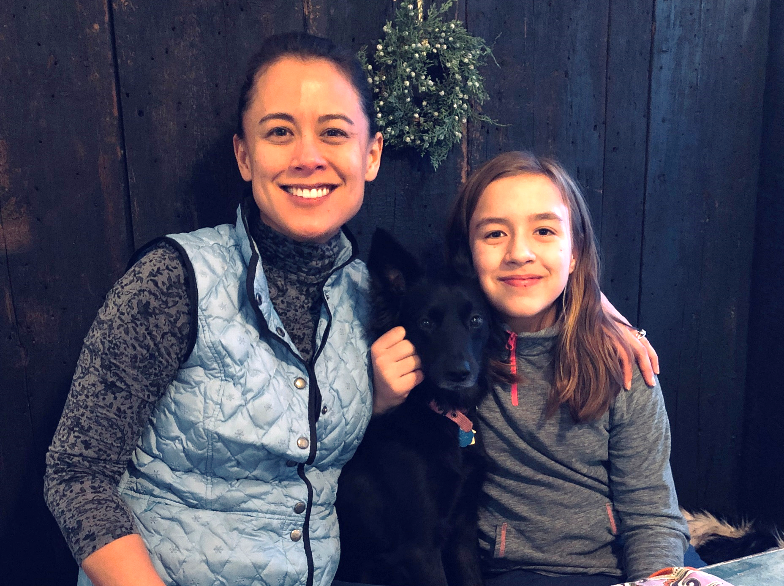
Program Managers
Amy Bronson
Boston University
Alexis Kanda-Olmstead
Dartmouth College

Slide 3

Verb am·pli·fied, am·pli·fy·ing.
enlarge or expand, increase in volume
cause to become more intense
synonym: give credit, advocate
antonym: ignore, silence
Notes:
AKO

Slide 4
Kristina Lentz Capano, Boston University
Janine Hetherington, Williams College
Elyssa Kelly, University of Connecticut
Louise Kennedy, Boston University
Shela Levante, Berkshire Community College
Liliana Mickle, Boston University
Colleen Murphy, Boston College
Katherine Norton, Dartmouth College
Kristina Ramsay, Concordia University
Janna Schwartz, Boston University
Cynthia Scott, Dartmouth College
Stasia Walmsley, Providence College
Georgia Young, Brown University
Amplify Leads

Slide 5

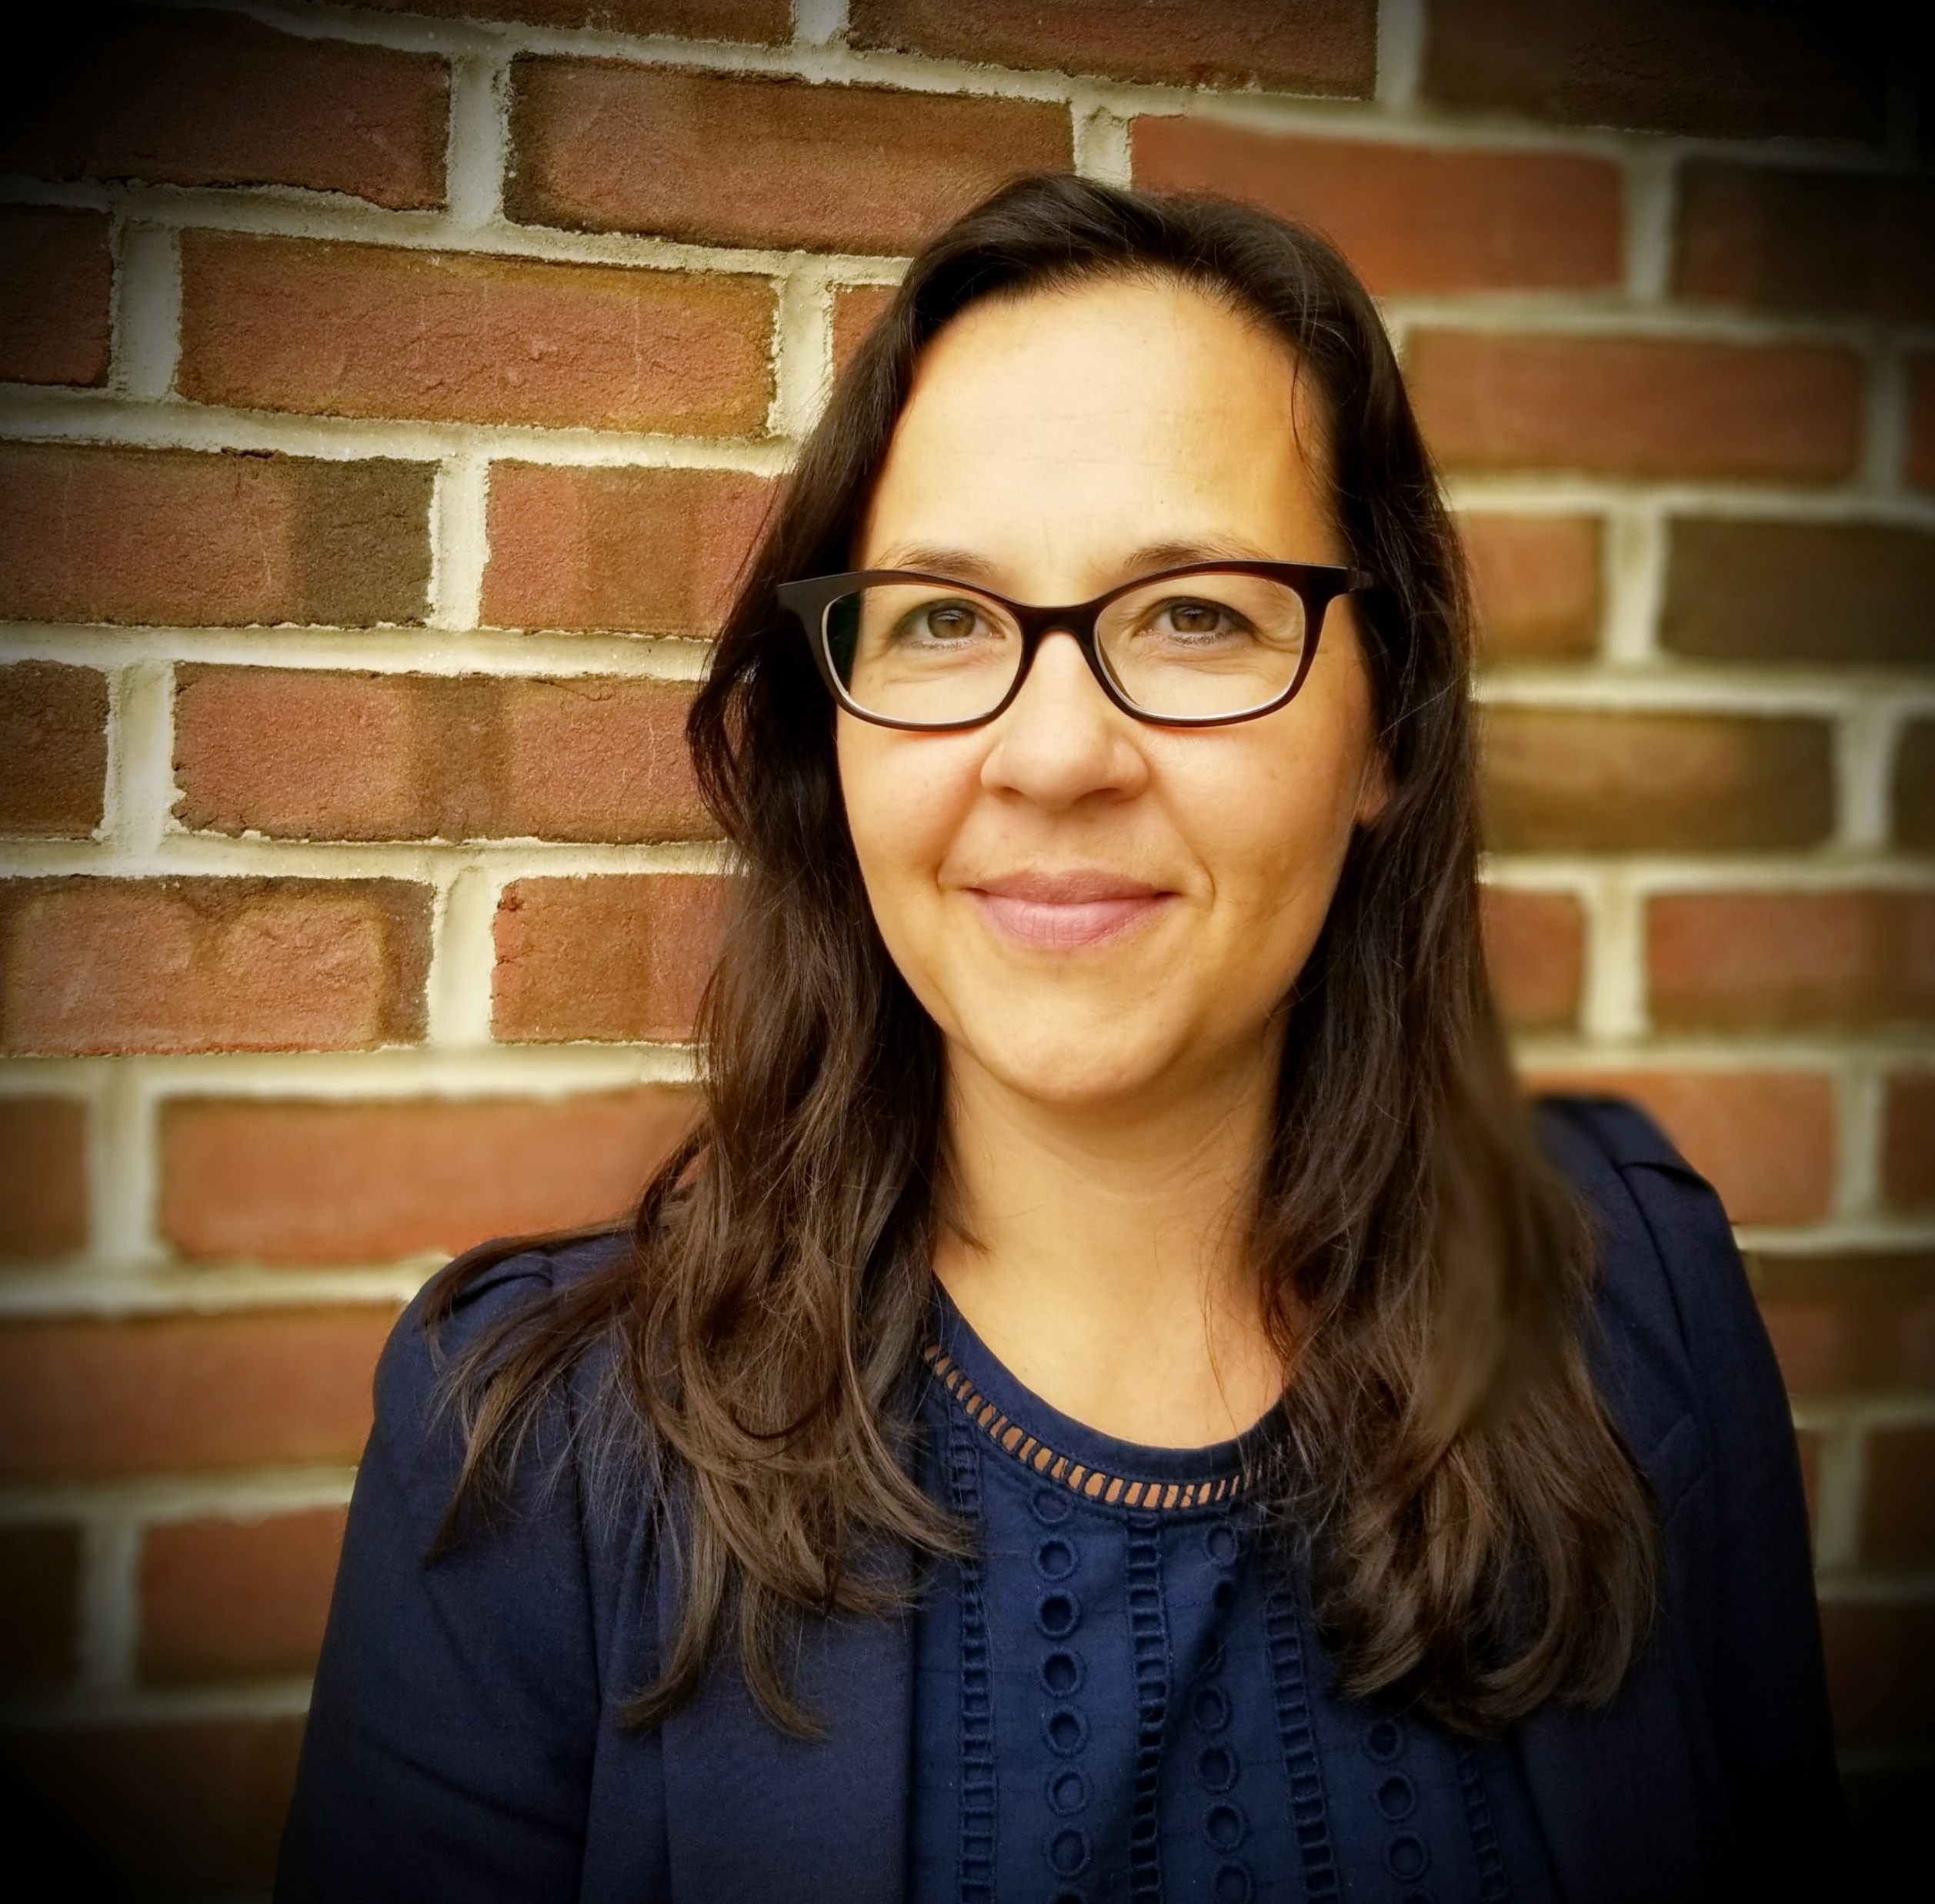
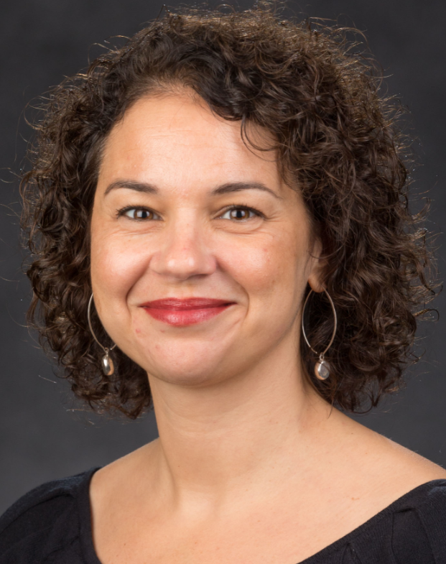
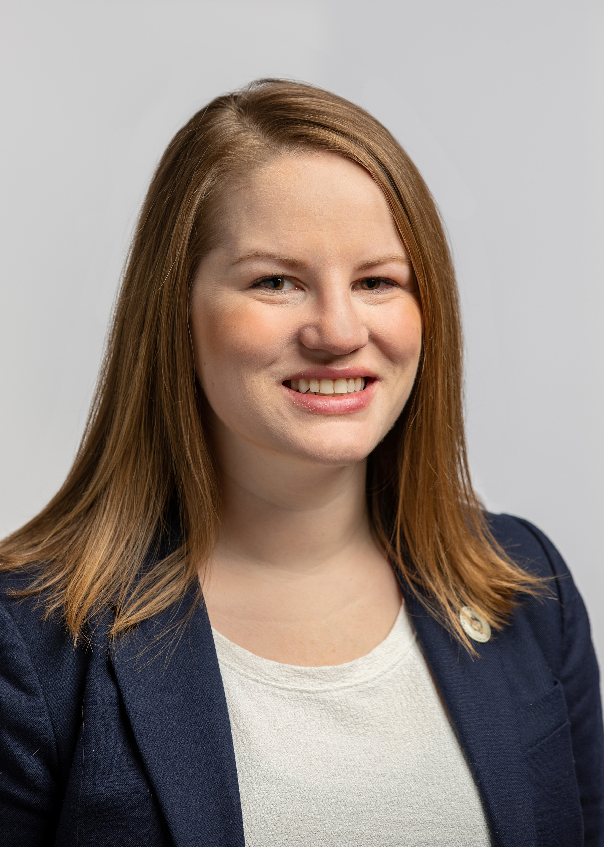
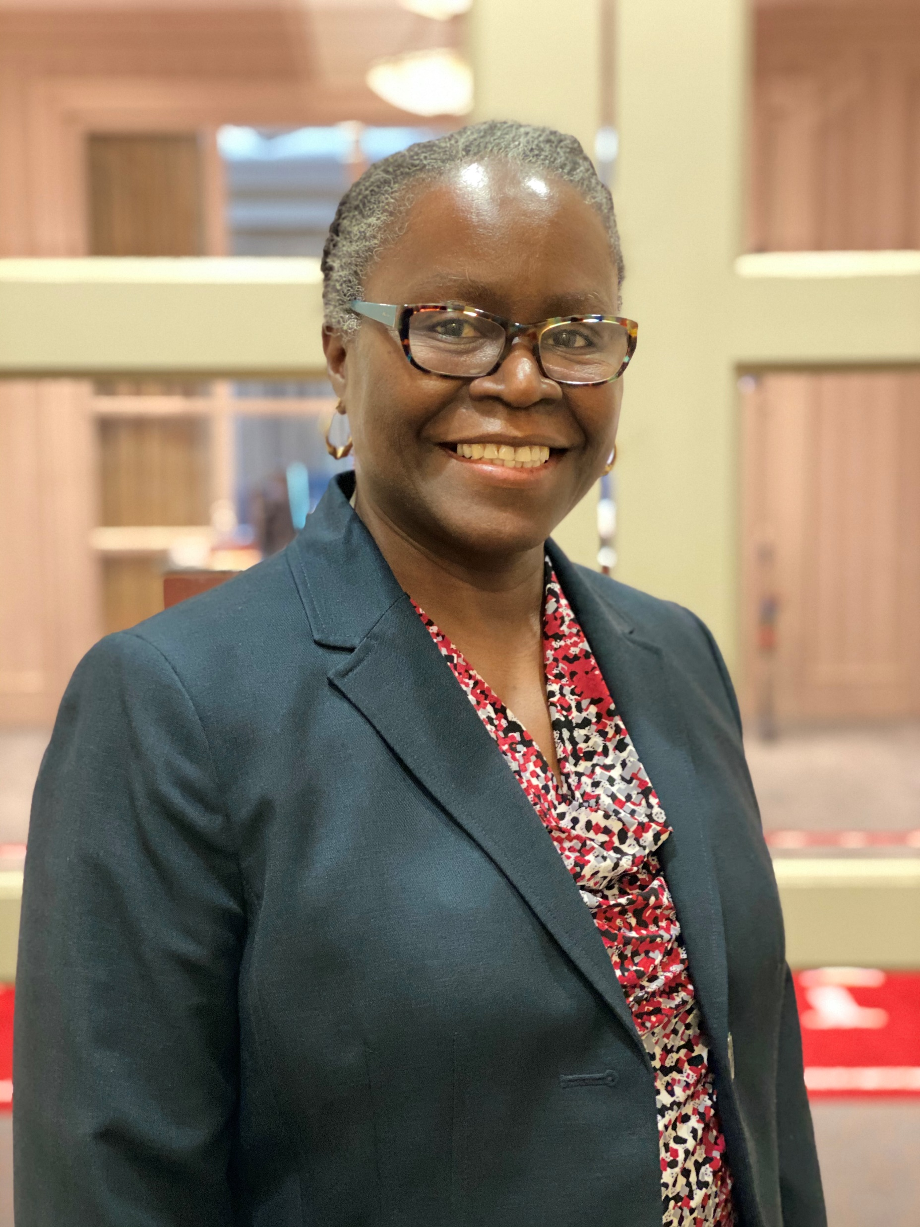
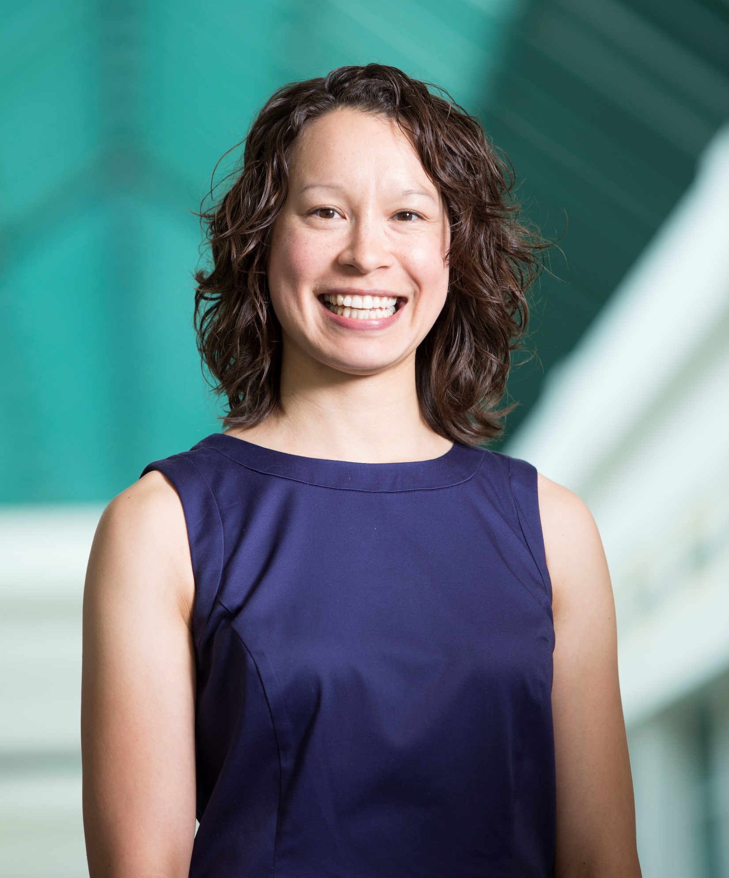
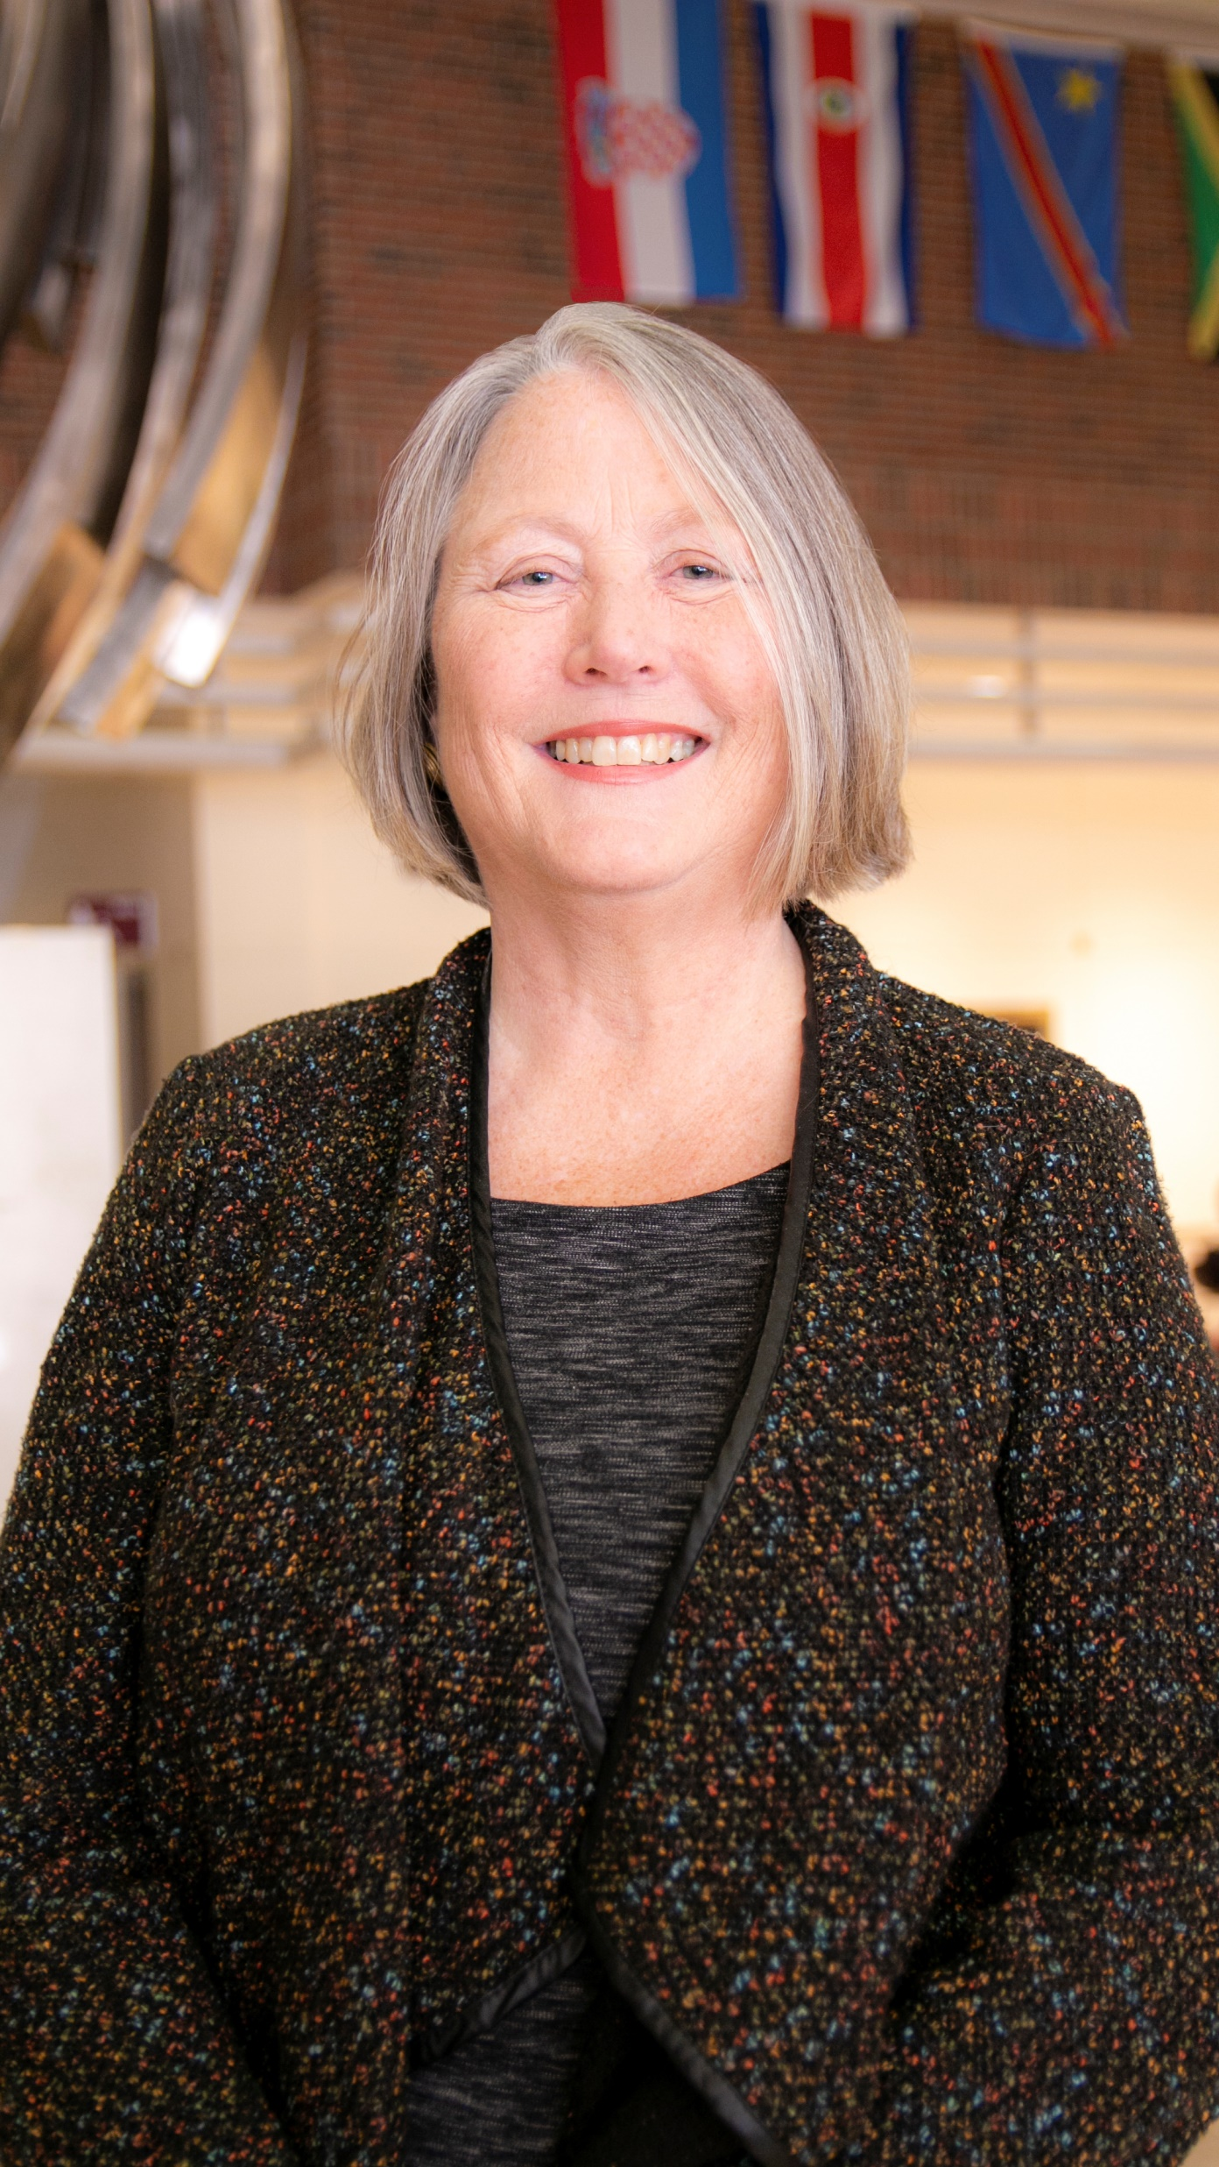
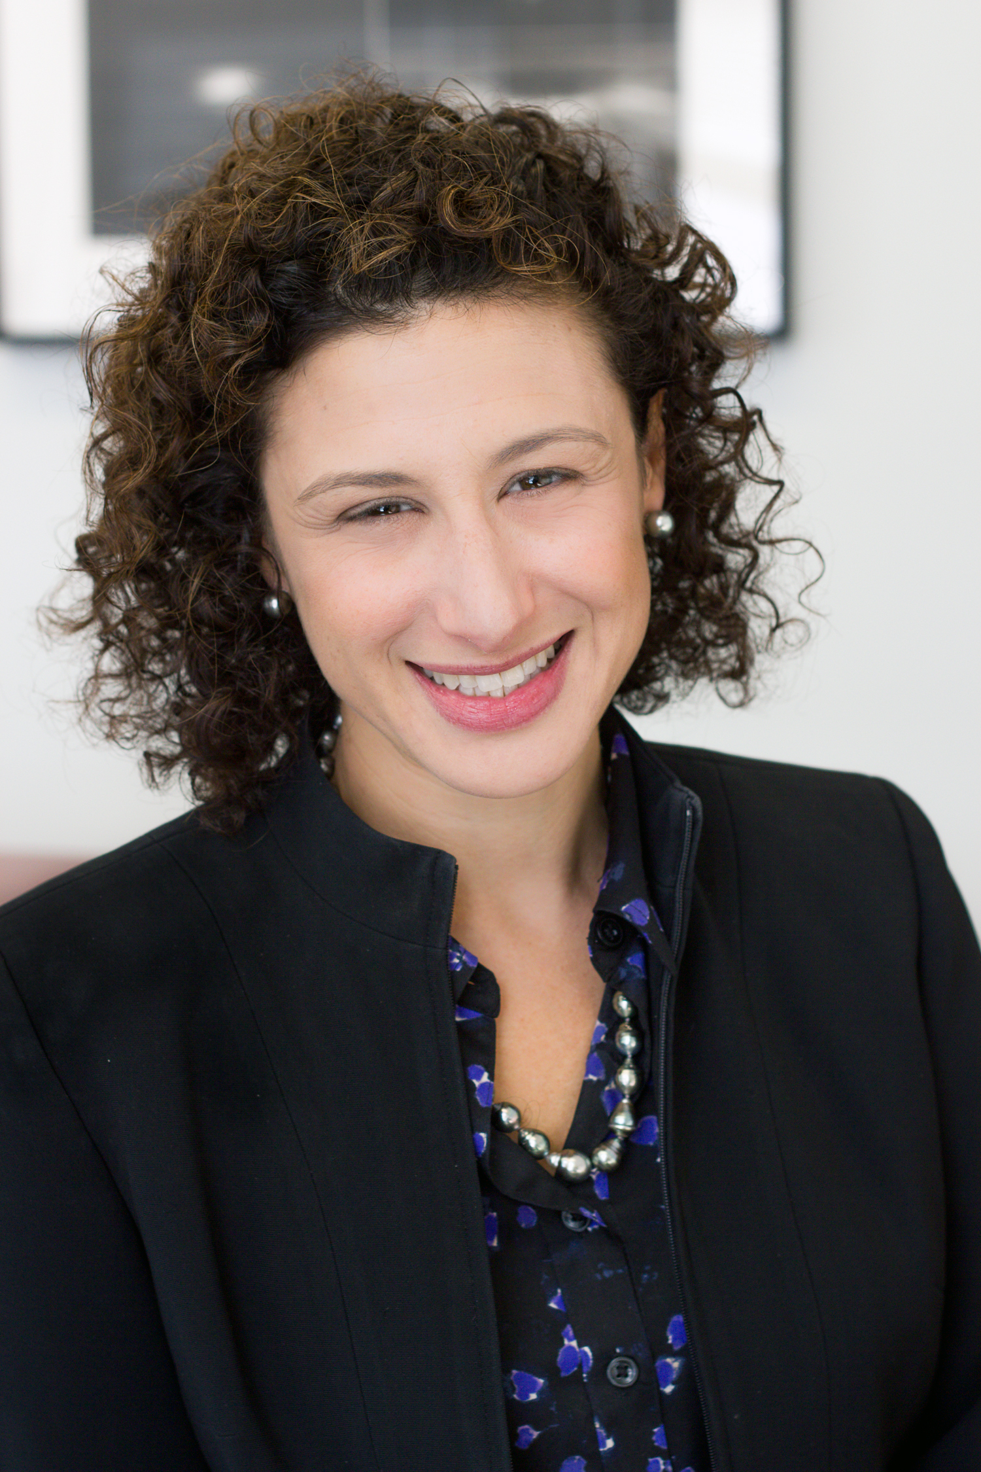
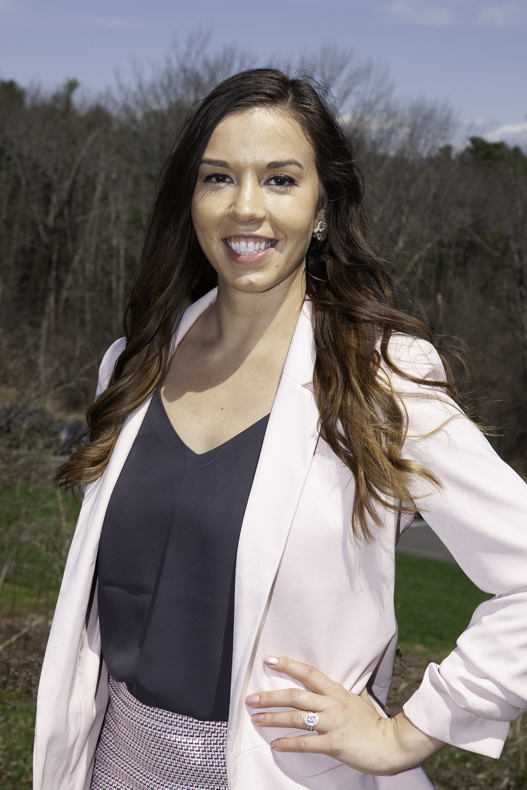
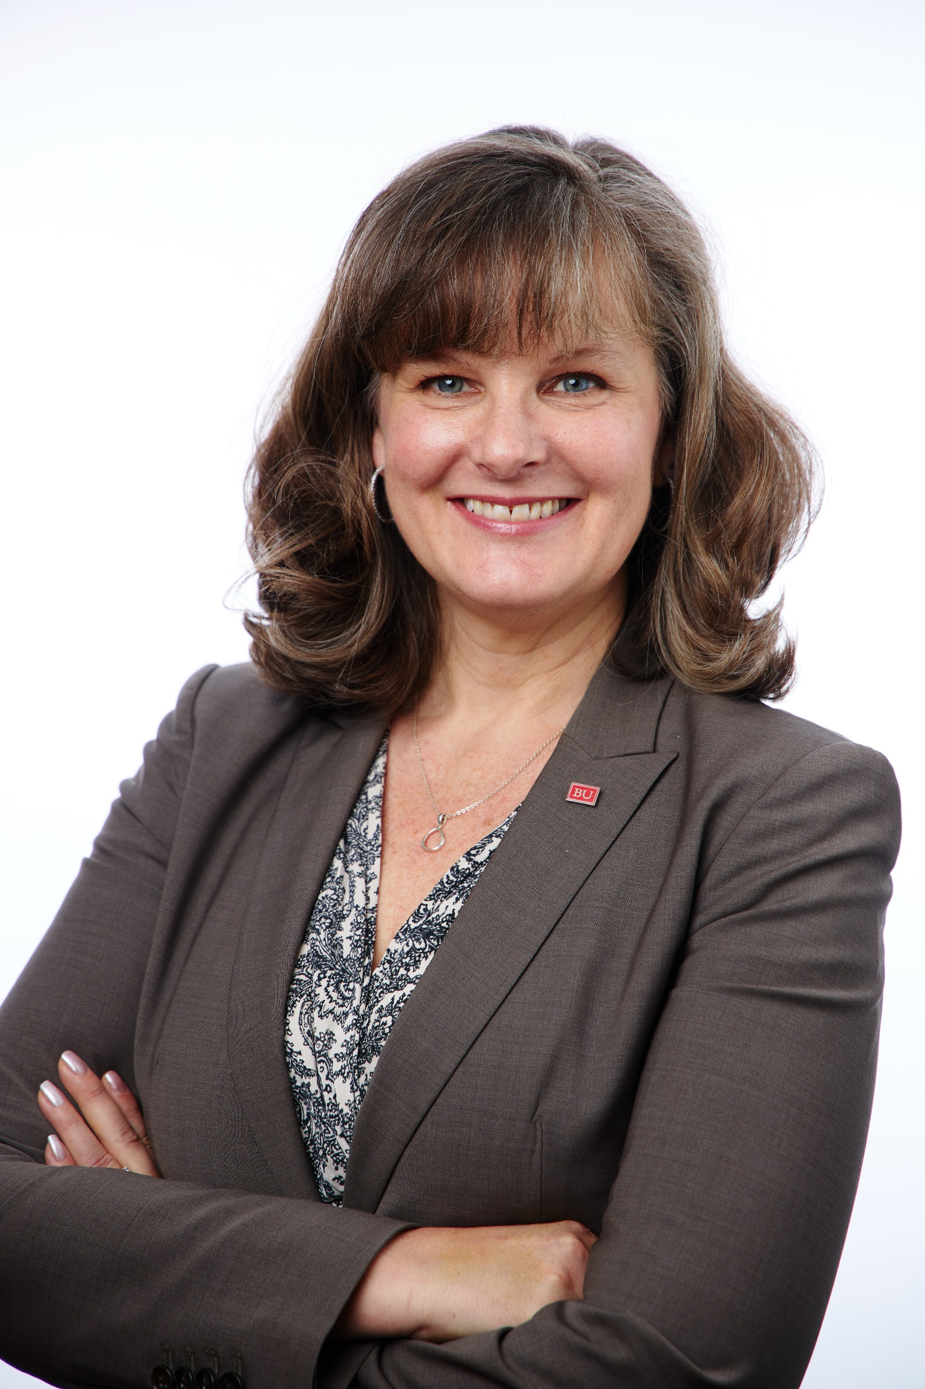
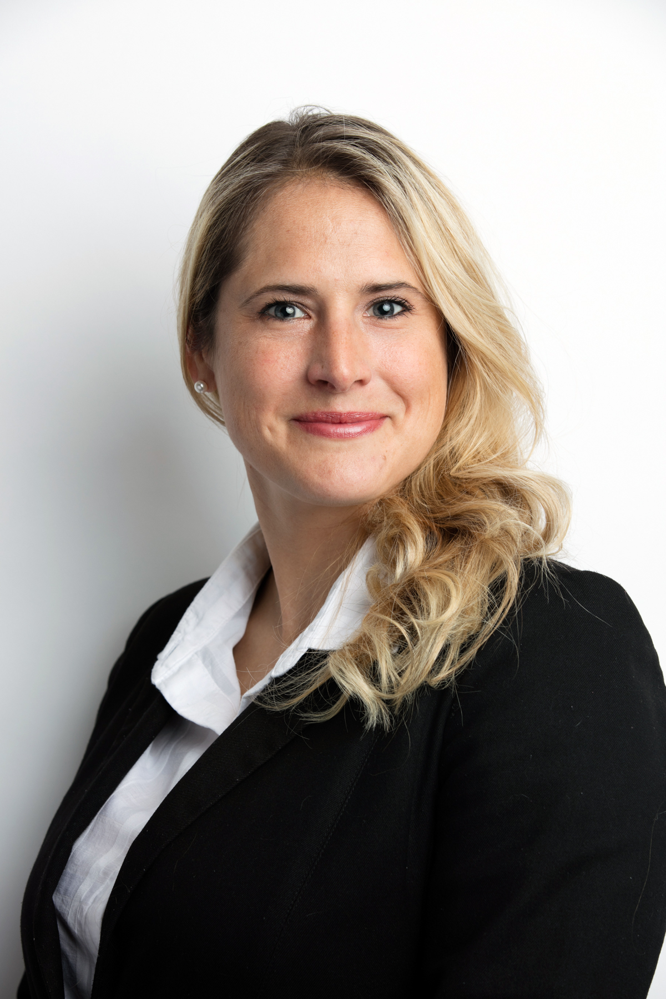
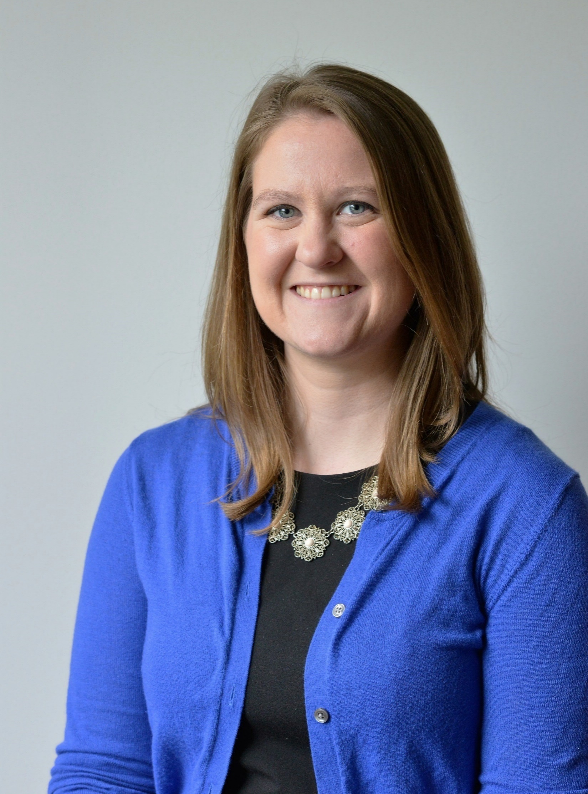
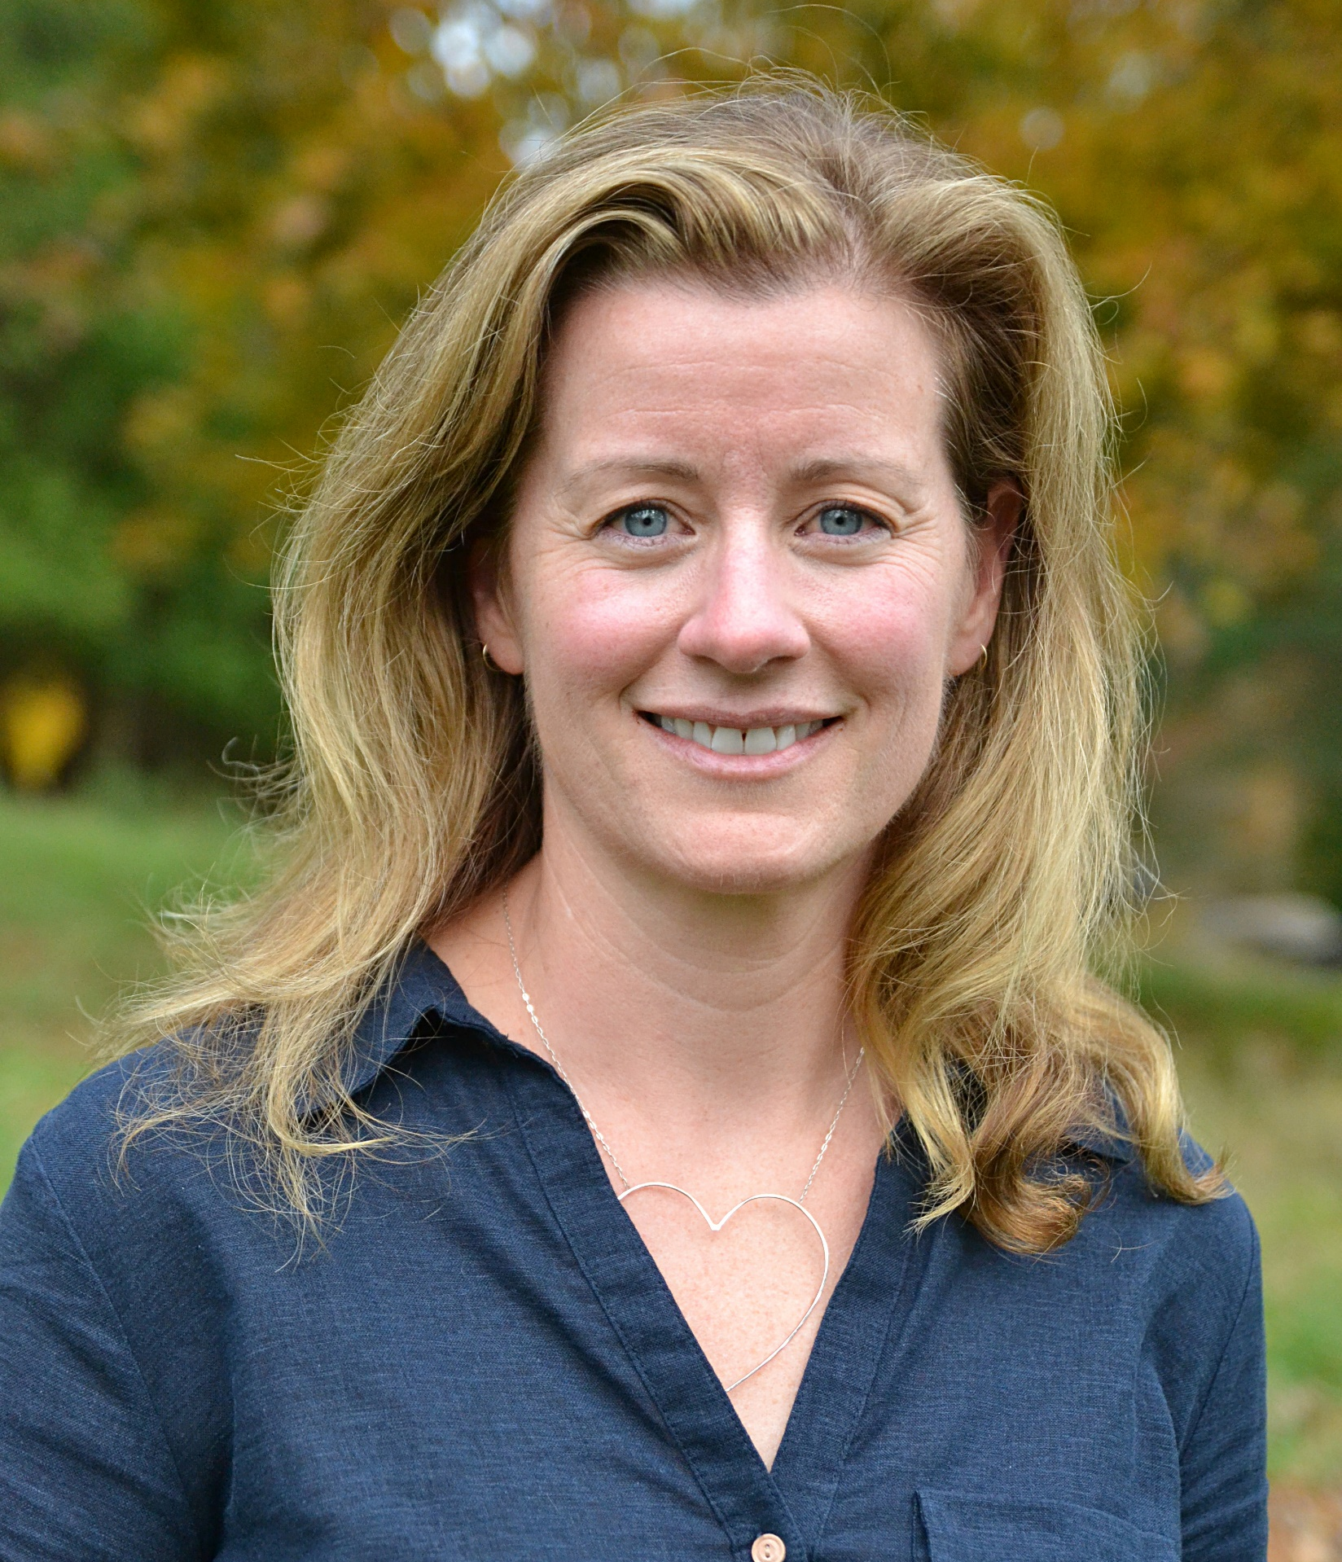
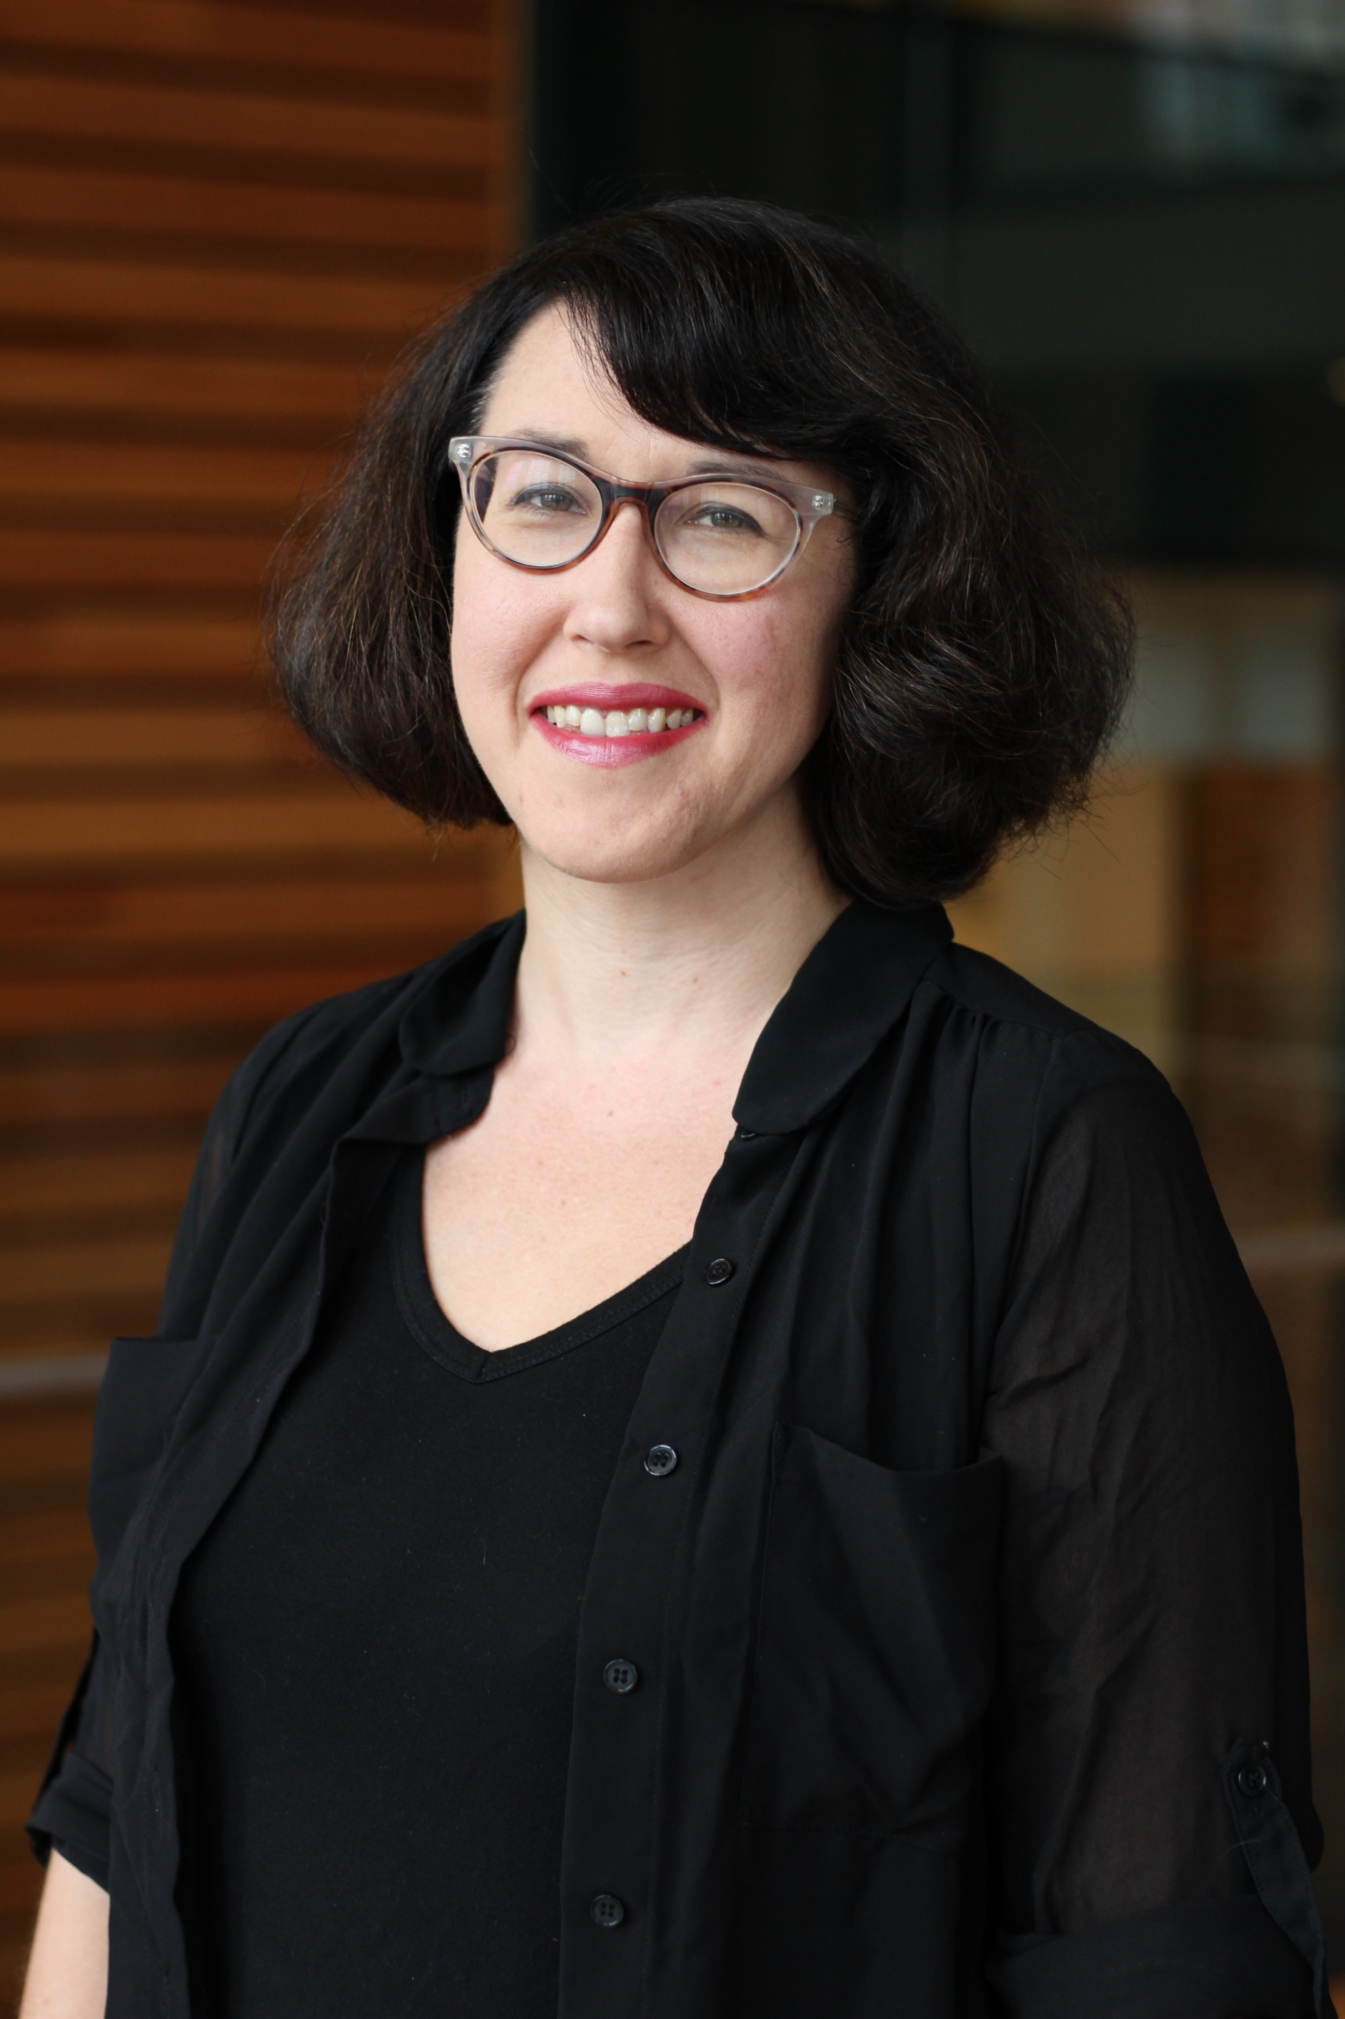

Slide 6
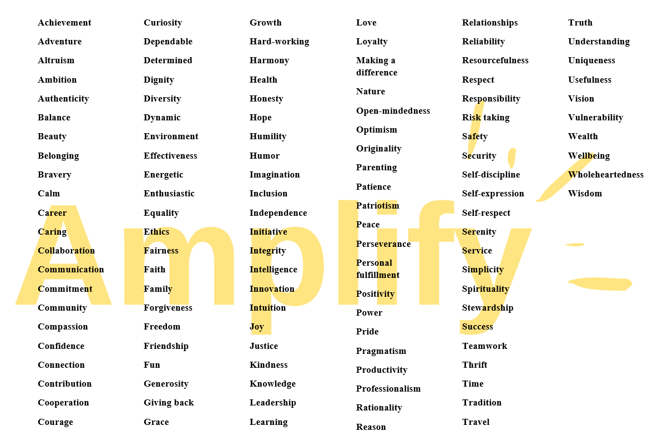

Slide 7

Zoom Chat
Please share your superpower in the chat.
(2 minutes)

Slide 8
Program Overview
Presentation
Discussion
Reunion
Assessment
Supervisor
Allies

Slide 9
Amplify Sessions
Session 1 (5/1/20) Amplifying Yourself and Others
Session 2 (5/8/20) Deconstructing Gender and Leadership
Session 3 (5/15/20) Expanding Identity to Values and Strengths
Session 4 (5/22/20) Cracking the Confidence Code
Session 5 (5/29/20) Cultivating Resilience
Session 6 (6/5/20) Building Inclusive Organizations
Session 7 (6/12/20) Creating Change through Community
Session 8 (6/19/20) Sustaining a Movement
Make-up sessions will take place Wednesdays at 4 p.m. Zoom info on the website.

Slide 10

Your Why for Amplify
Journal: Prep for Discussion
Reflection for Small Group Discussion
Why did you decide to join Amplify?
How might your superpower help you achieve your “why”?

Slide 11

Your Why for Amplify
Kristina Lentz Capano, Boston University

Slide 12
Amplify Aspirations
Practice courage, compassion, and curiosity
Elevate efforts to larger systems and structures
Ask questions and listen to increase understanding
Focus on productive thoughts, behaviors, and feelings
Monitor and adjust your level of participation
Keep confidences and protect people’s privacy
View everyone as a potential ally and partner
Expect, embrace, and celebrate imperfection
Take care of yourself
Have fun, laugh, and play

Slide 13
Amplify Aspirations
Practice courage, compassion, and curiosity
Elevate efforts to larger systems and structures
Ask questions and listen to increase understanding
Focus on productive thoughts, behaviors, and feelings
Monitor and adjust your level of participation
Keep confidences and protect people’s privacy
View everyone as a potential ally and partner
Expect, embrace, and celebrate imperfection
Take care of yourself
Have fun, laugh, and play

Slide 14
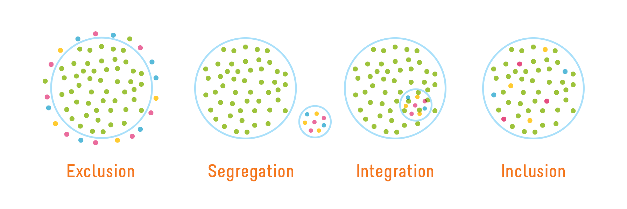
Inclusion of all genders
Image credit: Playcore https://www.playcore.com/inclusive-play-matters-1

Slide 15
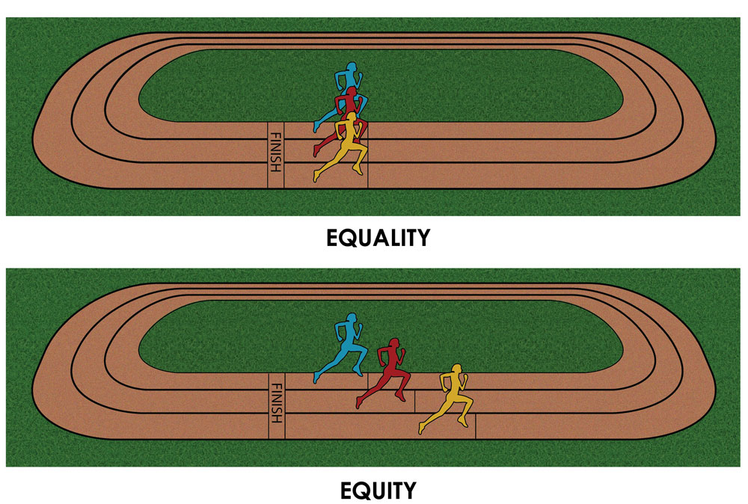
Equity to achieve equality
Equality : Treating everyone the same to ensure fairness.
The end goal.
Equity : Treating everyone differently to ensure fairness.
The means to get there.
Graphic by Paul Kuttner (2015) Cultural Organizing http://culturalorganizing.org/the-problem-with-that-equity-vs-equality-graphic/

Slide 16
Intersectionality or bust
gender
class
race
intersectionality
Image credit: Jennifer L. Le, Ph.D.
Image credit: Jennifer L. Le, Ph.D.

Slide 17
Amplify Strategies
Individual Development
Leadership Development
Organizational Development

Slide 18
Amplify Skills
Reframing
To look at something in a new way
Navigating
To avoid or go around obstacles
Advocating
To create change for self and others

Slide 19
Amplify Skill Application
Journal: Private Reflection
In what ways have you practiced each of the Amplify Skills to get where you are today?
Reframing
To look at something in a new way
Navigating
To avoid or go around obstacles
Advocating
To create change for self and others

Slide 20


Session 2:
Deconstructing Gender and Leadership
AFP membership is 70% female, but 4 out of 5 senior positions in fundraising are held by males.
Among the CASE 50 Institutions, only 26% are headed by female Chief Advancement Officers.
2018 statistics reported by the Educational Advisory Board and the Association of Fundraising Professionals.

Slide 21

Amplify
synonym: give credit, advocate
antonym: ignore, silence
to enlarge or expand, increase in volume, cause to become more intense

Slide 22
3B’s
Bummer
Boast
BTW

Slide 23
Amplify
Women and Gender Initiative

Slide 24
Zoom Poll
In your opinion, which image best represents women in the Advancement profession?
In your opinion, which image best represents women *leaders* in the Advancement profession?

Slide 25
Zoom Poll

