Slide 1

Zoom Chat
What’s one word that describes how you’re doing today?
Notes:
AB (2-3 min)
Amy will greet and ask people to respond to the question in the chat
Alexis will manage any Zoom issues (e.g., joining the call, muting themselves, etc.)
Patricia will post the question “What’s one word that describes how you’re doing today?” in the chat.
Please re-post this every few minutes because new participants won’t see the original question

Slide 2

Amplify
Women and Gender Initiative
Notes:
AB (1 min)
Thank you for joining us today. Have a great time in you’re discussion session with your Amplify Lead.

Slide 3

Amplify Sessions
Session 1 (5/1/20) Amplifying Yourself and Others
Session 2 (5/8/20) Deconstructing Gender and Leadership
Session 3 (5/15/20) Expanding Identity to Values and Strengths
Session 4 (5/22/20) Cracking the Confidence Code
Session 5 (5/29/20) Cultivating Resilience
Session 6 (6/5/20) Building Inclusive Organizations
Session 7 (6/12/20) Creating Change through Community
Session 8 (6/19/20) Sustaining a Movement
Make-up sessions will take place Wednesdays at 4 p.m. Zoom info on the website.
Notes:
AKO

Slide 4
Deconstructing
Gender &
Leadership
Session 2 • May 8, 2020
Explore Key Concepts
Create Gender Timeline
Revisit Amplify Skills

Slide 5
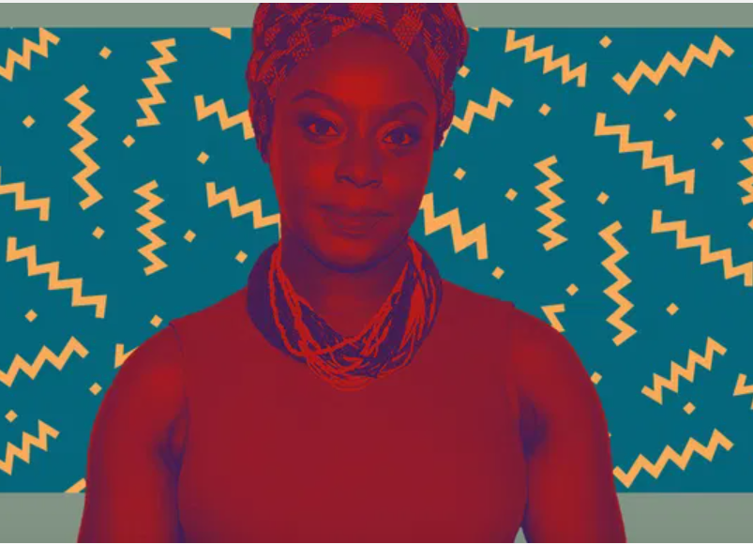
Chimamanda Ngozi Adichie
Nigerian author
Culture does not make people. People make culture.
If it is true that the full humanity of women is not our culture, then we can and must make it our culture.
Source: Creative Services / iOne Digital

Slide 6
Exploring
Gender

Slide 7



What is Gender?
Socially-constructed roles and behaviors based on assigned sex at birth
  Male = boy, man, he/him/his, masculine
  Female = girl, woman, she/her/hers, feminine
  Tied to power, privilege, and oppression
Gender Binary: False assumption that there are only two natural, immutable, and opposed genders (i.e., man and woman)
Gender Expression: One’s outward expression of gender through cultural forms such as language, gestures and artifacts
Gender Identity: One’s internal understanding of their own gender
Nicolazzo, Z. (2017). Trans* in College: Transgender Students’ Strategies for Navigating Campus Life and the Institutional Politics of Inclusion

Slide 8
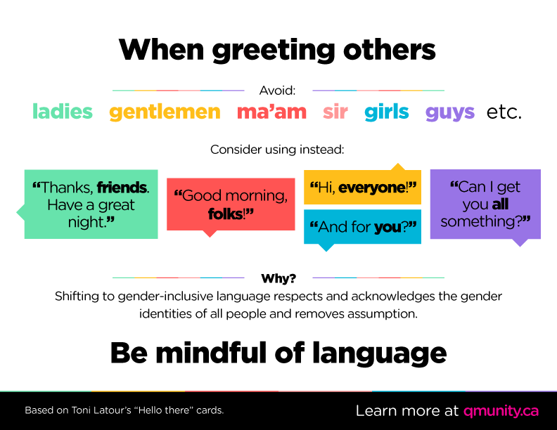

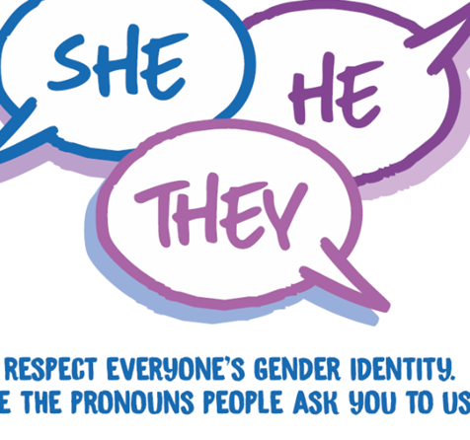
Gender Is Everywhere
Physical spaces
Social activities
Career choices
Parenting roles
Spending habits
Sports and recreation
Notes:
This invisible bias is “coded patriarchy,” and it shapes our daily lives. As a result, the female perspective is quietly omitted in design, business, media, technology, clothing — and even our cities. Take something as simple as entering your office each morning: The average woman struggles to open doors when going in and out of buildings — because most doors are designed for the tensile strength of an average man. Or even your drive to work: When airbags were first released, hundreds of women and children were injured or killed when the bags deployed. The reason? The group of male engineers who designed them were all over 250 lbs and didn’t think to test for women. Forward-thinking industries like tech can be just as stuck in the past: Of the top health trackers (Apple, Fitbit, Nike) — not one had a period tracker at release, even though half of the target customer base tracks periods as part of their normal health routine, and health trackers are primarily used by women.
The result of all of this is that men move through the world unaware that it’s been designed for their comfort, and women move through the world encountering small points of friction or discomfort daily, or pain points.
Their study, published Monday in the journal Nature Climate Change, says that most office buildings set temperatures based on a decades-old formula that uses the metabolic rates of men. The study concludes that buildings should “reduce gender-discriminating bias in thermal comfort” because setting temperatures at slightly warmer levels can help combat global warming.
Motherhood Penalty and Fatherhood Bonus: "On average, men’s earnings increased more than 6 percent when they had children (if they lived with them), while women’s decreased 4 percent for each child they had.“https://mobile.nytimes.com/2014/09/07/upshot/a-child-helps-your-career-if-youre-a-man.html

Slide 9

Idealized Femininity
Inside the Box/Outside the Box
Inside: Acceptable behaviors, roles, attitudes, ways of being
Outside: Unacceptable behaviors, roles, attitudes, ways of being
Notes:
AKO
Disclaimer about false gender binary….
Large group this
3:00 p.m. Gender and Leadership (AKO)
3:00-3:15 p.m.: Inside/outside the box in large group (15 min)
3:15-3:30 p.m.: Large group debrief (15 min)
3:30-4:00 p.m.: Create posters (30 min)
4:00-4:30 p.m.: Poster presentations

Slide 10

Zoom Chat
Idealized Femininity
What are examples of acceptable behaviors, roles, attitudes, and ways of being?
What are examples of unacceptable behaviors, roles, attitudes, and ways of being?

Slide 11
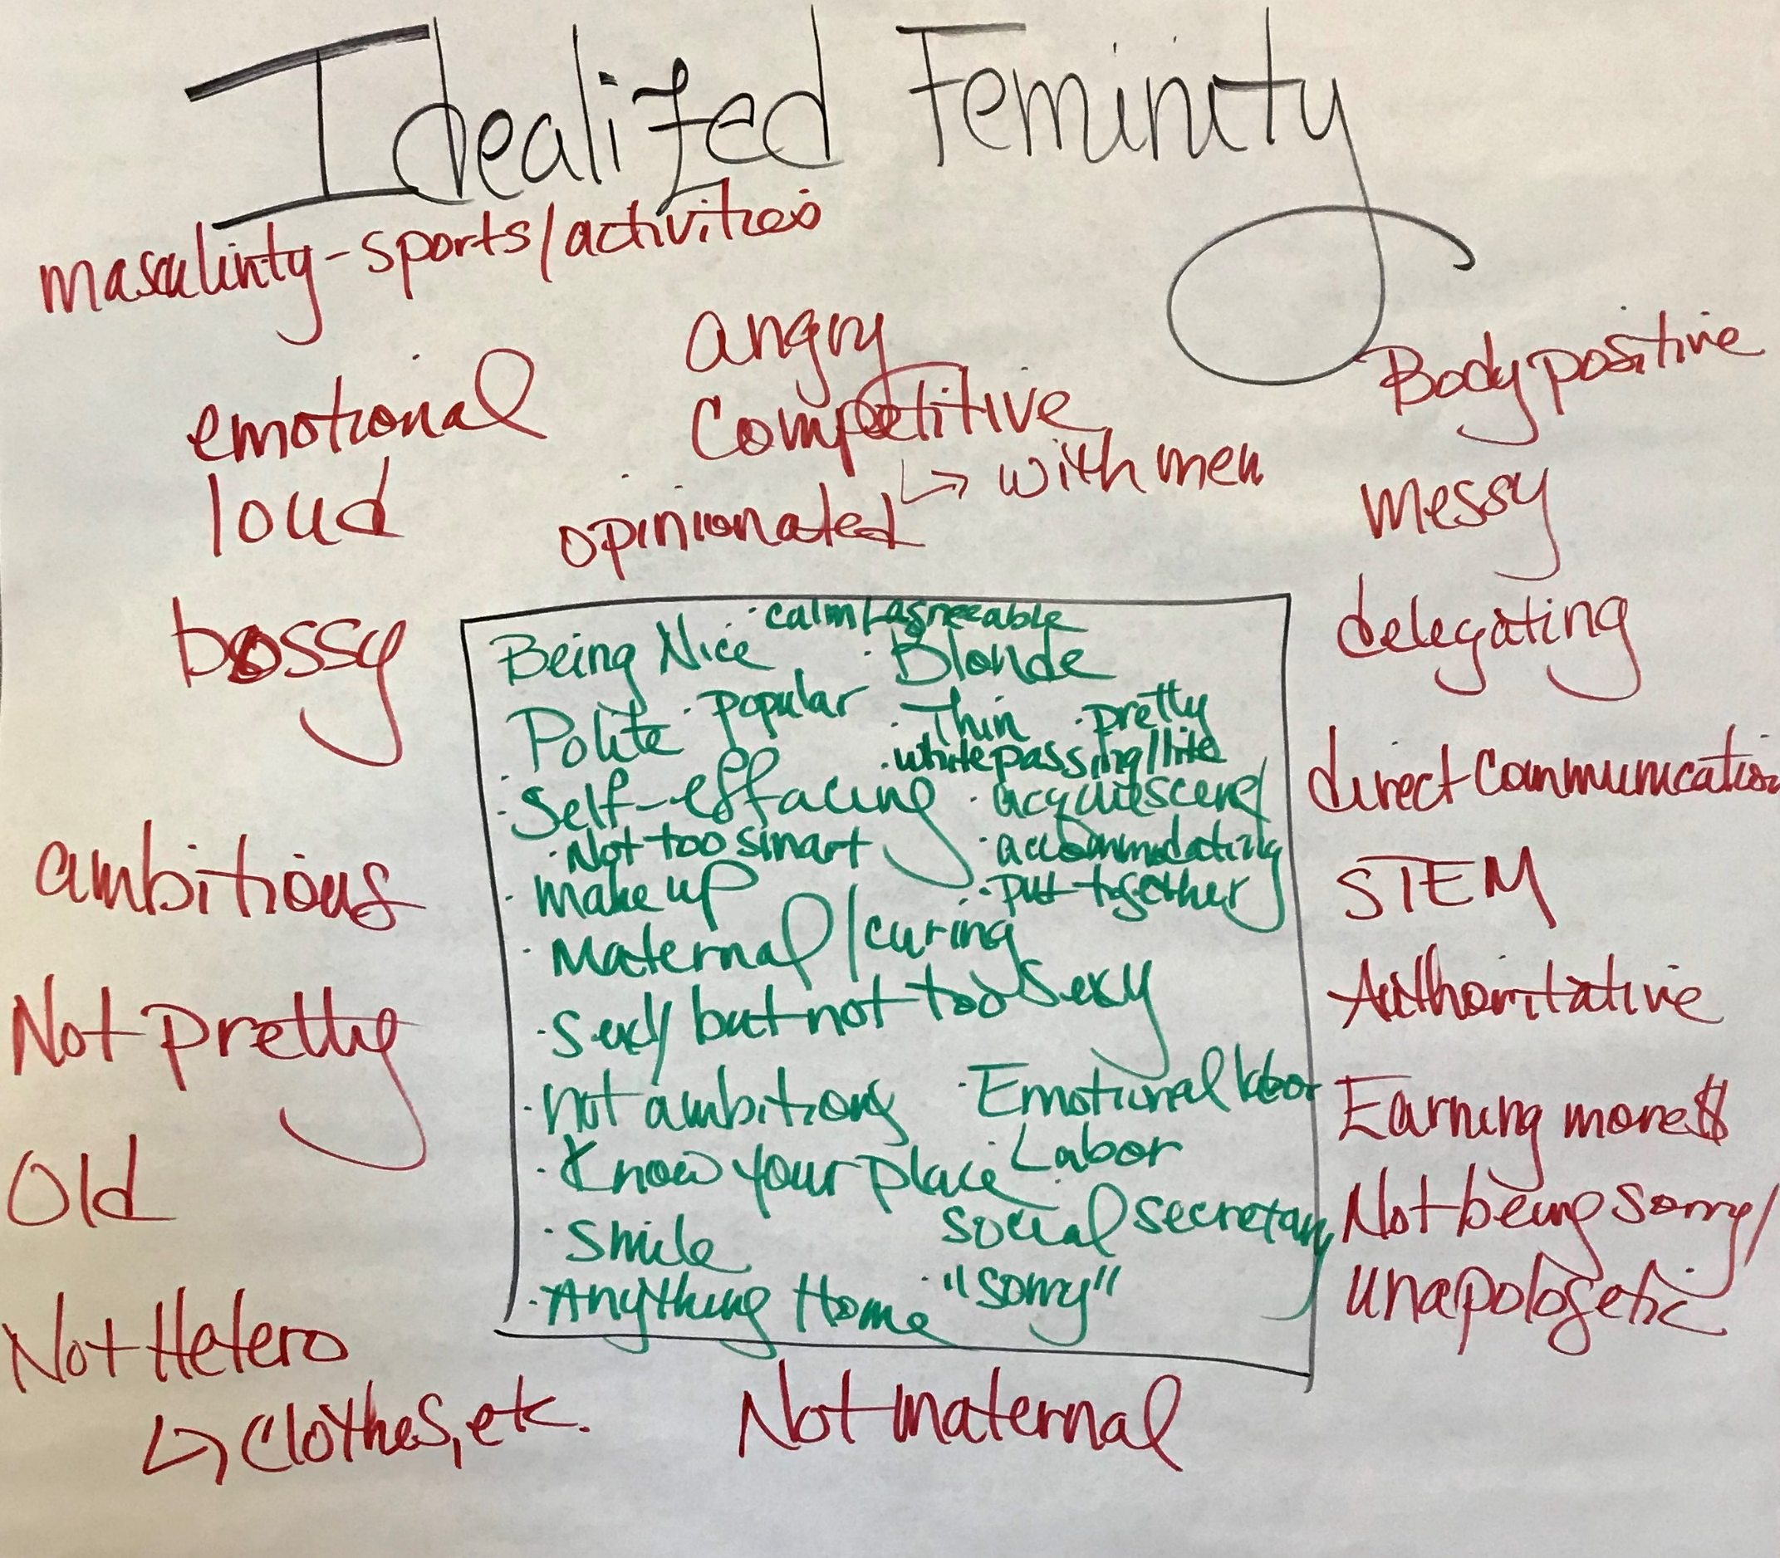

Slide 12

Idealized Masculinity
Inside the Box/Outside the Box
Inside: Acceptable behaviors, roles, attitudes, ways of being
Outside: Unacceptable behaviors, roles, attitudes, ways of being
Notes:
AKO
Same drill
3:00 p.m. Gender and Leadership (AKO)
3:00-3:15 p.m.: Inside/outside the box in large group (15 min)
3:15-3:30 p.m.: Large group debrief (15 min)
3:30-4:00 p.m.: Create posters (30 min)
4:00-4:30 p.m.: Poster presentations

Slide 13

Zoom Chat
Idealized Masculinity
What are examples of acceptable behaviors, roles, attitudes, and ways of being?
What are examples of unacceptable behaviors, roles, attitudes, and ways of being?

Slide 14
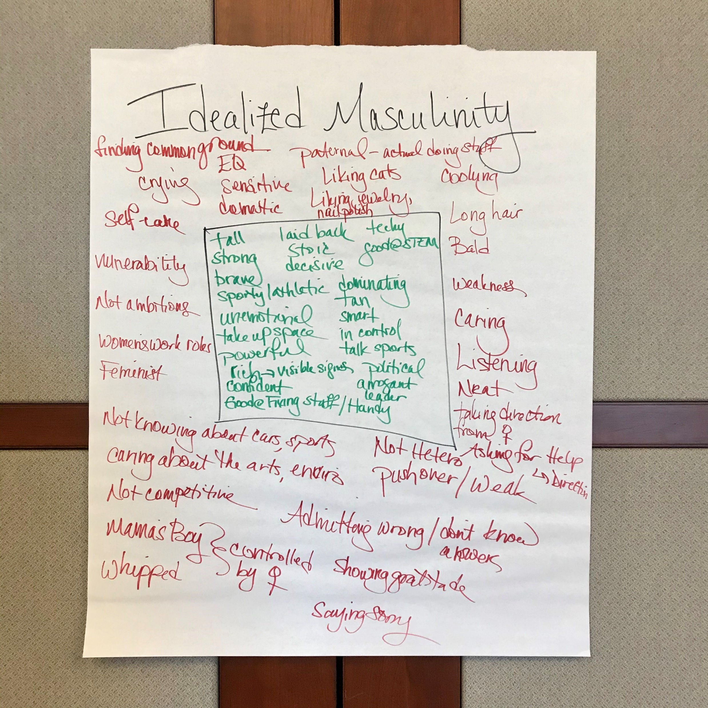

Slide 15
Gender
Timeline

Slide 16
Gender Timeline
Instructions
Draw a timeline
X Axis = Time
Y Axis = Impact
Plot 5 key life events that occurred because of gender
Connect the dots and use drawings, words, or color to add meaning
Y
X
0
Notes:
AB
Instructions:
Women draw a timeline with the X-axis indicating time in 5-10 year increments and the Y-axis indicating positive to negative impact.
They then graph the top 5 gender-related events in their lives to date (1=adolescence and 5=present) that impacted them positively or negatively.
Explain that women do not need to share their timeline in its entirety – it’s mostly a private reflection. They will be invited to share one item with the larger group.
Connect the dots and use drawings, words, or color to add meaning.
Amy to share a brief example on slide with 3 data points that are different in cause and impact.
10 min. individual drawing
At least 3-5 items, not everything in your entire life
10 min. journal
What stands out for you?

Slide 17
Gender Timeline
Instructions
Draw a timeline
X Axis = Time
Y Axis = Impact
Plot 5 key life events that occurred because of gender
Connect the dots and use drawings, words, or color to add meaning
Y
X
0
Time
(age, decade, etc.)
Notes:
AB
Instructions:
Women draw a timeline with the X-axis indicating time in 5-10 year increments and the Y-axis indicating positive to negative impact.
They then graph the top 5 gender-related events in their lives to date (1=adolescence and 5=present) that impacted them positively or negatively.
Explain that women do not need to share their timeline in its entirety – it’s mostly a private reflection. They will be invited to share one item with the larger group.
Connect the dots and use drawings, words, or color to add meaning.
Amy to share a brief example on slide with 3 data points that are different in cause and impact.
10 min. individual drawing
At least 3-5 items, not everything in your entire life
10 min. journal
What stands out for you?

Slide 18
Gender Timeline
Instructions
Draw a timeline
X Axis = Time
Y Axis = Impact
Plot 5 key life events that occurred because of gender
Connect the dots and use drawings, words, or color to add meaning
Y
Positive +++
Impact
X
0
Time
(age, decade, etc.)
Negative ---
Notes:
AB
Instructions:
Women draw a timeline with the X-axis indicating time in 5-10 year increments and the Y-axis indicating positive to negative impact.
They then graph the top 5 gender-related events in their lives to date (1=adolescence and 5=present) that impacted them positively or negatively.
Explain that women do not need to share their timeline in its entirety – it’s mostly a private reflection. They will be invited to share one item with the larger group.
Connect the dots and use drawings, words, or color to add meaning.
Amy to share a brief example on slide with 3 data points that are different in cause and impact.
10 min. individual drawing
At least 3-5 items, not everything in your entire life
10 min. journal
What stands out for you?

Slide 19
Gender Timeline
Instructions
Draw a timeline
X Axis = Time
Y Axis = Impact
Plot 5 key life events that occurred because of gender
Connect the dots and use drawings, words, or color to add meaning
Y
Positive +++
Impact
X
0
Time
(age, decade, etc.)
Negative ---
Notes:
AB
Instructions:
Women draw a timeline with the X-axis indicating time in 5-10 year increments and the Y-axis indicating positive to negative impact.
They then graph the top 5 gender-related events in their lives to date (1=adolescence and 5=present) that impacted them positively or negatively.
Explain that women do not need to share their timeline in its entirety – it’s mostly a private reflection. They will be invited to share one item with the larger group.
Connect the dots and use drawings, words, or color to add meaning.
Amy to share a brief example on slide with 3 data points that are different in cause and impact.
10 min. individual drawing
At least 3-5 items, not everything in your entire life
10 min. journal
What stands out for you?

Slide 20
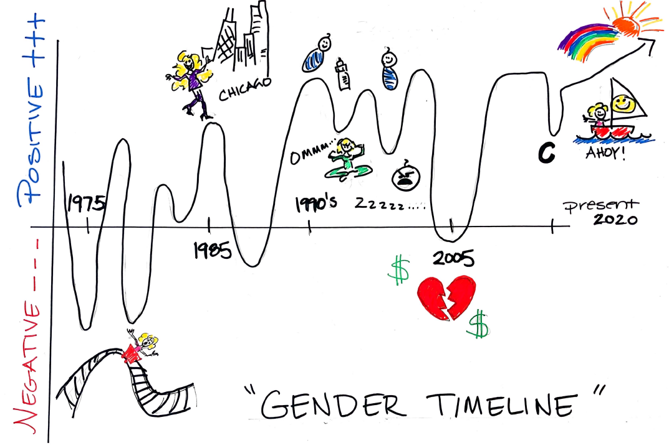
Notes:
AB
*Need 11x17 paper and colored pencils
1:00 p.m. Gender Timeline (AB)
1:00-1:20 p.m.: Intro activity, women draw timeline (20 min)
1:20-1:30 p.m.: Journal (10 min)
1:30-2:30 p.m.: Large group debrief (60 min)
Instructions:
Women draw a timeline with the X-axis indicating time in 5-10 year increments and the Y-axis indicating positive to negative impact.
They then graph the top 5 gender-related events in their lives to date (1=adolescence and 5=present) that impacted them positively or negatively.
Explain that women do not need to share their timeline in its entirety – it’s mostly a private reflection. They will be invited to share one item with the larger group.
Connect the dots and use drawings, words, or color to add meaning.
Amy to share a brief example on slide with 3 data points that are different in cause and impact.
10 min. individual drawing
At least 3-5 items, not everything in your entire life
10 min. journal
What stands out for you?
Apply Amplify Skills:
Reframing: Where do you see strength and resilience?
Navigating: What skills helped you find your way?
Advocating: How can you use your timeline to help others?
60 min. large group debrief
Share one of the following:
An item from your timeline and why it’s significant
A reframe/navigate/advocate example and what you learned from it
An insight or learning from the activity as a whole that you can apply to your life
Reflect as large group on what we heard and what it means for Amplify

Slide 21
Amplify Skill Application
Journal: Private Reflection
Reframing
To look at something in a new way
Navigating
To avoid or go around obstacles
Advocating
To create change for self and others
Where do you see strength and resilience?
What skills helped you find your way?
How can you use this to help yourself and others?
Notes:
AKO

Slide 22
Exploring
Leadership

Slide 23
Zoom Chat
What are the qualities of an effective leader?
(2 minutes)
Notes:
AKO

Slide 24
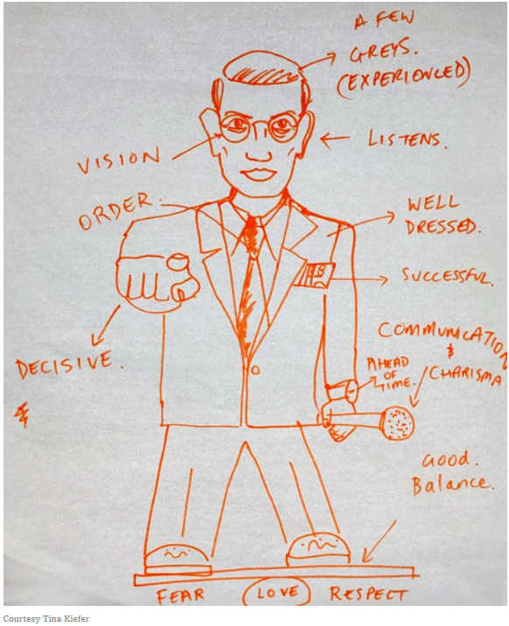
“Draw an effective leader.”
Brown, H. (2018, March 16). Picture an effective leader: Is she a woman?
Retrieved from: https://www.nytimes.com/2018/03/16/health/women-leadership-workplace.html?save=nyt-gateway-stories
Notes:
This image is the result of a simple experiment where students are asked to draw an effective leader. A professor fell upon the exercise accidentally, while leading a workshop full of executives who did not speak much English. Since then it has been adopted by organizational psychologists across the world because the results are consistent.
An effective leader has a default male identity. And in many countries, a default white male identity. This is true for men and for women who draw the images.
We have many conscious and unconscious beliefs about leaders and leadership, and these are problematic for people who do not fit this prototype.

Slide 25
Leader = Man
(Also white, heterosexual, able-bodied, cisgender, etc.)
Brown, H. (2018, March 16). Picture an effective leader: Is she a woman?
Retrieved from: https://www.nytimes.com/2018/03/16/health/women-leadership-workplace.html?save=nyt-gateway-stories
Notes:
This image is the result of a simple experiment where students are asked to draw an effective leader. A professor fell upon the exercise accidentally, while leading a workshop full of executives who did not speak much English. Since then it has been adopted by organizational psychologists across the world because the results are consistent.
An effective leader has a default male identity. And in many countries, a default white male identity. This is true for men and for women who draw the images.
We have many conscious and unconscious beliefs about leaders and leadership, and these are problematic for people who do not fit this prototype.

Slide 26
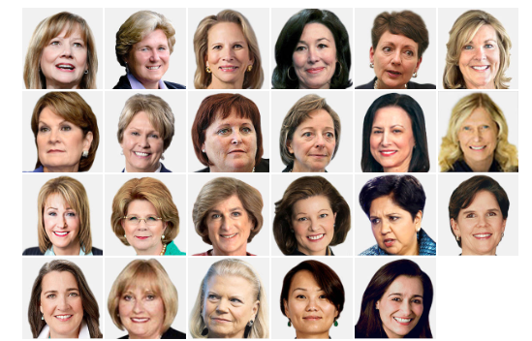
Fortune 500 Chief Executive Officers
There are fewer women than there are men named James.
Miller, C., Quealy, K., & Sanger-Katz, M. (2018, April 24). The top jobs where women are outnumbered by men named John.
Retrieved from: https://www.nytimes.com/interactive/2018/04/24/upshot/women-and-men-named-john.html

Slide 27
Fortune 500 Chief Executive Officers
2
Women of Color
Miller, C., Quealy, K., & Sanger-Katz, M. (2018, April 24). The top jobs where women are outnumbered by men named John.
Retrieved from: https://www.nytimes.com/interactive/2018/04/24/upshot/women-and-men-named-john.html

Slide 28


AFP membership is 70% female, but 4 out of 5 senior positions in fundraising are held by males.
Among CASE 50 Institutions, only 26% are headed by female Chief Advancement Officers.
2018 statistics reported by the Educational Advisory Board and the Association of Fundraising Professionals.

Slide 29
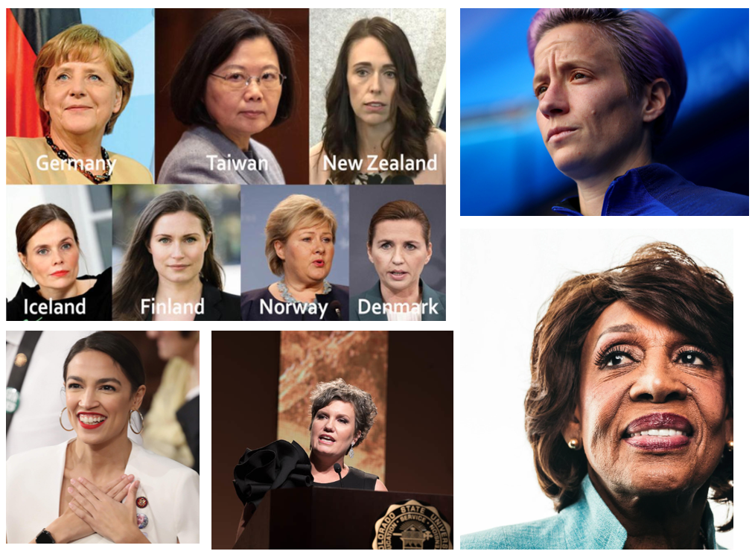
Reframe: What if leaders looked more like this?

Slide 30
Reframe: What if leaders looked more like this?
What Do Countries With The Best Coronavirus Responses Have In Common? Women Leaders
Megan Rapinoe US Women’s Soccer Captain
Maxine Waters
Congresswoman
Alexandria
Ocasio-Cortez
US Representative
Kim Tobin
VP for Advancement

Slide 31
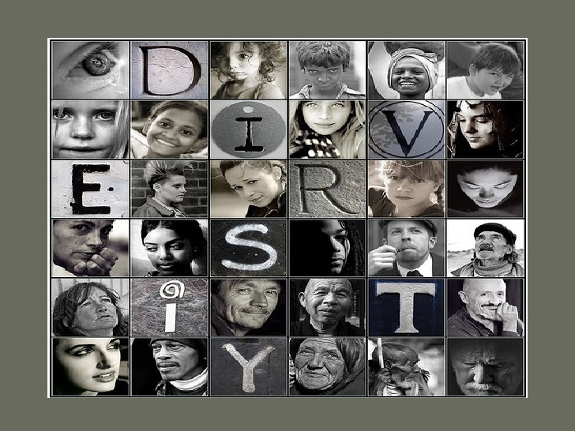
Diverse Leaders
Women
  Democratic
  Participative
People of color
  Fairness
  Integrity
LGBTQ
  Adaptability
  Embrace change
Eagly, A. H., & Chin, J. L. (2010). Diversity and leadership in a changing world. American psychologist, 65(3), 216.
Notes:
There has been research about leaders with diverse identities. Not a lot, but enough. And this is what we’re finding. In general…

Slide 32
Leadership as Power

Slide 33
Power Over
Leader
Follower
Follower
Follower
Follower
Follower
Follower
Follower
Follower
Follower
Follower
Follower
Follower
Follower
Follower
Follower
Follower
Follower
Follower
Follower
Follower
Follower
Follower
Follower
Follower
Leadership as Power Over

Slide 34
Leadership as a Process
Leadership as Service
Power With
Power Through
Leadership as Power Through/With

Slide 35
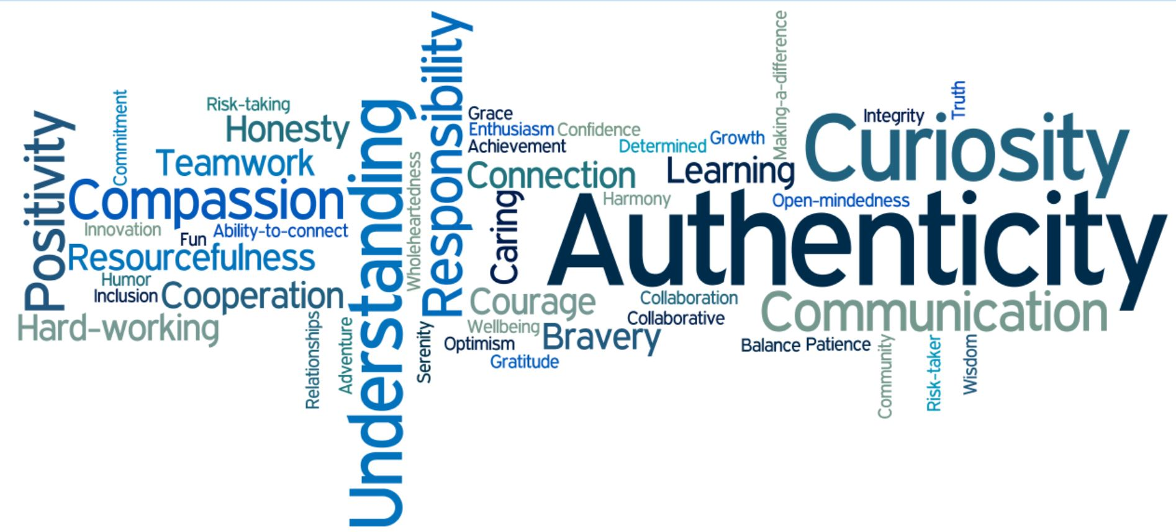
Leadership as (Super)power

Slide 36
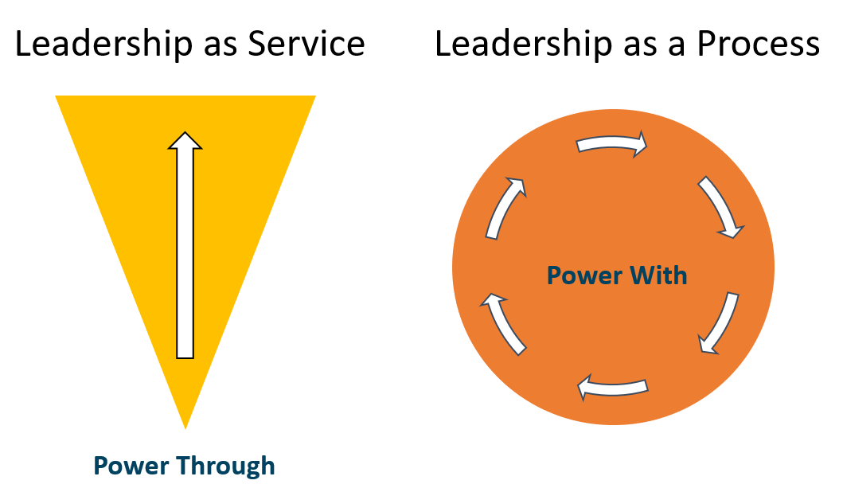
Reframe: What if leadership was more like this?

Slide 37

Reframe
Journal: Prep for Discussion
How does reframing “leadership” make you feel and think differently about being a leader?
Notes:
AKO

Slide 38

Birthdays, Celebrations & Milestones
Notes:
AKO

Slide 39
Zoom Chat
Please share any birthdays, celebrations, and milestones.
(2 minutes)
Notes:
AKO

Slide 40

Session 3:
Expanding Identity to Values & Strengths
Notes:
AKO

Slide 41
Amplify
Women and Gender Initiative
Notes:
AB (1 min)
Thank you for joining us today. Have a great time in you’re discussion session with your Amplify Lead.

